Slide 1
Unit 8 part 2
20-3 Revolts in Latin America

Slide 2
After 300 years of colonial rule, the revolutionary fever of Europe also gripped Latin Americans.
Many groups were unhappy with the strict social structure found across most of Latin America.

Slide 3
Discontent was rooted in the social, racial, and political structure.
peninsulares | Spanish-born upper class; held top government and church positions
creoles | European descent; resented second-class status; owned mines, haciendas, and ranches

Slide 4
Discontent was rooted in the social, racial, and political structure. (continued)
mestizos | A growing group of people of mixed European and Native American descent
mulattoes | Of mixed European and African descent; angry about lack of status and opportunities
Africans | Many were enslaved on plantations and longed for freedom

Slide 5
Educated creoles read Enlightenment writers and saw the North Americans throw off colonial rule.
Many traveled to Europe and were inspired by the ideals of the French Revolution.
In 1808 Napoleon invaded Spain. They saw Spain’s weakness as an opportunity to gain independence.

Slide 6
Before any revolts took place in Spanish colonies, a rebellion began in French-controlled Haiti.
By 1798 the rebels had taken most of Haiti.
Napoleon sent an army to retake the island.
Despite a truce, they arrested L’Ouverture, who died in France.
Enslaved Africans led by Toussaint L’Ouverture began a bloody revolution in 1791.
The French were defeated and left Haiti in 1804.

Slide 7
But most had no desire for economic or social disruption.
The slave revolt in Haiti worried them, because most owned haciendas, mines, or farms. Some used slave labor.
In most of Spanish America, creoles wanted more power and control.

Slide 8
In September 1810 a parish priest, Father Miguel Hidalgo, called for Mexicans to fight for their independence.
A ragged army of poor mestizos and Native Americans marched
on Mexico City.
Despite some early successes, without creole support the rebellion collapsed.
Hidalgo was captured and executed.

Slide 9
Another priest, Father José Morelos, began another rebellion.
He urged reforms such as the abolition of slavery, and the right to vote for all men.
For four years, rebels with Morelos fought.
In 1815 he was taken prisoner and executed.
It looked like the rebel movement had ended.

Slide 10
In 1820, liberals forced the Spanish king to issue a constitution for Mexico.
A conservative creole, Agustín de Iturbide, feared that the new Spanish government might impose liberal reforms on the colonies.

Slide 11
Aided by creoles, native Americans, and mestizos, Iturbide overthrew the Spanish viceroy.
Mexico was now free!
Iturbide took the title of Emperor Agustín I.

Slide 12
Iturdide tried to add these lands to his new Mexican empire.
During the 1820s other Spanish-ruled lands in Central America declared independence.
Liberal Mexicans toppled Iturdide and established the Republic of Mexico.
These lands became the republics of Costa Rica, Guatemala, Nicaragua, El Salvador, and Honduras.

Slide 13
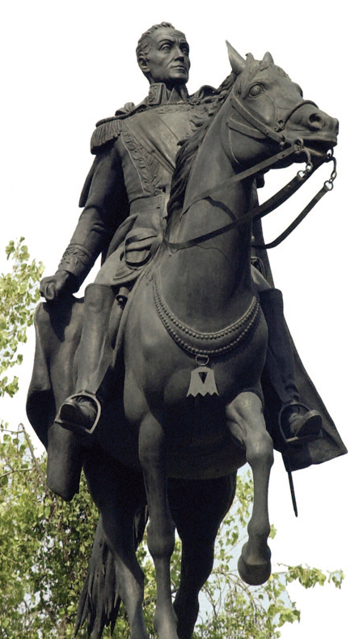
In 1810 Simón Bolívar led an uprising to create a republic in Venezuela.
The republic was quickly toppled by conservative forces, who forced him into exile.
However, Bolívar responded with a daring plan.

Slide 14
Bolívar and his army crossed the Andes; in August 1819, he surprised the Spanish in Bogotá, now capital of Colombia.
Other victories followed; by 1821 Caracas was free.
Bolívar moved on to Ecuador, Bolivia, and Peru.
Now called “The Liberator,” he joined forces with José de San Martín.

Slide 15
In 1816 José de San Martín helped win independence for Argentina.
He then led an army over the Andes to defeat the Spanish in Chile.
Moving next to Peru, he turned his forces over to Bolívar, who was victorious.
By 1824, the new nation of Gran Colombia was free. However, rivalries turned to civil war and it split into Colombia, Panama, Ecuador, and Venezuela.

Slide 16
Under Dom Pedro, son of the Portuguese king, Brazil became an independent nation.
In 1822, Portugal threatened
to end reforms in Brazil.
Dom Pedro declared himself emperor of a free Brazil.
He accepted a constitution
and many freedoms.
Brazil remained a monarchy until 1889.
When Napoleon conquered Portugal, Dom Pedro fled to Brazil.

Slide 17

Who were the key revolutionaries who led the movements for independence in Latin America, and what were their accomplishments?

