Slide 1
Chapter 10 Islam
(Unit 3)
Section 1
The Rise of Islam

Slide 2
The Muslim religion, or Islam, began when Muhammad, a 40-year-old Bedouin from Mecca, was meditating alone.
Muhammad, who led caravans of people across the desert, was a successful merchant known for his honesty.
Muhammad had been troubled by the materialistic behavior of the people of Mecca.
According to Muslim belief, Muhammad was embraced by the angel Gabriel.
Notes:
2

Slide 3
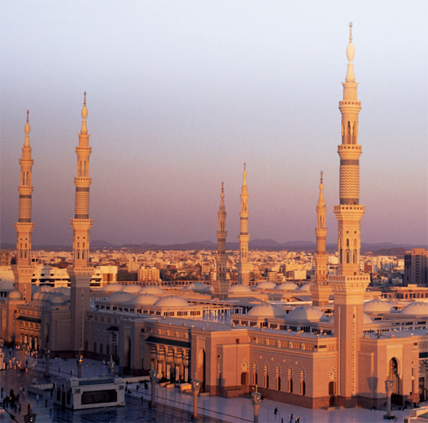
The Quran says that Muhammad became the messenger of God.
The merchants of Mecca feared that he would disrupt their business and threatened Muhammad.
In 622, he fled to Yathrib, soon renamed Medina or the “city of the Prophet.”
His journey, called the hijra, led to the beginning of the Muslim religion.

Slide 4
The people of Medina converted to Islam.
Family rivalries were soon replaced with a community of Islam.
In 630, Muhammad returned to Mecca with an army.
Pagan idols were removed from the Kaaba, now the holiest Muslim site. The Kaaba is believed to be Abraham’s first temple to God.

Slide 5
Islam is a monotheistic religion based on the belief in one God.
Muslims believe:
God is all-powerful and compassionate.
People are responsible for their own actions.
Priests are not needed to mediate between man and God.
Abraham, Moses, and Jesus are seen as prophets, but Muhammad is the last and greatest prophet.

Slide 6
Muslims believe that the Quran contains the sacred word of God as revealed to Muhammad.
The Quran provides a set of ethical beliefs that emphasize honesty, generosity, and social justice.
It contains harsh punishments for crimes such as murder.
According to the Quran, each individual will stand before God on judgment day.
The Quran is read in Arabic. This language has helped unite Muslims.

Slide 7
All must follow the Five Pillars of Islam.
Proclaim one’s faith in the one true God.
Face Mecca and pray five times a day.
Give charity to the poor.
Fast from sunrise to sunset during Ramadan,
the month when Muhammad received the Quran.
Make a hajj, or pilgrimage to Mecca, if able.

Slide 8
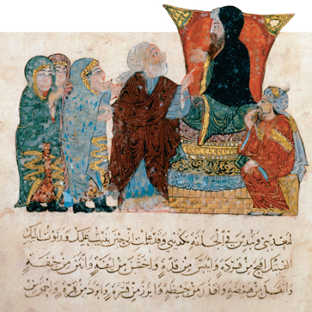
Islam is both a religion and a way of life that shapes the behavior of all Muslims.
Sharia is a system of
law based on scholarly interpretation of the Quran.
Sharia governs all aspects
of business, government, family life, and criminal law.
A man and women seek judgment from a judge in this Persian painting.

Slide 9
Before Islam, the position of women varied, but most had limited rights.
Islam taught equality for women, but each gender had different roles.
Islam promised salvation to all, male or female, who follow the Quran.
The rule for modesty led to wearing of veils.
In time, Muslims adopted customs of conquered peoples, which led to restrictions on women’s rights.

Slide 10
Section 2
Building a Muslim Empire

Slide 11
The death of Muhammad left the Muslims with
a problem—he had not named a successor.
Muhammad’s father-in-law, Abu Bakr, was chosen to be the first successor to Muhammad, or caliph.

Slide 12
After several battles Abu Bakr succeeded in reuniting the tribes based on allegiance to Islam.
Muslims then began converting other tribes, ending war among Arab tribes and uniting them under one leader.
Many Arab tribes refused to follow Abu Bakr and withdrew support from Islam; fighting resulted.

Slide 13
Muslims split over who should be the leader.
Shiites believed Muhammad’s true successors were the descendents of his daughter Fatima
and son-in-law Ali.
Called Imams, they were believed to be divinely inspired.
Sunnis became
a majority; they compromised on
a belief that any good Muslim could be a leader or caliph, and that this role was not divinely inspired.

Slide 14
The division between Shiite and Sunni Muslims continues today.
Both branches believe in the same God, follow the Five Pillars of Islam, and look to the Quran for guidance, but they differ in daily practices and have often fought over wealth and political issues.
About 90% of Muslims today are Sunnis.
Most Shiites live in Lebanon, Yemen, and Iraq.

Slide 15
Among both Sunnis and Shiites, Sufis emerged.
Sufis were groups of mystics who sought communion with God through meditation, fasting, and other rituals.
Like Christian monks or nuns, the Sufis spread Islam by traveling, preaching, and setting a good example to others.

Slide 16
Under the first four caliphs, the Arab Muslims had many victories over both the Byzantine and Persian empires.
They took Syria and Palestine from the Byzantines, including the cities of Damascus and Jerusalem.
They later captured the weakened Persian empire and swept into Byzantine Egypt.

Slide 17
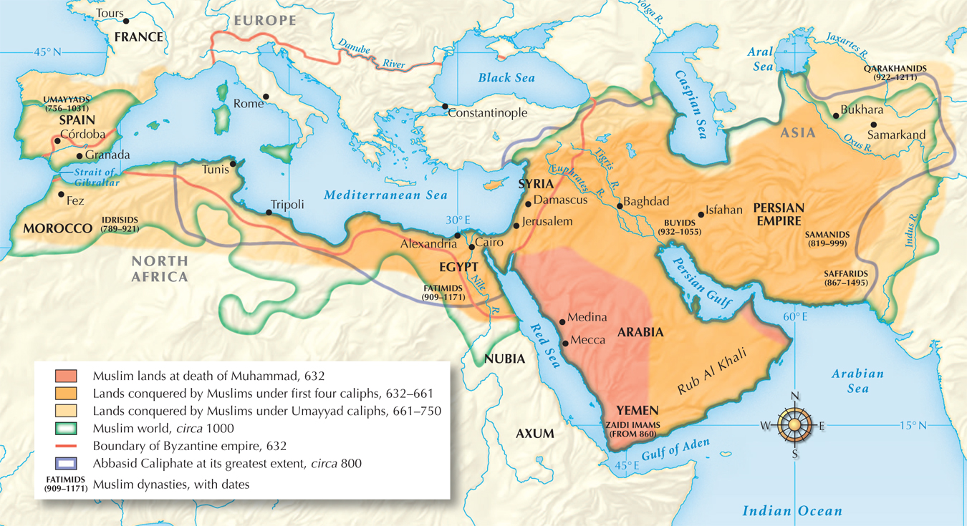
Muslim lands under the Umayyads and Abbasids

Slide 18
In the 700s, a powerful Meccan clan set up the Umayyad caliphate and ruled from Damascus.
In 731, they invaded France but were stopped in the Battle of Tours.
They also besieged, but failed to take, Constantinople, the Byzantine capital.
In 711, after conquering North Africa, they took over Spain.

Slide 19
Several factors explain the Muslim success.
Longtime enemies, the Persians and Byzantines had exhausted each other.
Their armies were efficient fighters with a cavalry of camels and horses.
Belief in Islam unified Arab Muslims;
many welcomed them as liberators.
The rulers established an orderly and efficient system of administration.

Slide 20
Conquered people who did not convert were taxed, but allowed to practice their faith.
Jews and Christians could hold government positions.
Islam had no religious hierarchy or class of priests.
In principle, Islam calls for equality among all believers.
Many embraced Islam’s equality and converted.

Slide 21
As the empire expanded, problems developed that led to its eventual decline. Umayyad caliphs were not used to running a large and diverse empire.
The wealthy lifestyle of caliphs was criticized; non-Arab Muslims were not being treated equally.
Discontented Muslims found a leader in Abu al-Abbas; in 750 he conquered Damascus.

Slide 22
The Umayyads were removed and the Abbasid dynasty began.
The Abbasids created an empire based on Muslim values, and as a result, Muslim culture flourished.
Military conquests were halted, ending dominance of the military class.
Discrimination against non-Arabs was ended.
A more sophisticated bureaucracy was created.
Learning was encouraged.
The capital was moved from Damascus to Baghdad.

Slide 23
Baghdad, the new capital, was located in Persian territory.
This gave Persian officials great influence.
The most important official was the vizier as in Persian tradition.
Baghdad became a magnificent city of gardens, markets, mosques, and tall minarets where the faithful were called to prayer. It was “The City of Peace, Gift of God, Paradise on Earth.”

Slide 24
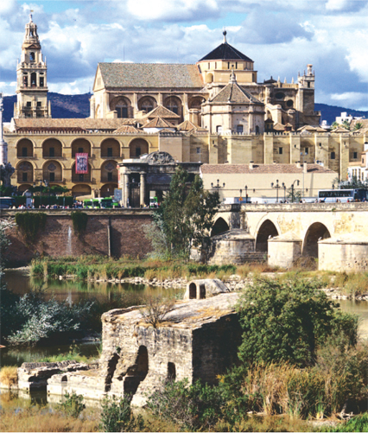
The surviving members of the Umayyad caliphate fled to Spain, where they remained until 1492.
They oversaw a grand age of art and architecture in Spain, exemplified by such buildings as the Grand Mosque in Córdoba.
Leaders of Muslim Spain
were more tolerant of other religions than were Christian rulers at the time.

Slide 25
The Abbasids never ruled Spain; beginning in 850 the rest of their empire began to fragment.
In Egypt and elsewhere, independent dynasties came to power. In the 900s the Seljuk Turks took control of Baghdad.
The Seljuks adopted Islam and created a powerful empire.

Slide 26
In 1216 Genghis
Khan led
a Mongol invasion.
In 1258 Baghdad was looted and the last Abbasid caliph was killed.
Later, the Mongols
accepted Islam and mingled
with local inhabitants.
In the 1300s another Mongol leader, Tamerlane, attacked Muslim and non-Muslim lands in the Middle East as well as in southwest Asia, Russia, and India.

Slide 27
Section 3
Muslim Civilization’s Golden Age

Slide 28
Muslim rulers united diverse cultures and incorporated learning from many regions.
Camel caravans crossed the Sahara
to West Africa.
The Silk Road brought trade from East Asia and provided a link
to Europe.
Monsoon winds brought ships to Asia and East Africa.
Merchants were valued in the Muslim world. They spread products, cultures, and ideas widely.
Notes:
28

Slide 29
Indian numbers were introduced and became today’s Arabic numerals.
Sugar arrived from India.
Papermaking came from China.
As more people converted to Islam, Arabic became widely understood, facilitating trade
and new learning.
New business practices, such as partnerships, checks, and credit, grew from the use of a money economy.

Slide 30
Some valued products included:
Steel swords—Damascus
Leather goods—Córdoba
Cotton textiles—Egypt
Carpets—Persia
Handicraft industries were valued. Heads of each guild regulated quality, price, and production.
Muslim rulers extended
agriculture.
In addition to food, farmers grew cotton, sugar cane, flowers, and herbs.

Slide 31
There was social mobility, with options to improve one’s standing through religious, military, or scholastic achievements.
Slavery did exist, however.
Many slaves were
house servants, skilled artisans, or soldiers, who could earn their freedom.
Slaves could often buy their freedom. If a slave’s father was a freeman, he could be freed as well.
Notes:
31

Slide 32
Islamic art and literature reflected the diverse cultures within the Muslim world.
It was forbidden to portray God or human figures in religious art.
The Quran itself was the greatest literature.

Slide 33
The rich tradition of Arab storytelling continued
in this period.
Firdawsi’s the Shah Namah, or Book of Kings, told of the history of Persia.
The Rubáiyát, by Omar Khayyám, is a philosophical work in four-line stanzas.
Poets wrote tales of romantic and dangerous desert journeys. Some are remembered today—“Ali Baba and the Forty Thieves” and “Aladdin and His Magic Lamp,” from The Thousand and One Nights.

Slide 34
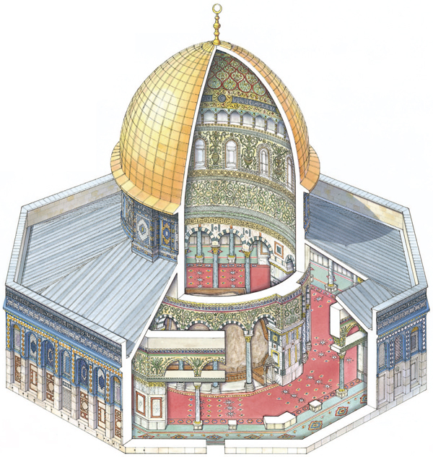
Domes and arches adapted from the Byzantines became symbolic of Muslim architecture.
The Dome of the Rock in Jerusalem is the oldest surviving example of Muslim architecture. It was built
in 688.
Domed mosques and high minarets still dominate Muslim cities such as Medina.

Slide 35
Works in elaborate flowing script, especially illustrating verses of the Quran, are found as decorations on buildings, ceramics, and books.
Muslim artists perfected skills in calligraphy.

Slide 36
Muhammad’s great respect for learning inspired advances in philosophy, history, mathematics, and the sciences.
Learning from earlier civilizations was translated into Arabic from Persian, Sanskrit, and Greek.
Great centers of learning were founded in cities such as Cairo, Baghdad, Córdoba,
and Timbuktu.

Slide 37
Ibn Rushd put knowledge to the test of reason.
Ibn Khaldun set standards to avoid bias and error in the study
of history.
Arab scholars translated works from Greek, Hindu, and Buddhist philosophers.
Scholars sought to harmonize Greek ideas, based on reason, with Muslim ideas based on divine revelation.

Slide 38
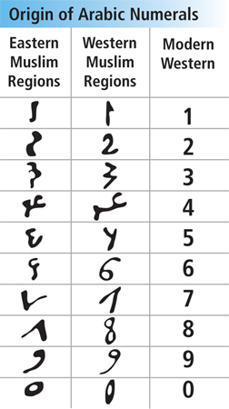
Arab scholars made many mathematical advances.
Arab mathematicians developed what became our modern number system.
The study of algebra was pioneered by al-Khwarizmi in the 800s.

Slide 39
Building on the work of the Greeks, Muslims greatly advanced medicine and public health.
Physicians and pharmacists had to pass tests.
There were hospitals and physicians who traveled to rural areas.
Pharmacists mixed bitter-tasting medicines with sweet-tasting syrups and gums for the first time.

Slide 40
Muhammad al-Razi studied measles and smallpox. He also stressed the need to treat the mind as well as the body.
Ibn Sina compiled a huge encyclopedia of all known medical knowledge called the Canon on Medicine.
Muslim physicians made great advances in medicine.
Arabic physicians could even perform cataract surgery using hollow needles.

Slide 41
Section 4
India’s Muslim Empires

Slide 42
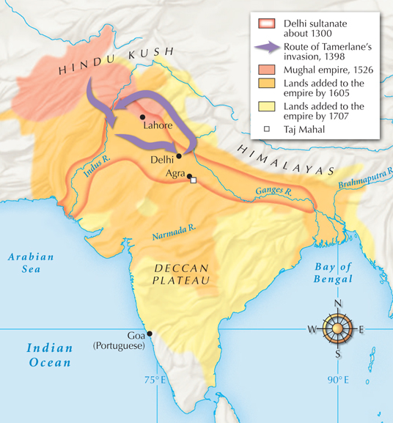
Two Muslim sultanates ruled India—the Delhi sultanate and
later, the Mughal dynasty.

Slide 43
Swift mounted archers outmaneuvered Hindus on elephants.
Rival Hindu princes fought among themselves.
Islam’s social mobility appealed to Hindus locked into a low social position by the caste system.
The Delhi sultanate conquered rival Hindu and Buddhist kingdoms through greater unity and better technology.

Slide 44
Indian government and society changed as sultans introduced Muslim traditions.
Turks, Persians,
and Arabs migrated to India to serve as soldiers
or officials, bringing increased trade.
During the 1200s, when the Mongols raided Baghdad, many scholars fled to India.
These immigrants helped architecture and the arts flourish.

Slide 45
In 1398, Tamerlane plundered the northern plain and smashed Delhi.
Artisans were enslaved to build Tamerlane’s capital at Samarkand.
Northern India fell into rival Hindu
and Muslim states.
Muslim sultanates would not regain control until 1526.

Slide 46
Muslim beliefs conflicted sharply with those
of the Hindu they conquered in northern India.
Hindus:
Muslims:
Believed in many
sacred texts and gods.
Honored a priestly class called the Brahmans.
Accepted a hereditary caste system.
Monotheistic with one sacred text.
Taught equality of
all believers.

Slide 47
In time, Muslim and Hindu cultures began
to blend.
Muslim scholars suggested that one God was behind the many Hindu gods.
Hindus were protected as long as they paid a poll tax.
In some places, local rajahs, Hindu leaders, were allowed to rule.
Many Hindus converted to Islam, out of belief,
to avoid the caste system, or for trade and commerce.

Slide 48
Indian Muslims began to absorb Hindu influences as well.
Urdu, a new language, combined Persian, Arabic, and a Delhi dialect.
Some marriage and caste customs were accepted.
Indian dance and music reappeared in the courts
of the sultan.
A new religion, Sikhism, blended Hindu and Muslim ideas.

Slide 49
An Indian Holy man, Nanak, sought to blend Islamic and Hindu beliefs.
Nanak preached “the unity of God, the
brotherhood of man, the rejection of caste,
and the futility of idol worship.”
The Sikhs later gained military power and challenged for control in the north.

Slide 50
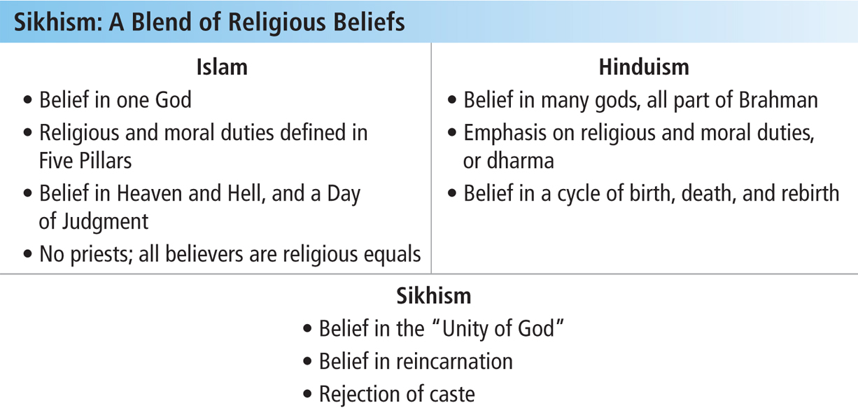

Slide 51
Led by Babur, Turkish and Mongol armies swept away the Delhi sultanate in 1526.
Babur, a military genius and poet, claimed to descend from Genghis Khan and Tamerlane.
In 1526 Babur defeated Sultan Ibrahim just north of Delhi and established the Mughal dynasty.
The Mughals, which means “Mongols” in Persian, ruled much of southern Asia until 1857.

Slide 52
The greatest ruler of the Mughals was Akbar the Great, grandson of Babur. Akbar reigned from 1556 to 1605.
Replacing hereditary officials with professionals, including Hindus
Listening to advisors from many faiths
Modernizing the army
Marrying a Hindu princess
Encouraging trade
Akbar built
a united empire by:

Slide 53
Women were influential in the Mughal empire.
Akbar’s son Jahangir left the details of governing to his wife, Nur Jahan, who was the most powerful woman in pre–twentieth century India.
The high point of Mughal art came during the reign of Shah Jahan. Grief-stricken at the death of his wife, he ordered a grand tomb in her honor.
The lavish Taj Mahal was her memorial. It took 22,000 workers 20 years to complete.

Slide 54
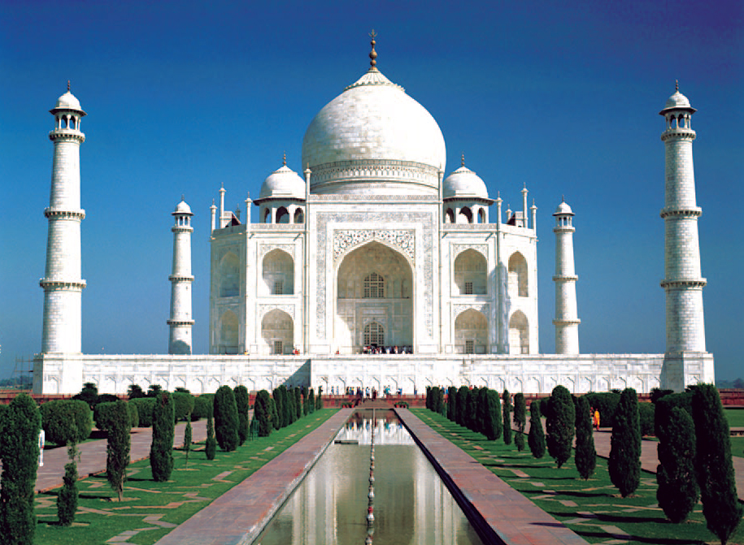
The Taj Mahal, a memorial to the wife of Shah Jahan.

Slide 55
Section 5
The Ottoman and Safavid Empires

Slide 56
In 1452, Mehmet II began a 52-day siege
of Constantinople. After pounding the walls
with cannon fire, he finally defeated the city.
Renamed Istanbul, the city became capital
of the Ottoman empire.
The Ottomans were
a Turkish-speaking people from Central Asia.
From their new capital the Ottomans moved into Asia Minor and the Balkans.

Slide 57
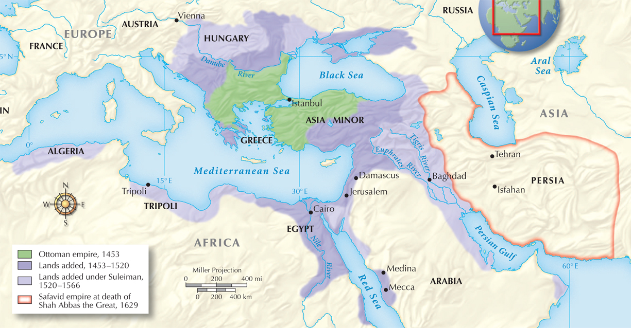
The Ottoman and Safavid Empires

Slide 58
Suleiman extended Ottoman rule into the Middle East.
He invaded as far west as Vienna.
His empire stretched from Hungary to Arabia and across North Africa.
The golden age of the Ottomans was during
the reign of Suleiman “the Magnificent,” 1520 to 1566.

Slide 59
Suleiman took the titles of “emperor” and “protector
of the sacred places” (Mecca and Medina); he was also known as “the lawgiver.”
He was a fair but absolute leader who improved the justice system.
He ruled using a council of advisors called viziers.
Ottoman law was based on Sharia.

Slide 60
Ottoman society was organized into four classes:
Men of
the sword
Soldiers who defended the sultan and the state
Men of
the pen
Scientists, judges, lawyers,
and poets
Men of
negotiation
Merchants, tax collectors, and artisans
Men of
husbandry
Farmers and herders who produced
the food

Slide 61
People
were also divided into religious communities called
“millets.”
These included Muslims, Greek Christians, Armenian Christians, and Jews.
Each millet had its own leaders, responsible for education and legal matters.

Slide 62
The Ottomans recruited officers for the army and government from among those they conquered.
In the Balkans, Christians were “taxed” by turning
over their sons for government service.
Some were converted to Islam and put through military training. The best won a place in the janizaries.
Bright students were educated to be officials in the government.

Slide 63
Non-Muslim girls were also forced into
service, often enslaved to work in the
households of wealthy Muslim families.
They might be accepted as members of the household.
They might be freed upon the owner’s death.

Slide 64
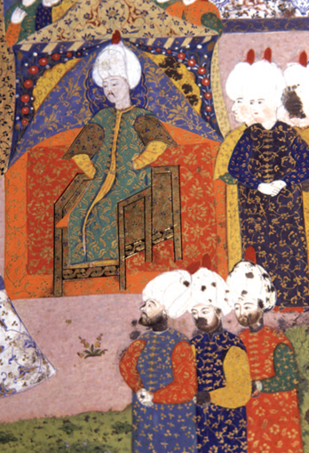
The arts flourished under Suleiman.
Poets adapted Persian and
Arab models to Turkish.
Royal architect Sinan created beautiful mosques.
Painters created detailed illuminated manuscripts and miniature paintings.

Slide 65
The Ottoman empire began a slow decline following Suleiman’s death in 1566.
Suleiman had executed his two most able sons, whom he suspected of treason.
His successor, Selim II, left most governing to his ministers. The bureaucracy grew corrupt.
European nations and Russia took Ottoman land. North Africans broke away.

Slide 66
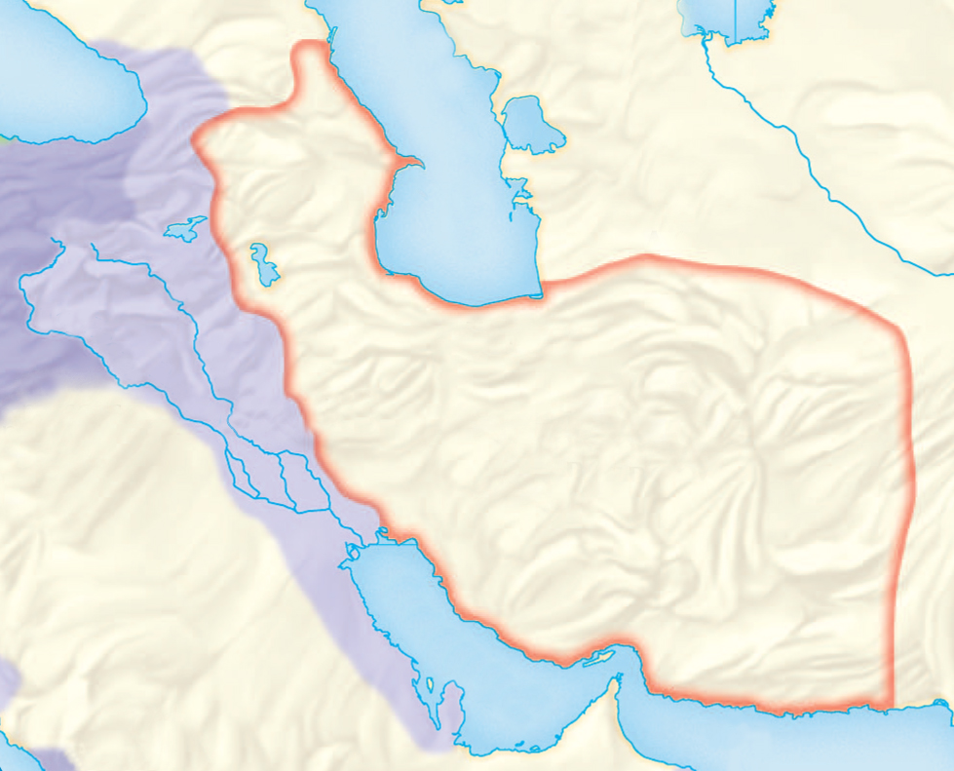
By the early 1500s, the Safavid dynasty had arisen in Persia (present-day Iran).
Caught between
Mughal India and the Ottoman empire, they were frequently at war.
The Safavids were
Shiite Muslims;
the Sunni Ottomans considered them heretics.
Persia
Ottoman empire

Slide 67
Shah Abbas the Great (1588–1629) revived the glory of ancient Persia.
He centralized the government, created a powerful military, and negotiated alliances with European enemies of the Ottomans.
He helped the economy by reducing taxes on herders and farmers and encouraging industry.

Slide 68
Abbas tolerated non-Muslims and valued their economic contributions.
He built a new capital at Isfahan and invited the Armenian Christians, who controlled the silk trade, to Isfahan.
Isfahan became the center of the silk trade; the Armenians were allowed to live outside the capital and to govern themselves.

Slide 69
After the death of Abbas a power struggle arose and the Safavid dynasty declined.
Shiite scholars challenged
the political authority of the shahs (Safavid kings).
These
scholars encouraged the persecution
of religious minorities.
In response, Sunni Afghans rebelled, forcing out the Safavids in 1722.

Slide 70
The Safavid left a lasting impact, establishing Shiism in Iran and providing Persians with a sense of identity.
In the late 1700s, a new dynasty, the Qajars, took control of
Persia.
The Qajars made Tehran their capital and ruled until 1925.

