Slide 1
Chapter 11
Early Civilization in Africa and the Spread of Islam

Slide 2
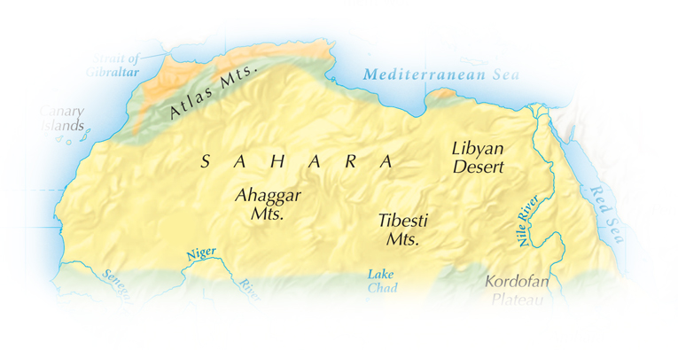
The variety of climate and geography in Africa influenced its diversity of culture.
One of its most notable geographic features is the vast Sahara Desert.
Notes:
2

Slide 3
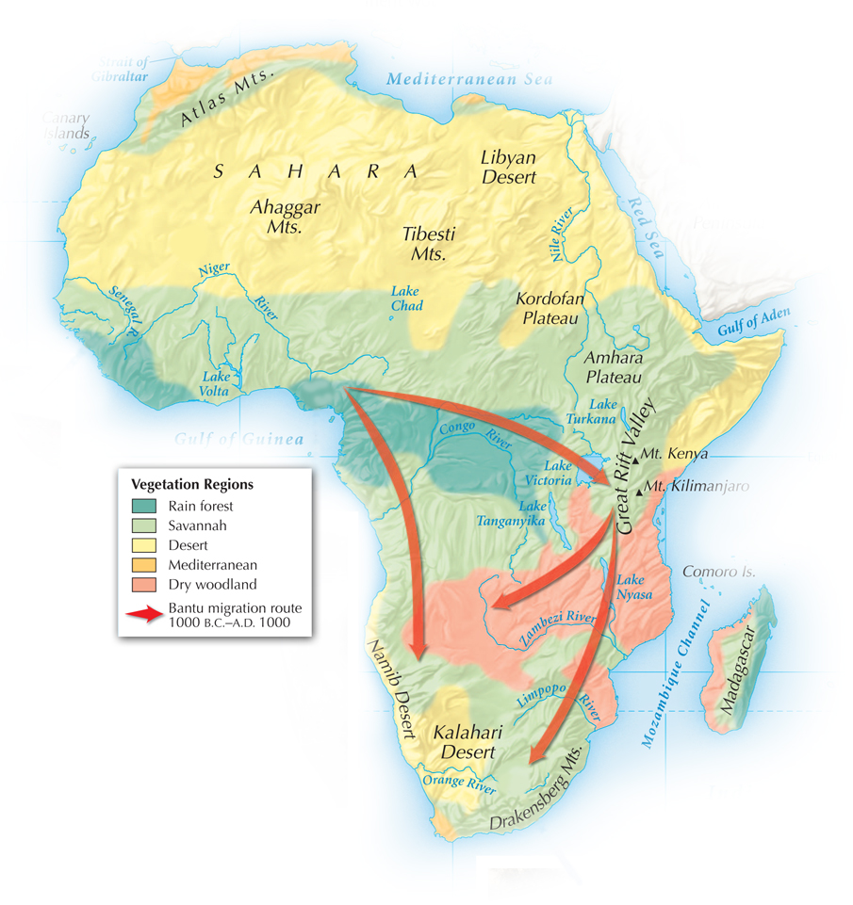
African vegetation regions are wide bands across the continent.
The most populated regions are the savannas.
Deserts, rain forests, and rivers with cataracts hindered easy movement.
Notes:
3

Slide 4
Despite the difficulty of travel, trade expanded
by A.D. 200 due to camels from Asia.
They could carry heavy loads 20 or 30 miles a day.
Merchants on both sides of the Sahara profited from these “ships of the desert.”

Slide 5
Neolithic farmers cultivated the Nile Valley.
Villages also appeared in the Sahara.
The Sahara was a well-watered area at the time.
However, around 2500 B.C. climate change led to desertification of the Sahara.
As farmland was lost, people began to migrate south.

Slide 6
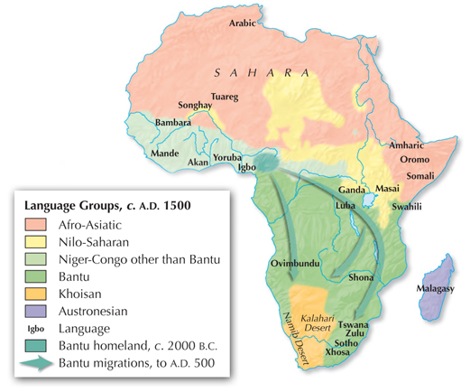
The West Africans who migrated south and east spoke
a language
called Bantu.

Slide 7
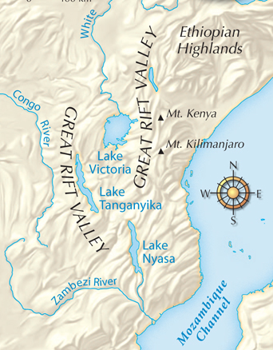
The kingdom of Nubia took shape at the same
time as the great Egyptian civilization.
It was located south of Egypt on the upper Nile River.
Nubia was under the control
of Egyptians for many years.
It was forced to move its capital to Meroë because
of Assyrian invaders.

Slide 8
People in the Nubian capital Meroë mastered ironworking and the city became a trade center.
Nubians worshipped their own gods and
developed their own form of writing.
Ultimately, the civilization declined.
Nubia was invaded from the south by the kingdom of Axum in A.D. 350.

Slide 9
Phoenician traders built the city of Carthage, which was powerful between 800 B.C. and 146 B.C.
Romans farmed North Africa to feed their people.
Early civilizations
in Africa had strong ties to the Mediterranean Sea and were influenced by outsiders.

Slide 10
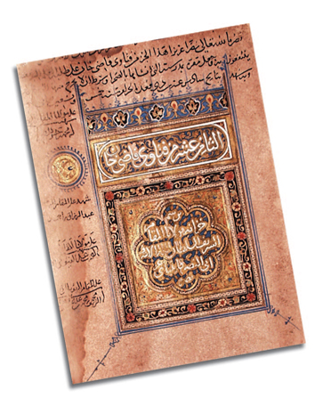
Islam spread to North Africa in the 690s and became the dominant religion there.
Muslim civilization flourished in cities such as Cairo, Fez, and Marrakesh.

Slide 11
When farmers created surpluses, trade expanded across Africa.
A trade network took goods from the savannah across the Sahara.
Gold and salt were two of the most traded commodities.
As trade grew, cities developed on the northern edges of the savanna.
Monarchs gained control of trade routes and built powerful kingdoms.
Notes:
11

Slide 12
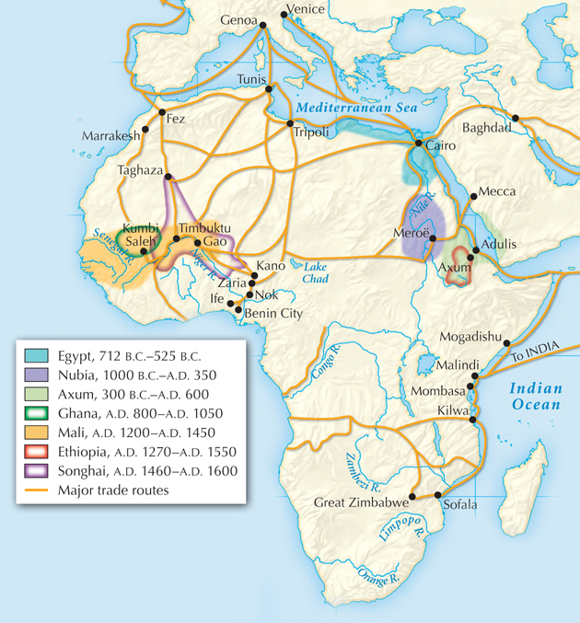
Trade routes criss-crossed the African continent between 1000 B.C. and
1600 A.D.
Travel along desert routes was long and dangerous.

Slide 13
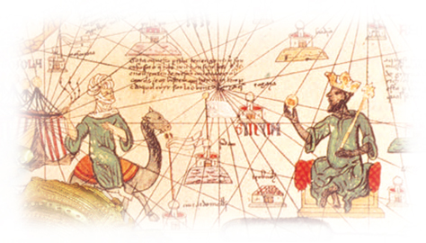
According to tradition, the kingdom of Mali was founded in 1235 by a young man named Sundiata.
The kings of Mali, or mansas, took control of gold-mining regions and salt supplies.

Slide 14
The greatest ruler of Mali, Mansa Musa,
came to power in 1312.
He conquered additional territory and converted to Islam.
He made the pilgrimage to Mecca and brought back Muslim scholars and architects to Mali.

Slide 15
In the 1400s a new West African kingdom, Songhai, developed.
The soldier-king Sonni Ali brought trade routes and cities under his control.
When he died, the emperor Askia Muhammad expanded Songhai territory, holding court at Gao.
He formed strong ties to the Muslim world.

Slide 16
The Songhai kingdom experienced disputes
over succession in the late 1500s.
In 1591, invaders from Morocco conquered the empire.
Though the invaders couldn’t maintain control, the glory of the Songhai kingdom was over.

Slide 17
Great Kingdoms of West Africa
Kingdom | Notable Cities | Years
Ghana | Kumbi Saleh | 800–1050
Mali | Timbuktu | 1235–1400s
Songhai | Gao | 1464–1591

Slide 18
In addition to the great kingdoms of Ghana,
Mali, and Songhai, there were several smaller societies in the region.
Benin rose on the Guinea Coast during the 1300s. Its people knew how to cast bronze and brass.
The Hausa of West Africa became prominent in the 1300s. They built walled cities for protection. They were quite progressive—many of their rulers were women.

