Slide 1
Unit 8
The French Revolution
Chapter 18
The French Revolution and Napoleon

Slide 2
18-1
On the Eve of Revolution

Slide 3
In 1789, France’s society was based on a system created in the Middle Ages. The ancien régime separated everyone in French society into one of three estates:
First Estate
Clergy
Second Estate
Nobility
Third Estate
The remainder of the
population, including the bourgeoisie and rural peasants
Notes:
3

Slide 4
The first two estates enjoyed most of the
wealth and privileges of France.
The Church | The nobility
Owned 10% of the land Collected tithes Paid no direct taxes to the state | Had rights to top jobs in the government, the army, the courts, and the Church Paid no taxes
Notes:
4

Slide 5
The Third Estate was the most diverse and made up 95% of the population in France.
Bourgeoisie and middle class Urban workers Rural peasants | Paid taxes on everything from land to soap
 | Owed fees and services dating back to medieval times
When the ideals of the Enlightenment spread among the Third Estate, many people began to question the existing social order.
Notes:
5

Slide 6
Economic troubles added to the social unrest and heightened tensions. Years of deficit spending created a government that was deeply in debt.
The money from the government had been spent on:
Louis XIV’s court
The Seven Years’ War
The American Revolution
Rising costs of goods and services
Bad harvests in the 1780s made it harder to recoup
this money.

Slide 7
To solve the financial crisis, the government
had to increase taxes, reduce expenses, or both.
The first two estates resisted any attempts to make them pay taxes.
Louis XV ran up more debt.
Louis XVI was weak but attempted
some economic reforms.

Slide 8
Reduce extravagant court spending
Reform government
Abolish tariffs on internal trade
Tax the First and Second Estates
Louis XVI appointed Jacques Necker
as his financial advisor. Necker made several recommendations
to reduce the debt:
When Necker proposed taxing the First and Second Estates, the nobles and high clergy forced Louis XVI to dismiss him.

Slide 9
The pressure for reforms mounted, but the powerful classes demanded that the king
summon the Estates-General.
In the meantime, France was on the verge of bankruptcy.
Bread riots were spreading and nobles continued to fight against taxes.
The nobles hoped that the Estates-General could bring the absolute monarch under their control and guarantee their own privileges.

Slide 10
Before the meeting, Louis had all the estates prepare cahiers listing their grievances.
Fairer taxes!
Freedom of the press!
Regular meetings!
Many delegates from the Third Estate went to solve the financial crisis but also to insist on reforms.

Slide 11
The voting system created a stalemate, because each estate traditionally had one vote.
1 vote
Third Estate
1 vote
First Estate
1 vote
Second Estate
The Third Estate moved to create a fairer system in which the votes were counted by heads rather than estates.

Slide 12
In June, 1789, after weeks of stalemate, members of the Third Estate declared themselves to be the National Assembly and the true representatives
of the people of France.
The members of the National Assembly pledged, by the
Tennis Court Oath,
to continue to meet until a constitution
was established.
They were
locked out of their meeting hall and moved to a nearby tennis court.

Slide 13
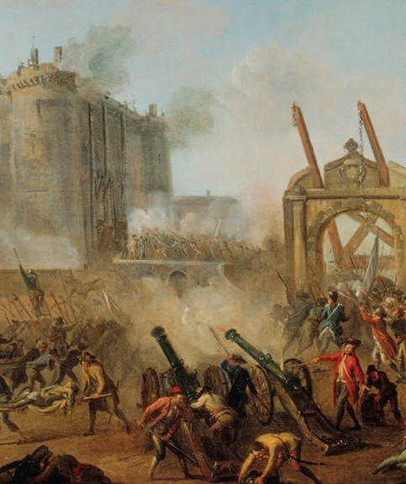
Rumors abounded that the royal troops were about to occupy Paris.
On July 14, 1789, crowds gathered around the Bastille demanding weapons and gunpowder that they thought were stored there.
The storming and fall of
the Bastille represented
a challenge to the regime.

Slide 14
What led to the storming of the Bastille, and therefore, to the start of the French Revolution?

Slide 15
18-2
The French Revolution Unfolds

Slide 16
Historians have divided the period of the
French Revolution into four different phases.
National Assembly | France became a constitutional monarchy
Reign of Terror | A radical phase with escalating violence End of the monarchy
Directory | A period of reaction against extremism
Age of Napoleon | Consolidation of many revolutionary changes A period of war throughout Europe

Slide 17
The political crisis of 1789 in France coincided
with the worst famine in memory. Rumors were rampant and created panic.
During the period known as the “Great Fear,” peasants believed that government troops were seizing their crops.
Peasants blamed nobles, who they thought were trying to reinstate medieval dues.

Slide 18
Paris was the revolutionary center of France,
in which a variety of factions were trying to
gain power.
National Guard | Moderate Led by the Marquis de Lafayette A mainly middle-class militia
Paris Commune | Radical Replaced the royalist government of Paris Mobilized violent action for the revolution

Slide 19
The National Assembly reacted to the uprisings and voted to end the privileges of the nobility.
Nobles gave up old manorial dues and exclusive hunting rights.
Nobles ended their special legal status and their exemptions from paying taxes.
The assembly enacted the equality of all male citizens before the law.

Slide 20
At the end of August, 1789, the National Assembly issued the Declaration of the Rights of Man and the Citizen.
Free and equal rights for all men
Natural rights for all men
Equality before the law for all men
Freedom of religion for all citizens
Taxes levied fairly for all citizens
Modeled after the American Declaration of Independence, it announced:

Slide 21
The Declaration of the Rights of Man did not
please everyone.
Many women were disappointed that
the Declaration
did not grant
equal citizenship
to women.
Louis XVI did
not want to accept
the reforms of
the National Assembly.

Slide 22
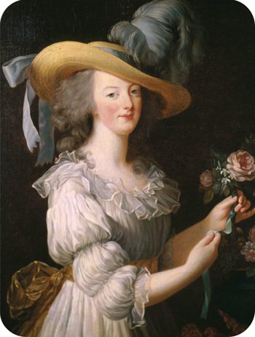
Women marched on Versailles on October 5, 1789. They were angry about the famine, and they demanded to see the king.
They were also angry at Marie Antoinette, who was against reforms and lived a life of luxury.
The women brought the king and queen to Paris, where they lived as virtual prisoners.

Slide 23
The National Assembly placed the Church
under state control.
It dissolved convents and monasteries.
It ended papal authority over the French Church.
It made bishops and priests elected,
salaried officials.
This move was condemned by the pope, many bishops and priests, and large numbers of French peasants.

Slide 24
The National Assembly produced the Constitution of 1791. This set up a limited monarchy.
Make laws
Collect taxes
Decide on issues of war and peace
The new Legislative Assembly could:
Moderate reformers felt that the Constitution
of 1791 completed the French Revolution.

Slide 25
At the time of the creation of the
Constitution of 1791, Louis XVI and Marie Antoinette attempted to escape France.
To many, this attempt meant that Louis
was a traitor to the revolution.
To other nations, supporting the king meant
being against the revolution.
The emperor of Austria and king of Prussia
signed the Declaration of Pilnitz supporting
Louis and threatening to intervene.
The revolutionaries prepared for war.

Slide 26
Rulers in Europe feared the French Revolution, a fear fed by stories of émigrés to their countries.
The sans-culottes and the Jacobins held the upper hand in the Legislative Assembly.
They demanded a republic and an end to tyranny abroad.
The radicals moved the Legislative Assembly to declare war on Austria, Prussia, Britain, and other states.

Slide 27
What political and social reforms did the National Assembly institute in the first stage of the French Revolution?

Slide 28
18-3
Radical Days of the Revolution

Slide 29
In 1792, the war abroad was going badly for the French.
Many revolutionaries believed that the king was in league with foreign powers to retain his power.
Citizens attacked the palace where the king was held. The king and his family escaped to the Legislative Assembly.
Citizens also attacked prisons that held nobles
and priests.
Violence was spreading.

Slide 30
Radicals took control of the Legislative Assembly and called for the election of a new legislative body—the National Convention.
National Convention
Suffrage was extended to all male citizens.
Nobles’ lands were seized.
In addition, the monarchy was abolished in favor
of the creation
of a republic.

Slide 31
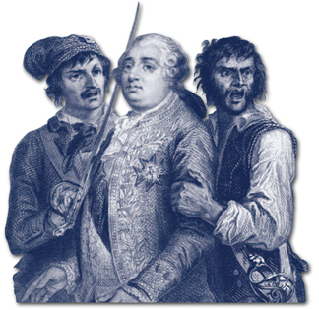
Louis XVI was put on trial as a traitor to France. He was convicted and sentenced to death.
In January, 1793,
Louis XVI was executed.
In October, 1793,
Marie Antoinette was executed.

Slide 32
By 1793, France as a nation was in peril.
External and internal threats were rampant.
War continued with the Netherlands, Spain, Britain, and Prussia.
Royalists and priests led rebellions against the government.
Sans-culottes demanded relief from food shortages and inflation.
The Convention was divided between the Jacobins and the Girondins.
The Convention created the Committee of Public Safety to deal with these issues.

Slide 33
The Committee of Public Safety was granted absolute power to save the revolution.
At war:
French armies overran the Netherlands
and invaded Italy.
At home:
France battled counter-revolutionaries through the use
of terror.

Slide 34
Maximilien Robespierre became the leader of the Committee of Public Safety.
Robespierre:
Promoted religious tolerance
Tried to abolish slavery
Arrested and tried all those who threatened the revolution
He was a reformer, but also supported terror as a way to maintain order.
Nearly 300,000 people were arrested and 17,000 executed by guillotine for opposing the revolution. The Reign of Terror continued until Robespierre was executed in 1794.

Slide 35
In reaction to the Terror, moderates produced
the Constitution of 1795 and set up a five-man Directory along with a two-house legislature.
The Directory:
Made peace with Prussia and Spain
Continued the war with Austria and Great Britain
Created a constitutional monarchy
The Directory was also corrupt and did not solve continued problems such as rising bread prices. They appointed Napoleon Bonaparte, a popular military hero, to rule France.

Slide 36
By 1799, France had changed dramatically from the country of Louis XVI and his court.
The term citizen applied to people of all social classes.
Elaborate fashions gave way to practical and simple clothing.
Nationalism rose throughout France.
State schools replaced religious ones.
Systems were organized to help the poor, old soldiers, and widows.

Slide 37
What events occurred during the radical phase of the French Revolution?

Slide 38
18-4
The Age of Napoleon

Slide 39
Napoleon Bonaparte was a military hero who rose quickly through the army. He favored republican rule and the Jacobins.
1793 | Drove British forces from Toulon Won several victories against the Austrians Captured most of northern Italy
1798 | Lost in Egypt
1799 | Overthrew the Directory and set up a three-man governing board known as the Consulate
Notes:
39

Slide 40
When Napoleon helped create the Consulate,
he became First Consul.
1802—Napoleon became consul for life.
1804—Napoleon crowns himself Emperor
of the French.
Each step of the way, Napoleon had held a plebiscite and had been strongly supported by the French people.

Slide 41
Controlled prices
Encouraged new industry
Built new roads and canals
Set up a system of public schools
Made peace with the Catholic Church
Encouraged émigrés to return
Recognized peasants’ right
to lands
Napoleon consolidated power by strengthening
the central government. He:

Slide 42

He implemented a new set of laws known
as the Napoleonic Code.
Napoleonic Code
  Equality of all male citizens before the law
  Religious toleration
  Abolition of feudalism
The code embodied Enlightenment principles.
But women lost
most of their rights
of citizenship.

Slide 43
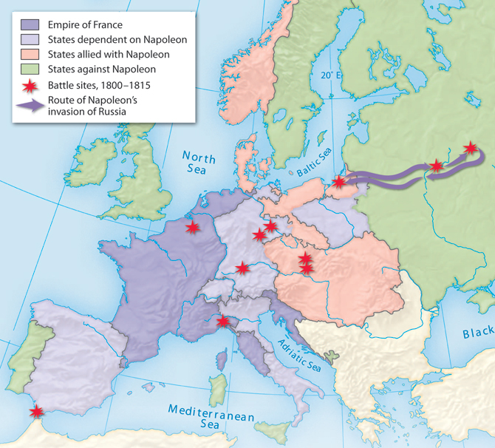
From 1804 to 1812, Napoleon successfully
battled most of Europe and created an empire.
France annexed:
The Netherlands
Belgium
Parts of Italy
Parts of Germany
Napoleon also:
Abolished the Holy Roman Empire
Cut Prussian territory
in half

Slide 44
Napoleon was unable to defeat Great Britain at
sea or through the use of the Continental System.
Napoleon was defeated in the Battle of Trafalgar in 1805.
The blockades created some hardships but Britain was able to maintain its trade routes in the Americas and India.

Slide 45
Many Europeans who had welcomed the ideas
of the French Revolution saw Napoleon and
his army as oppressors.
In Spain, people resisted reforms that undermined the king and the Catholic Church.
Nationalism in occupied countries created revolts and patriotic resistance through guerrilla warfare.

Slide 46
In 1812, the Russian winter stopped Napoleon’s army from a victory.
The tsar initially supported Napoleon but ended
up withdrawing from the Continental System.
When Napoleon attacked, the retreating Russian army’s scorched-earth policy made it impossible for Napoleon’s army to survive on what they left.
Napoleon retreated, and this disaster created an opportunity: a Russian-British-Austrian-Prussian
alliance against France.

Slide 47
In 1813, the newly created alliance defeated Napoleon in the Battle of the Nations.
Napoleon abdicated in 1814 and Louis XVIII
was recognized as king of France.
But Napoleon returned to France in triumph
after Louis XVIII’s return rekindled fears
of the old regime.

Slide 48
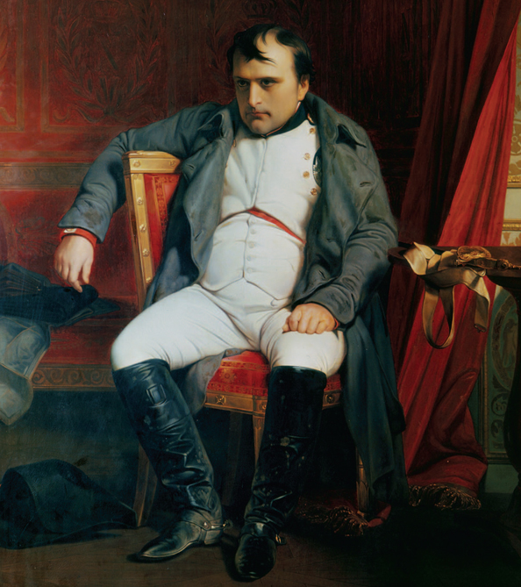
Napoleon once again took to the battlefields.
He was dealt a crushing blow by British forces
at the Battle of Waterloo.
He was forced
to abdicate a second and final time.
Thus ended
the period of
the French Revolution.

Slide 49
Napoleon’s legacy:
Within France | Abroad
Napoleonic Code Expanded suffrage More citizens had rights to property More citizens had rights to education | Failed to make Europe into a French empire Sparked nationalist feelings across Europe Created a new Germany Sold the Louisiana Territory and doubled the size of the United States

Slide 50
After Waterloo, the map of Europe was redrawn. Diplomats and heads of state sat down at the Congress of Vienna.
The chief goal was to create a lasting peace while preserving the old order. They wanted to:
Create a balance
of power
Protect the system
of monarchy

Slide 51
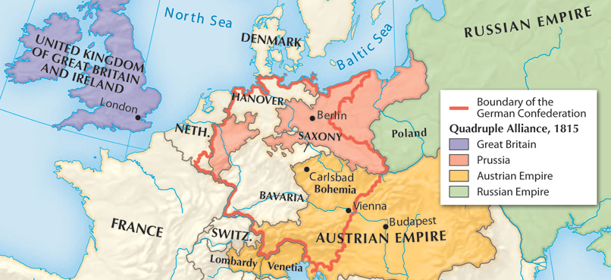
The Quadruple Alliance included Austria, Russia, Prussia, and Britain.
The architects of peace promoted the principle of legitimacy and restored monarchies in nations throughout Europe.
They pledged
to act together
to maintain the
balance of
power and
suppress
revolutionary
uprisings.

Slide 52
The creation of the Concert of Europe enabled the powers to meet periodically to address any new problems affecting the peace of Europe.
This peace lasted for 100 years, but ultimately failed to recognize how nationalism would shake the foundations of Europe and Latin America in the next decades.

Slide 53
Explain Napoleon’s rise to power in Europe, his subsequent defeat, and how the outcome still affects Europe today.

