Slide 1
World History
Fall Semester Exam Review
2013

Slide 2
When the unifying force of the Roman empire disappeared from Western Europe, Germanic kingdoms replaced it.
Greco-Roman, Germanic, and Christian traditions blended during the Middle Ages.

Slide 3
Charlemagne, briefly united Western Europe.

Slide 4
Feudalism developed in Europe in response to the need for protection from outside invasion.
Vassals pledged military service and loyalty to the lord.

Slide 5
Charlemagne’s empire broke apart even more when the Vikings began attacking European coastal and river towns.

Slide 6
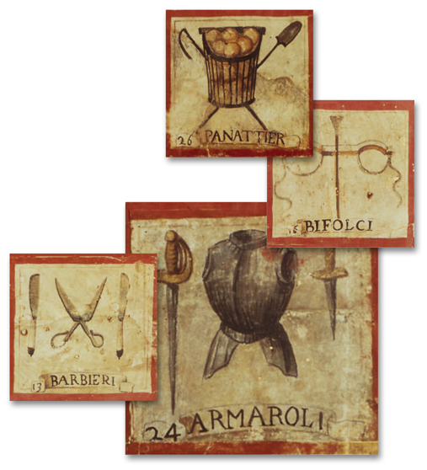
Merchants, traders, and artisans formed a new middle class.
They operated
in guilds, using emblems such as these to advertise.

Slide 7
The plague was spread by fleas carried by rats.
When plague struck, normal life broke down. People fled cities, hid in their homes, turned to witchcraft, and blamed Jews.
Economies failed as the cost of labor soared and inflation occurred. There was a large increase in wages and prices.
People revolted and social unrest became the norm for 100 years.

Slide 8
King John, placed all of England under the interdict.
Nobles, angry about taxes and his abuse of power, forced King John to sign the Magna Carta.

Slide 9
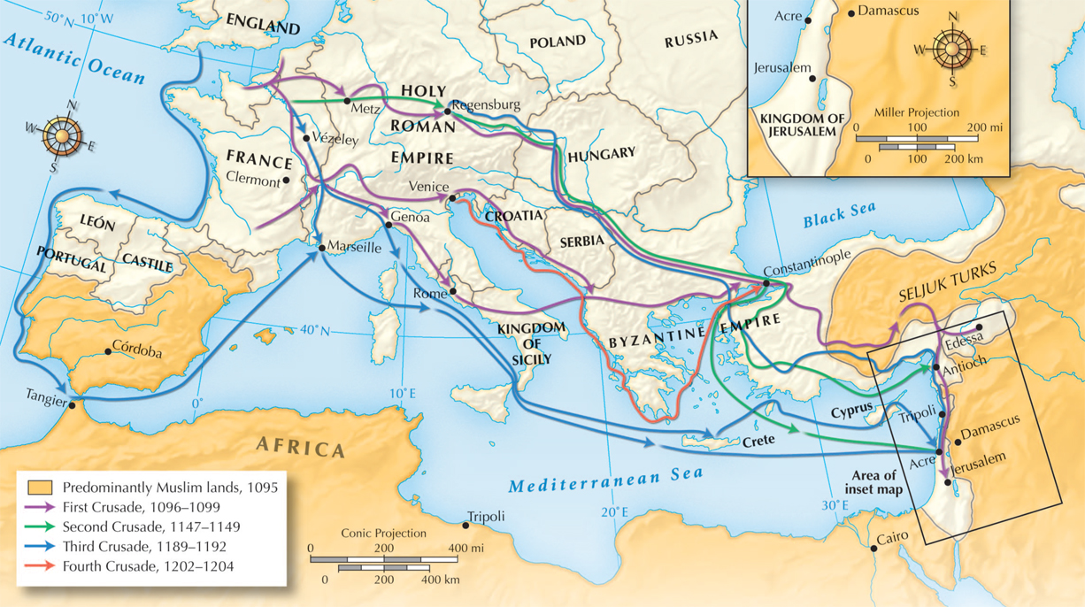
Christian knights captured Jerusalem in 1099, but in 1187, it fell again to the Muslims.

Slide 10
Emperor Constantine made Byzantium the center of the eastern Roman empire, a “New Rome,” and renamed it Constantinople.
It had an excellent harbor and sat at a crossroad of trade between Asia and Europe.
Notes:
10

Slide 11
Constantinople reached its peak under the Emperor Justinian, who ruled from 527 to 565.
The eastern Roman empire was renamed the Byzantine empire.
Justinian’s armies retook many lands in North Africa and southern Europe. His armies were the strongest in the world.
Notes:
11

Slide 12
Over time these differences grew into a
Great Schism, a split between the two churches.
The church divided into rival religions, the Eastern or Greek Orthodox Church and the Roman Catholic Church.

Slide 13
All must follow the Five Pillars of Islam.
Proclaim one’s faith in the one true God.
Face Mecca and pray five times a day.
Give charity to the poor.
Fast from sunrise to sunset during Ramadan,
the month when Muhammad received the Quran.
Make a hajj, or pilgrimage to Mecca, if able.

Slide 14
The rich tradition of Arab storytelling continued
in this period.
Poets wrote tales of romantic and dangerous desert journeys. Some are remembered today—“Ali Baba and the Forty Thieves” and “Aladdin and His Magic Lamp,” from The Thousand and One Nights.

Slide 15
The Muslim religion, or Islam, began when Muhammad, a 40-year-old Bedouin from Mecca, was meditating alone.
According to Muslim belief, Muhammad was embraced by the angel Gabriel and he became a prophet of God.
Notes:
15

Slide 16
Muslims believe that the Quran contains the sacred word of God as revealed to Muhammad.

Slide 17
Islamic art and literature reflected the diverse cultures within the Muslim world.
It was forbidden to portray God or human figures in religious art.
The Quran itself was the greatest literature.

Slide 18
Despite the difficulty of travel, trade expanded
by A.D. 200 due to camels from Asia.
They could carry heavy loads 20 or 30 miles a day.
Merchants on both sides of the Sahara profited from these “ships of the desert.”

Slide 19
The greatest ruler of Mali, Mansa Musa,
came to power in 1312.
He conquered additional territory and converted to Islam.
He made the pilgrimage to Mecca and brought back Muslim scholars and architects to Mali who created an Islamic university.

Slide 20
A trade network took goods from the savannah across the Sahara.
Gold and salt were two of the most traded commodities.
As trade grew, cities developed on the northern edges of the savanna.
Monarchs gained control of trade routes and built powerful kingdoms, such as Ghana.
Notes:
20

Slide 21
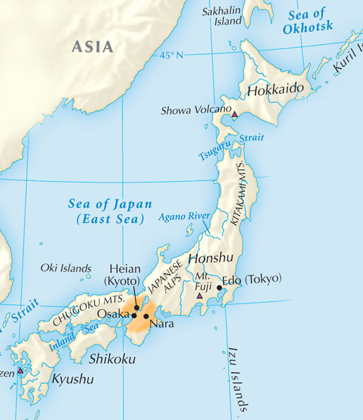
Japan’s unique geography set it apart from the Asian mainland.
  Japan’s isolated island location has protected it from being conquered by China.
Notes:
21

Slide 22
Japanese feudal system.
The emperor became powerless, though revered, as the shogun, or military commander, took over, setting up a military dynasty.

Slide 23
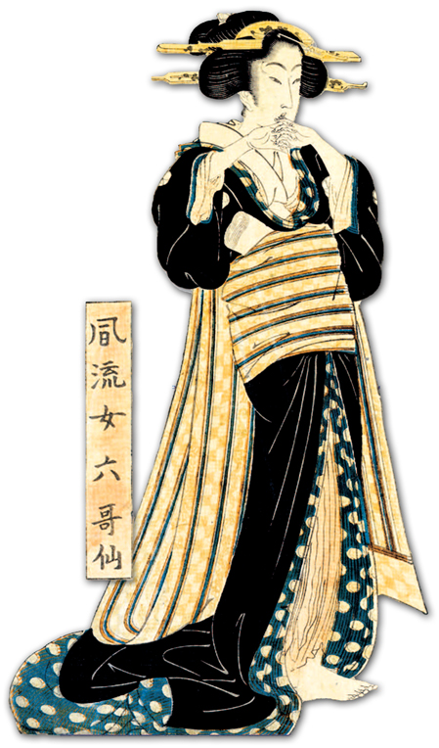
During the Heian period, women shaped the court, and an elegant culture emerged.
  Women produced important works of Japanese literature
  during this period.

Slide 24
In 1555, after several brief wars, Charles and the princes signed the Treaty of Augsburg.
Each prince chose a religion for his realm—either Catholic or Lutheran.

Slide 25
The heart of the Italian Renaissance was humanism.
Focused on worldly issues,
not religion
Humanists:
Humanists studied the works of Greece and Rome
to learn about their own culture.

Slide 26
The Renaissance began in Italy in the 1300s.
The Renaissance is an age of great change, evolved a new worldview, and reawakened interest in classical Greek and Roman learning and the arts.
Also, Italy had been the center of the Roman Empire.
Notes:
26

Slide 27
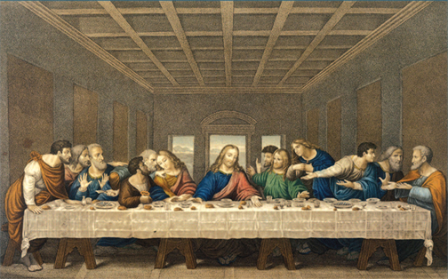
Leonardo da Vinci was an artist and inventor.
He studied botany, optics, anatomy, architecture, and engineering. Most famous painting was “Mona Lisa”.
He used
perspective
in painting
“The Last Supper.”
He left sketchbooks filled with ideas for inventions, including submarines and flying machines.

Slide 28
Sir Thomas More was an English humanist who pushed for social reforms.
In Utopia he described
an ideal society where all are educated and justice is achieved for all.

Slide 29
In the mid-1500s, a profound shift in scientific thinking brought the final break with Europe’s medieval past. Ideas from the Renaissance and Reformation helped scientists challenge medieval views. At the heart of this Scientific Revolution was the assumption that mathematical laws governed nature and the universe.

Slide 30
In Italy Galileo Galilei built a telescope and observed several moons in orbit around Jupiter.
He said these movements were the same as those of the planets around the sun.
This contradicted Church doctrine that the Earth was the center
of the universe. (geocentric)
Galileo was forced to recant his theories before
the Inquisition.

Slide 31
The English Reformation was not due to reformers, but rather to a king—Henry VIII.
In 1527 Henry sought an annulment from his wife Catherine, who had only borne a daughter, Mary Tudor.
He wished to marry a young noble-woman, Anne Boleyn. He hoped she would bear him a male heir.
When the
pope refused
to annul the marriage (divorce), the king took over the English Church.

Slide 32
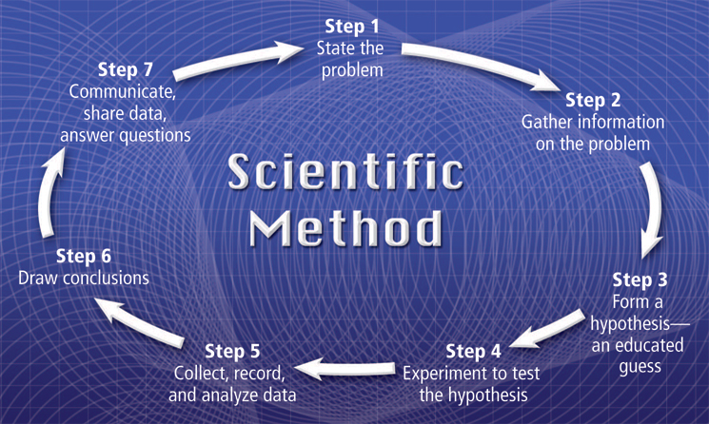
Over time, a step-by-step scientific method was developed. It required the collection of accurate data and the proposal of a logical hypothesis (possible explanation) to be tested.

Slide 33
In 1493 Ferdinand and Isabella appealed to
the pope to support their claim to all land in this new world.
Land to the west went
to Spain.
Land to the east went to Portugal.
The pope set a Line of Demarcation dividing all non-European land between Portugal and Spain.

Slide 34
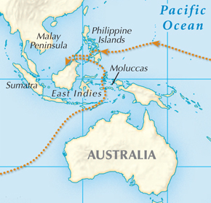
Europeans desired luxury goods from Asia, especially spices.
Most spices came from a chain of islands called the Moluccas.

Slide 35
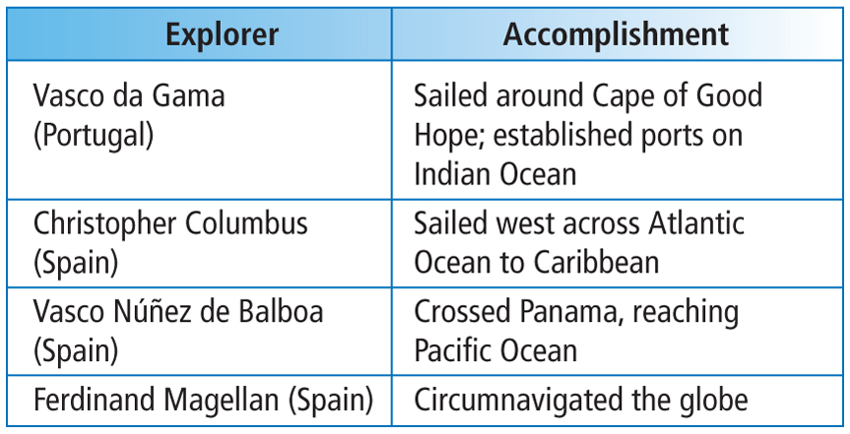
Important European Explorers

Slide 36
Cortés form alliances with groups of people who’d been previously conquered by the Aztecs.

Slide 37
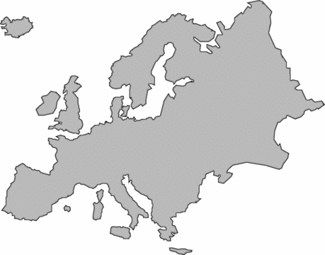
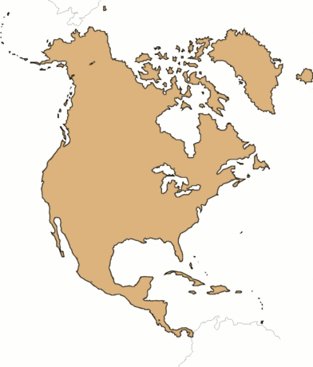
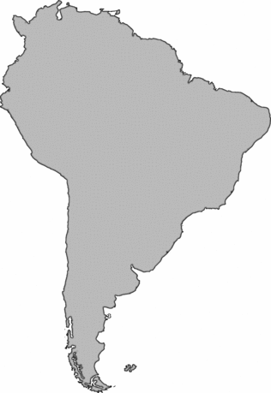
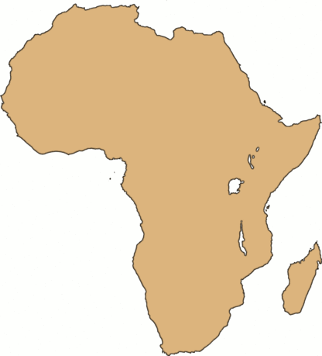
3. Finally, merchants carried goods from America to Europe—sugar, cotton, furs.
1. First, ships brought European goods
to Africa—guns,
cloth, cash.
2. Slaves were transported to
the Americas
on the second
leg, known as the Middle Passage.
Notes:
37

Slide 38
Prices began to rise in Europe due to the huge amount of silver and gold coming in from the Americas. This led to inflation.

Slide 39
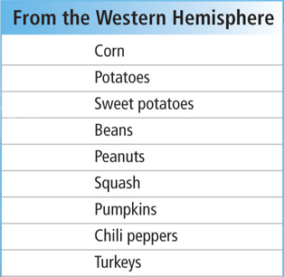
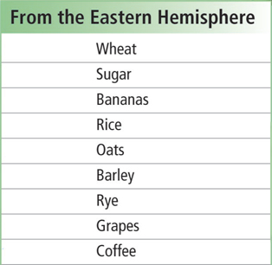
People’s diets changed around the world due to new types of foods crossing the globe.
Notes:
39

Slide 40
Louis XIV ruled France for 72 years.
After the death of his chief minister, Louis XIV took complete control of the government.
At the end of his reign, France was the strongest country in Europe.

Slide 41
“A Vindication of the Rights of Women”
Some women protested that “free and equal” did not apply to women. Mary Wollstonecraft, a writer, called for equal education for girls and boys.

Slide 42
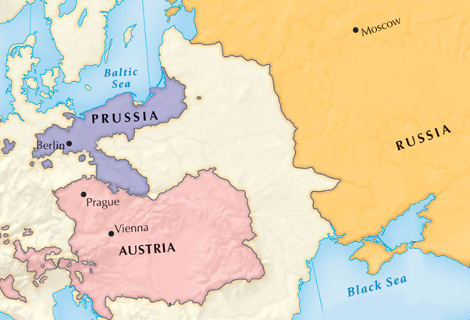
Absolute monarchs who adopted or accepted Enlightenment ideas were known as enlightened despots.
Monarchs who applied enlightened ideas to their governments included:
  Frederick the Great
  of Prussia
  Joseph II of Austria
  Catherine the Great
  of Russia

Slide 43
Thomas Hobbes’s Leviathan
People created social contracts because only an absolute monarchy could ensure an organized society.
John Locke’s
Two Treatises
of Government
The purpose of governments is to protect the natural rights of the people.

Slide 44
Diderot
Edited and published the Encyclopedia to “change the general way of thinking” and spread enlightened ideas.

Slide 45
The free market should regulate business activity.
All economic factors were related to the market forces of supply and demand.
The Scottish economist Adam Smith wrote
The Wealth
of Nations.

Slide 46
Most government and church authorities felt they had a sacred duty to defend the old order.
The most common defense was through censorship of writers and books. Writers fought back by disguising their ideas in fiction.

