Slide 1
Unit 1
Histiography and Ancient Civilizations part 1

Slide 2
They learn by studying artifacts, objects made by humans, such as clothing, coins, artwork, or tombstones.
They rely heavily on written evidence such
as tax records or letters.
Historians are scholars who study and write about the historical past.
Notes:
2

Slide 3
Historians are like detectives. They evaluate and interpret evidence.
Historians:
Assess information
Look for causes
Explain events
Historians explain the past to help us better understand events today and in the future.
Notes:
3

Slide 4
Prehistory is the period before the invention and use of writing.
Anthropology is the study of the origins and development of people and their societies.
Anthropologists investigate how culture has changed since prehistoric times.
Culture refers to a society’s beliefs, values,
and practices.

Slide 5
Archaeology is a branch of anthropology that looks at past cultures by studying their material remains.
Archaeologists:
Study artifacts—objects left behind, such as tools, weapons, or jewelry
Use artifacts to draw conclusions about a society’s culture
Notes:
5

Slide 6
Later hominids have also been identified.
Homo habilis “Handy man” | 2 million years ago; made stone tools for cutting, scraping, and chopping
Homo erectus “Upright man” | 2 million years ago, walked fully upright, had a larger brain, used fire and hand axes
Homo sapiens Neanderthals and early modern humans | Appeared 250,000–100,000 years ago. Neanderthals disappeared 50,000–30,000 years ago. Early modern humans, the only surviving hominid, spread around the world.

Slide 7
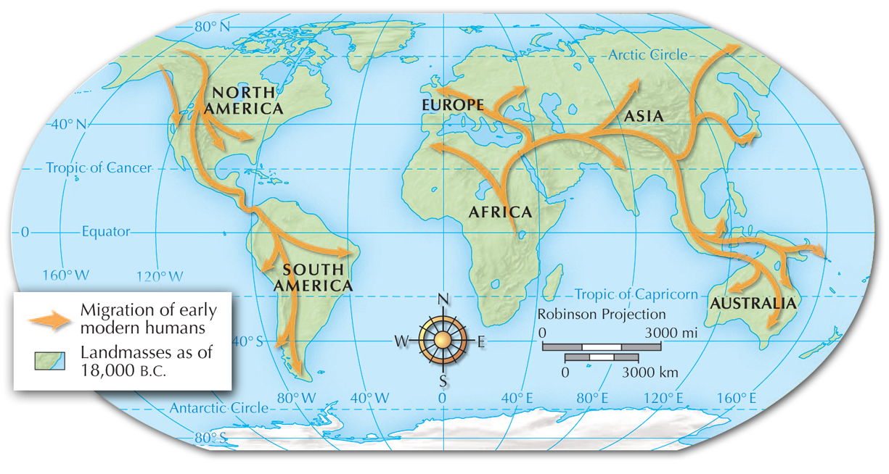
Early modern humans migrated to all parts of the world.

Slide 8
They lived in nomadic bands of 20 to 30 people.
Men hunted or fished.
Women and children gathered berries, fruit, nuts, grains, roots,
or shellfish.
Old Stone Age humans depended heavily on their environment for food and shelter.
Notes:
8

Slide 9
Early modern humans needed to develop
technology and strategies for survival.
They made tools and weapons from stone, wood, or bone.
To cook, they used fire.
They used animals skins for clothing.
The development of language allowed for cooperation and planning.
Notes:
9

Slide 10
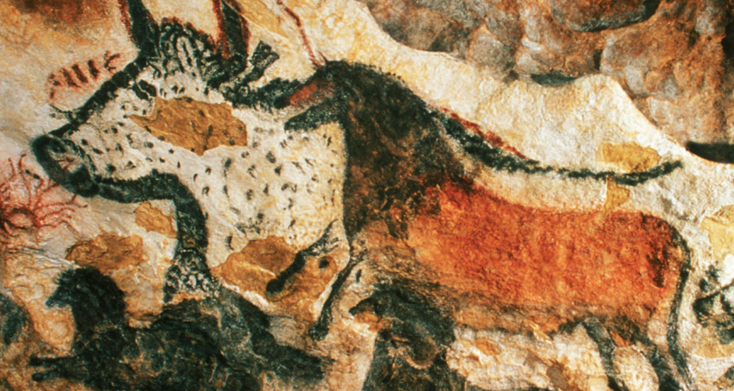
Cave and rock art portrayed animals they relied on,
such as deer, horses, and buffalo.
Some paintings were found deep in caves, perhaps painted in animist religious rituals.

Slide 11
The New Stone Age or Neolithic Period began when people started farming about 12,000 years ago.
People began domesticating plants and animals, raising them for human use.
Food or skins were more available.
This Neolithic Revolution, the transition from nomadic life to settled farming, brought dramatic changes, such as the first permanent villages.
Notes:
11

Slide 12
Jericho, which still exists as a city today,
was a large, walled village built between 10,000 B.C. and 9000 B.C.
Several thousand people lived in an area only
a few soccer fields in size.
A surrounding wall suggests there was a government or leader able to organize a large construction project.

Slide 13
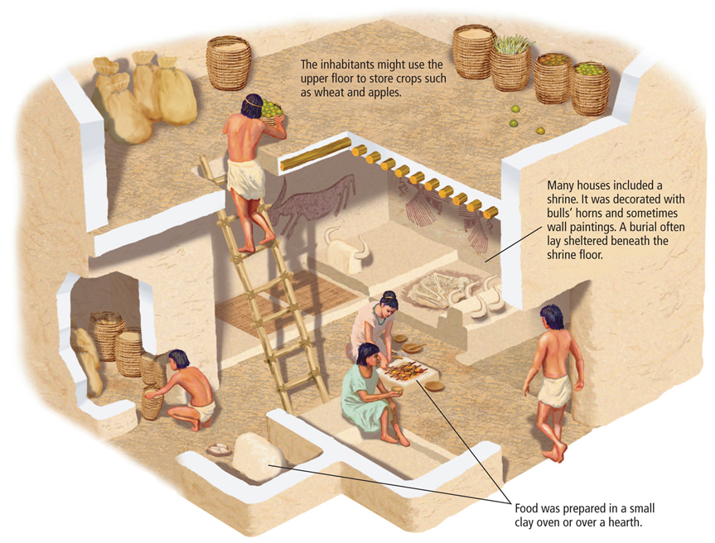
Çatalhüyük,
an early
Neolithic village in modern-day Turkey,
may have
had 6,500 inhabitants living in rectangular
mud-brick homes.

Slide 14
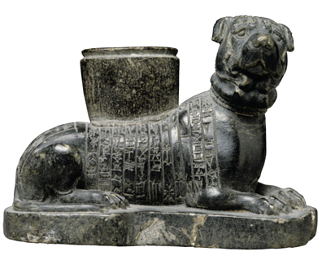
The Neolithic Revolution brought dramatic changes to human life.
Settled farming led to the establishment of the first villages.
This led to the first cities and civilizations.
Dogs were probably first domesticated about 13,000 B.C.
Notes:
14

Slide 15
Rivers provided water
for drinking and transportation.
Animals that came to drink provided food.
River valleys favored farming.
Floodwaters brought silt that kept the soil fertile.
The earliest civilizations arose near major rivers.
Notes:
15

Slide 16
Favorable conditions enabled farmers to produce surpluses, more food than was necessary.
Surpluses could be stored for future use.
These surpluses supported a larger population.
Villages grew into the first cities.
Notes:
16

Slide 17
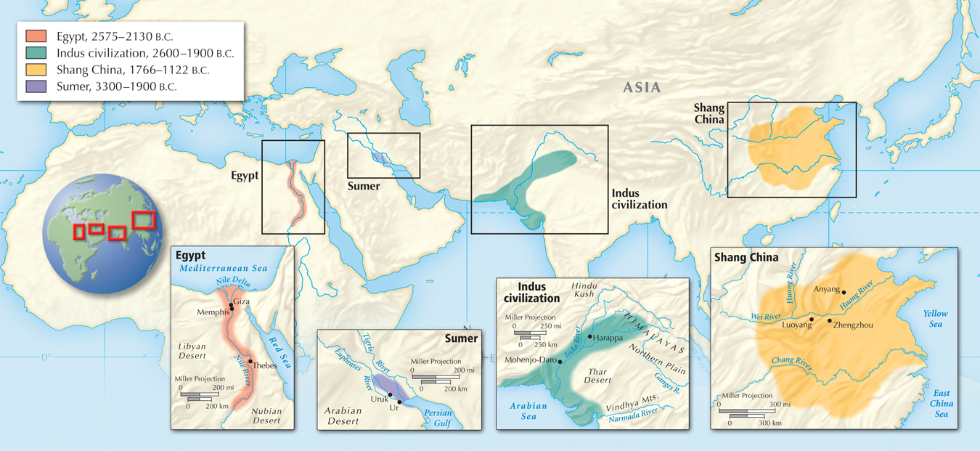
The first civilizations arose along the Nile, Tigris and Euphrates, Indus, and Huang Rivers.

Slide 18
The Olmec and Maya
of Mexico and Central America filled in swamps.
The Incas emerged in
the highlands of Peru, where they farmed on mountainsides.
The first civilizations in the Americas did not arise in river valleys.

Slide 19
In addition to cities, historians identify seven basic features of early civilizations.
1
Organized Governments
4
Social Classes
2
Complex Religions
5
Arts and Architecture
3
Job Specialization
6
Public Works
7
Writing
Notes:
19

Slide 20
1
Organized Governments
Centralized governments arose to oversee large-scale efforts to benefit people. They:
coordinated food production and storage
maintained flood control and irrigation projects
organized departments, made laws, collected taxes, and defended the city
Priests or warrior kings often claimed power from the gods and passed power from father to son.
Notes:
20

Slide 21
2
Complex Religions
Most ancient people were polytheistic—they believed in many gods.
They appealed to the deities believed to control the forces of nature.
They sought to gain favor with complex rituals.
They built temples and made sacrifices.
Ceremonies required full-time, trained priests.

Slide 22
3
Job Specialization
For the first time, people specialized. Artisans, people skilled in one craft, arose.
Carving, weaving, and pottery were needed.
Metalwork became particularly important.
Weapons and tools were made first from copper
and later from more durable bronze.
Merchants, bricklayers, soldiers, storytellers, and people with other skills were needed.

Slide 23
4
Social Classes
Social organization became more complex; people were ranked according to their job.
Priests and nobles had top ranks.
Next came a small class of wealthy merchants
and artisans.
The vast majority were peasant farmers from surrounding villages.
Slaves often made up the lowest social level.

Slide 24
5
Arts and Architecture
Skills in these areas expressed the talents, beliefs, and values of their creators.
Large buildings were reminders of the rulers’ power.
Palaces and temples often dominated the landscape.
They were generally decorated with paintings and statues of gods, goddesses, or the rulers.

Slide 25
6
Public Works
Dams, bridges, roads, defensive walls, and related structures.
7
Writing
Most civilizations developed some form of writing.
Writing began as pictographs, drawings that resemble the object represented.
As complex writing systems developed, scribes were specially trained to read and write.

Slide 26
Several factors caused civilizations to change
over time.
Dependent on resources such as stone, metals, and lumber.
Climate and geological changes, such as earthquakes, volcanoes, droughts, changes in soil fertility.
Environmental Changes
Ideas, customs, and technology spread between cultures.
Migration, trade, and wars can be sources of cultural diffusion.
Cultural Diffusion

Slide 27
Several factors caused civilizations to change
over time.
As rulers conquered territory they incorporated neighboring lands.
Conquered people were forced to provide part of their harvest to the rulers.
Cities grew into city-states.
An empire was a group of states and territories conquered by one ruler.
Defeat could be painful but often ended wars.
The first empires were established.

Slide 28
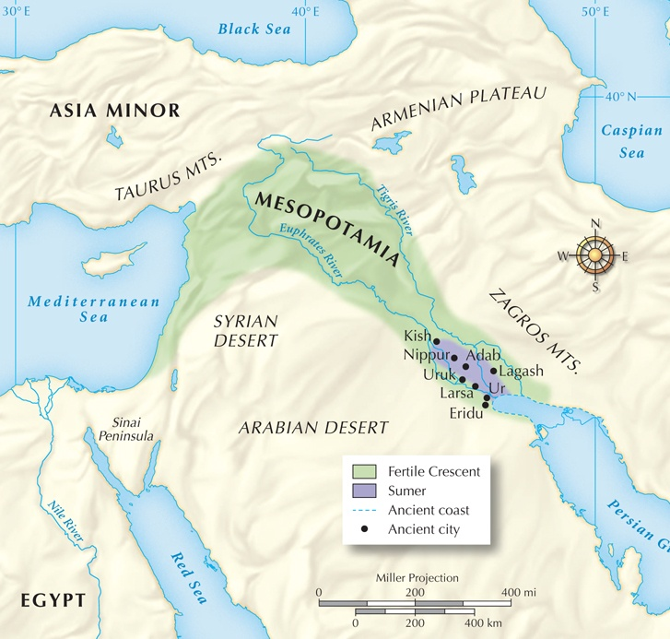
About 3300 B.C., the world’s first civilization developed between the Tigris and Euphrates rivers
at Sumer in southeastern Mesopotamia.

Slide 29
Sumerian society was highly structured.
Each city-state had a hierarchy, a system
for ranking groups
of people:
Women lacked legal equality, but some were educated and some female deities were honored.
Rulers,
leading
officials,
high priests
Lesser priests,
scribes, merchants
and artisans
Farmers
Slaves

Slide 30
To ensure the safety of their city-state, Sumerians believed it was their responsibility to keep the deities happy.
Each city built a ziggurat, a large stepped platform topped by a temple.
Holy days were celebrated with ceremonies and processions for the gods. Sumerians believed in a grim afterlife.

Slide 31
Sumerian scholars developed astronomy and mathematics.
They recorded the movements of planets and stars.
They created a number system based on six.
Babylonians, Greeks, and Romans all used Sumerian knowledge.

Slide 32
Hammurabi’s Code was the first attempt to codify or arrange and put laws in writing.
Laws were divided into two branches still used today:
Civil Law
Private rights, taxes,
business contracts,
marriages, divorce, and property inheritance.
Criminal Law
Robbery, assault, murder, and personal offenses.
Set out specific punishments for specific offenses.

Slide 33
Beginning of the Iron Age
In 1400 B.C. the Hittites used a new technology, to conquer Mesopotamia―ironworking. Iron was plentiful and stronger than bronze.
The Hittites also built larger, stronger, three-man chariots.

Slide 34
Under Nebuchadnezzar, Babylon again became
a great city.
He rebuilt temples, canals, roads, and palaces.
A defensive moat and walls surrounded the city.
The empire stretched from the Persian Gulf to the Mediterranean Sea.
He may have built the mythical “Hanging Gardens,” one of the “seven wonders of the ancient world.”

Slide 35
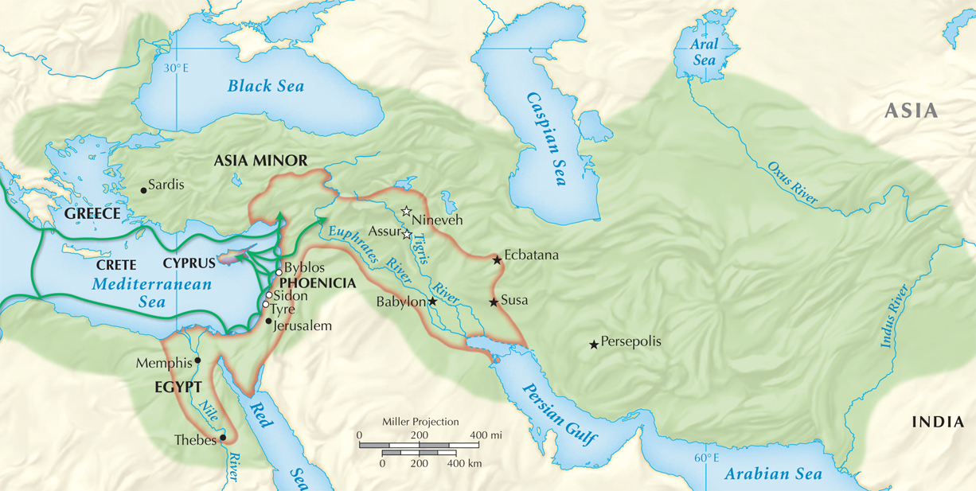
The Persian Empire under Emperor Darius I

Slide 36
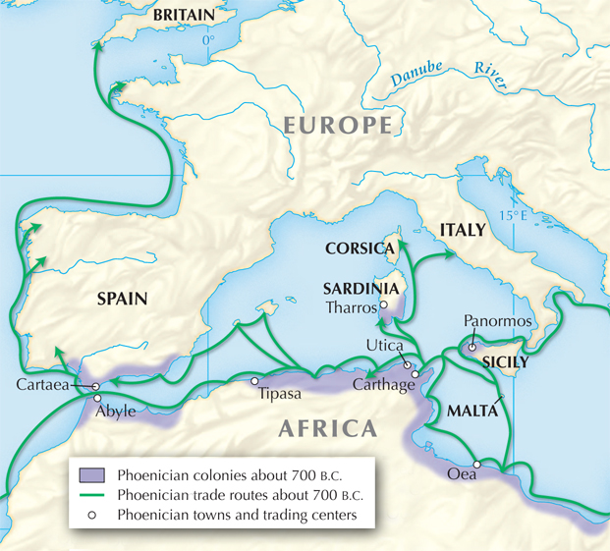
Phoenician sailors were the “carriers of civilization” who spread Middle Eastern civilization around the Mediterranean.
Phoenicians set up colonies in North Africa, Spain, and Sicily. They sailed as far as Britain.

Slide 37
The Phoenicians developed our modern alphabet, based on twenty-two consonant sounds.
The Greeks later
added vowel sounds
to create the alphabet we use today.
abcdefghijklmnopqrstuvwxyz
Notes:
37

Slide 38
During the Old Kingdom, Egypt became a centralized state.
The pharaoh was viewed as a god, though he was expected to act morally.
Rule was by a bureaucracy or system of departments with different levels of authority.
A vizier or chief minister supervised departments for taxes, farming, irrigation, etc.
The Great Pyramids were built at Giza, as homes for pharaohs in the afterlife.

Slide 39
The Middle Kingdom was also a turbulent era.
The Nile did not rise as regularly as in the past. Rebellions and corruption were also problems.
In 1700 B.C.,
the Hyksos invaded the delta after awing Egyptians with horse-drawn chariots.
The Hyksos ruled
for a hundred years, until new Egyptian leaders arose.

Slide 40
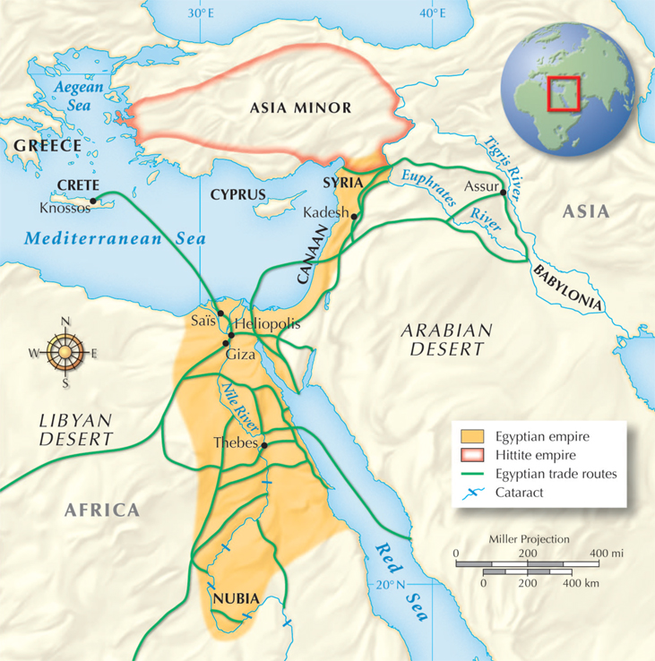
Under ambitious pharaohs, the
New Kingdom grew powerful, reaching as far north as Syria and the Euphrates River
in 1450 B.C.

Slide 41
Ramses II was pharaoh for 66 years.
Ramses battled the Hittites before signing the oldest known peace treaty.
He used gold from Nubia to pay his army, which
included many Nubian charioteers.
Nubians played a prominent part in Egyptian culture during this era.
After 1100 B.C. Egypt declined and was invaded.

Slide 42
Egyptian society was highly stratified.
Pharaoh
Royal family
High priests
and priestesses,
government officials, merchants, scribes, artisans
Peasant farmers and slaves
Notes:
42

Slide 43
Egyptian women enjoyed greater rights than
in other ancient civilizations.
Women could inherit property, go into business, obtain a divorce, and go to court.
Women entered the priesthood serving goddesses.
However, women could not become scribes or hold government jobs.

Slide 44
The ancient Israelites, or Hebrews, established the first monotheistic religion.
They believed in one all-knowing, all-powerful God who was present everywhere.
In their view, each event in history represented part of God’s plan for the people of Israel. All of these events and the laws were recorded in the Torah, the first five books of the Hebrew Bible.

Slide 45
The Bible says that Moses renewed the Israelites’ covenant with God.
According to the Book of Exodus, Moses told the Jews that God was rewarding their faithful obedience. He led them out of Egypt, and for
40 years they roamed the deserts of Canaan.
Famine had forced them to leave Canaan and live in Egypt, where they were enslaved.
Notes:
45

Slide 46
About 1000 B.C. King David united 12 feuding Jewish tribes and established Israel.
His son, King Solomon, sought to build Jerusalem into an impressive capital.
Solomon completed a temple dedicated to God that was begun by David.
He became famous for his wisdom and understanding.
He negotiated with powerful empires in Egypt and Mesopotamia.

Slide 47
Israel declined after Solomon’s death in 922 B.C.
Southern Israel split off and became Judah.
722 B.C.—the Assyrians captured Israel.
589 B.C.—Babylon captured Judah.
539 B.C.—Persia freed the Israelites.
King Nebuchadnezzar of Babylon forced many into
exile and destroyed the temple during the time called the Babylonian Captivity.

Slide 48
Judaism taught an ethical world view.
Morality was guided by the Ten Commandments.
The first four
outlined religious
duties to God, such as reserving a holy day
for rest and worship.
The rest outlined
behavior toward others. They include “Honor your father and mother” and “You shall not kill.”

Slide 49
For 500 years, beginning with the Babylonian Captivity, Jews were spread throughout the empires that controlled their land.
During this Diaspora, many remained in small communities living by their laws and traditions.
Many faced persecution, but survived and maintained their faith.
Judaism’s unique contributions to religious thought heavily influenced the rise of two later monotheistic religions, Islam and Christianity.

