Slide 1
Unit 1
Part 2
India and China

Slide 2
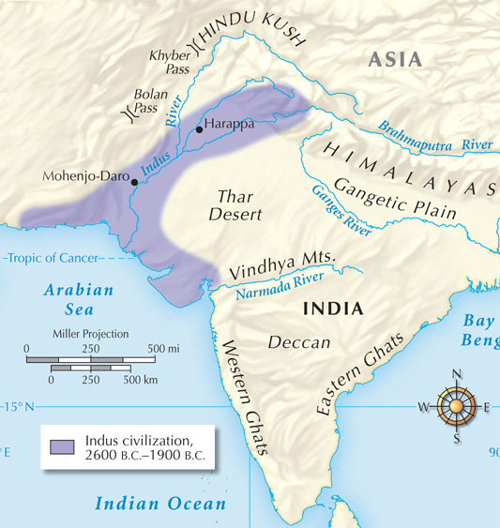
Geography affects where people live on the Indian subcontinent.
Agriculture is possible
in the Gangetic Plain because it is watered
by three rivers.
The Deccan plateau, on the other hand, is arid and unpopulated.

Slide 3
Archaeologists believe the Indus people were polytheistic and viewed some animals as sacred, including the buffalo and the bull.
This may have influenced later Indian veneration
of cattle.

Slide 4
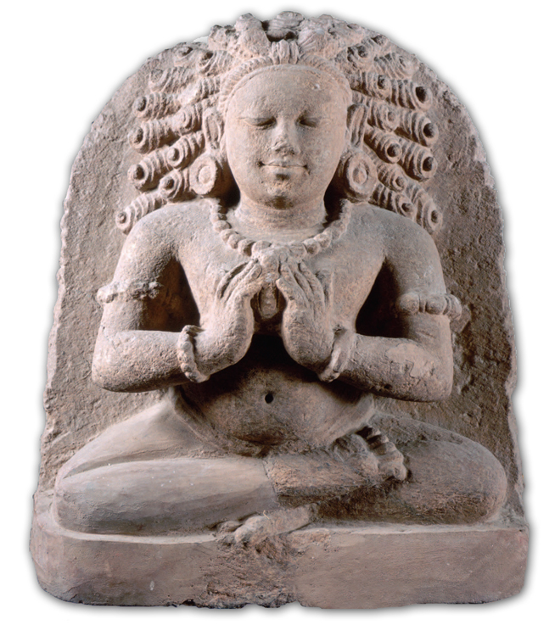
Nomads from Central Asia traveled to the Indian subcontinent after 2000 B.C.
They mingled with local people. This acculturation
created the Aryan people.
Clues about their lives are now found in the Vedas.

Slide 5
Aryans organized their society into
ranked groups.
Brahmins | priests
Kshatriyas | warriors
Vaisyas | herders, farmers, artisans, merchants
Sudras | farmworkers, servants, other laborers
Dalits -
“ Untouchables” - had to do the jobs no one else wanted

Slide 6
As a result, it is one of the most complex religions in the world.
Hindu teachings were recorded over hundreds of years in sacred texts called the Vedas.
The beliefs of Hinduism developed over time with contributions from many different groups who settled in India.

Slide 7
Despite the complexity of the religion,
all Hindus have the same goal and core beliefs.
One force, brahman, underlies everything.
The goal of life is to achieve moksha, or union with brahman.
Every person
has an atman,
or essential self,
and experiences reincarnation.
Karma holds that our actions affect our fate in the next life.

Slide 8
Hindus believe in dharma, the religious and moral duties of the person.
They practice ahimsa, nonviolence.
Hindus worship many gods. The most important are:
Brahma, the Creator
Vishnu, the Preserver
Shiva, the Destroyer

Slide 9
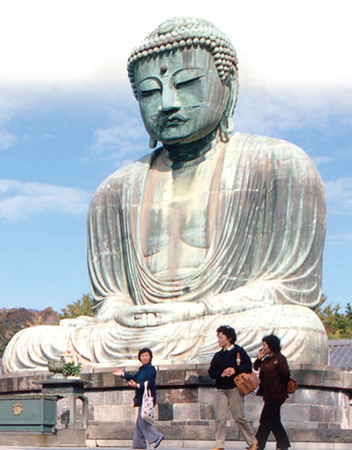
Buddhism emerged in the foothills of the Himalayas around 500 B.C.
The teachings of a reformer named Siddhartha Gautama spread to form the religion.
It began when Gautama left his palace home to find an answer to why people suffer.
Notes:
9

Slide 10

Gautama took a seat under a tree and meditated. When he finally rose, he had become the Buddha, “Enlightened One.”
He described the Eightfold Path, a way of life that would eventually lead to enlightenment.
The final goal for the Buddhist is nirvana, union with the universe.
Notes:
10

Slide 11
Buddha spent his life explaining the
Four Noble Truths, the heart of Buddhist belief.
All life is full of suffering, pain, and sorrow.
The cause of suffering is nonvirtue. (desire)
The only cure for suffering is to overcome nonvirtue.
The way to overcome nonvirtue is to follow the Eightfold Path.

Slide 12
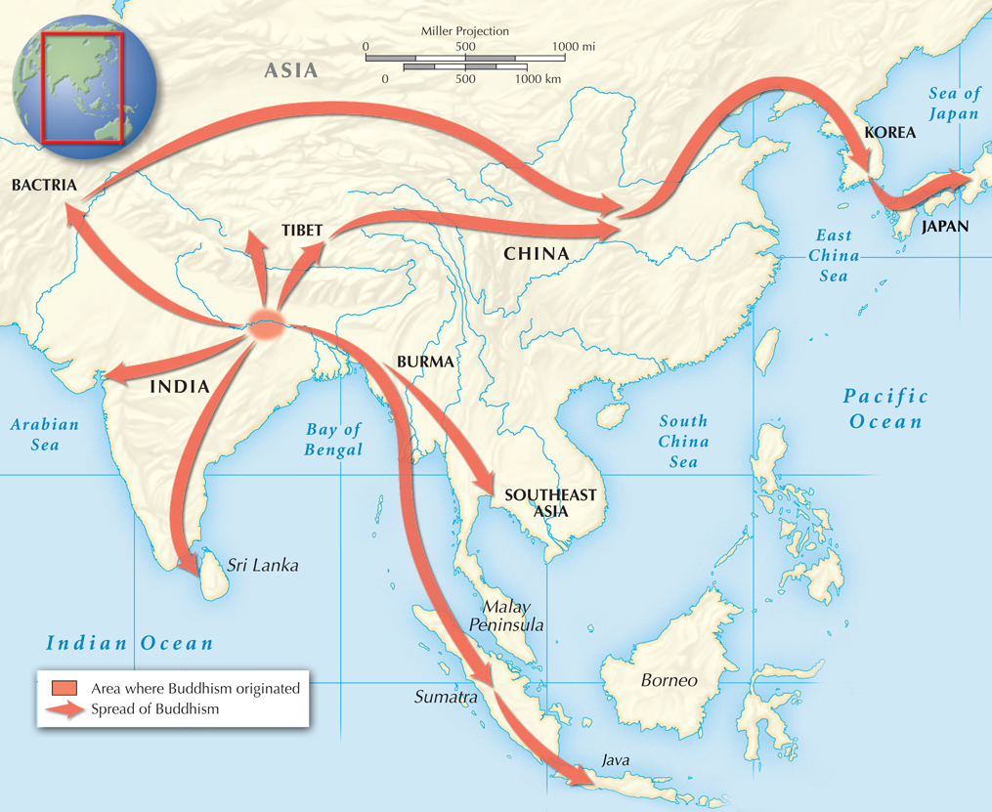
Buddhism rejected the Hindu caste system.
Rather than focusing on priests, ritual and deities, Buddhism encouraged each person to seek self-enlightenment.
The religion spread and the Buddha’s teachings were recorded.

Slide 13
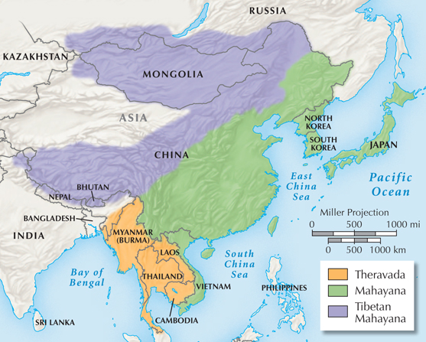
Buddhism eventually declined in India as it took root in other parts of Asia.

Slide 14
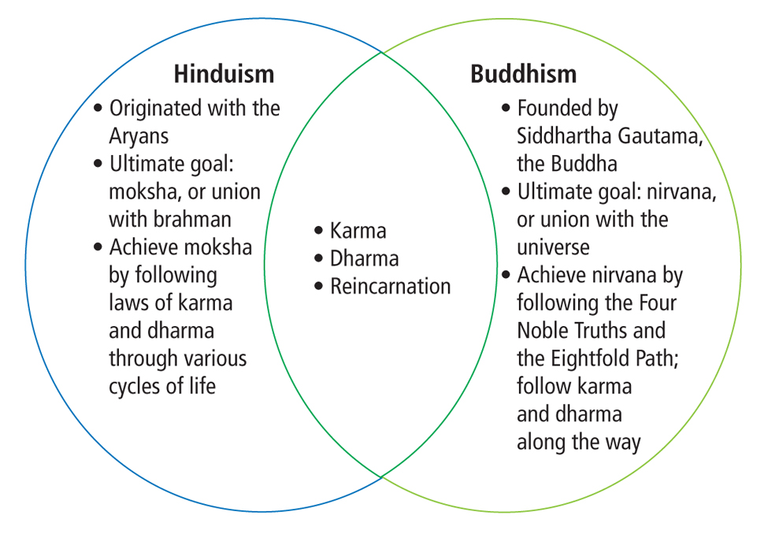
Religions Founded in India

Slide 15
Indus civilization
2600 B.C.
to 1900 B.C.
Aryan civilization
1500 B.C.
to ?
Maurya empire
321 B.C.
to 185 B.C.
Gupta
empire
A.D. 320
to A.D. 550
Gupta rule declined in 550 A.D. due to foreign invaders, civil war, and weak rulers.
India split again into many separate kingdoms.

Slide 16
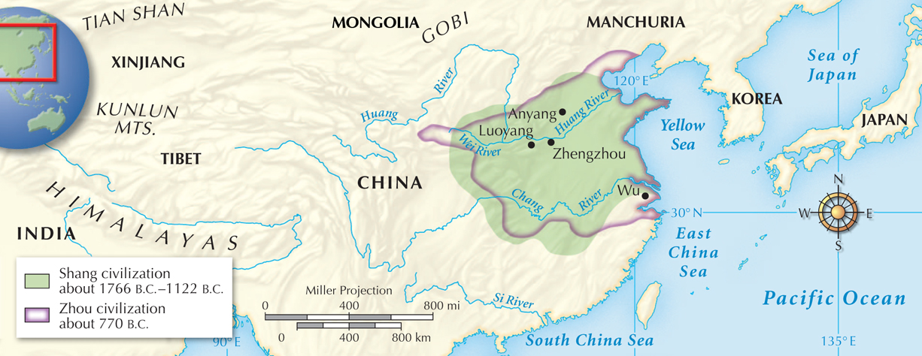
Geography influenced Chinese civilization by isolating it from outside people.
The Gobi desert, the Himalayan mountains, thick rainforests, and the Pacific Ocean all set China apart.

Slide 17
The first Chinese dynasty, the Shang, arose around 1766 B.C. and lasted until 1122 B.C.
The dynasty was organized by clans.
Most members of Shang society were peasants
who led grueling lives working the fields.
The cities supported artisans skilled in bronze work.

Slide 18
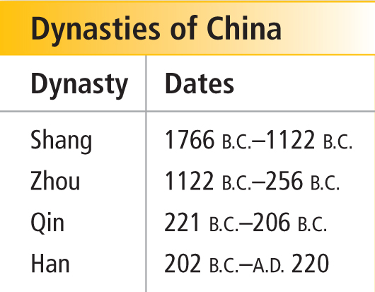
The Shang dynasty ended in 1122 B.C. in
a rebellion led by two Zhou warriors.
The Zhou claimed a divine right to rule, calling it the Mandate
of Heaven.
Notes:
18

Slide 19
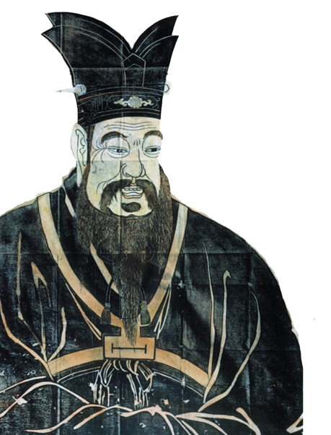
Confucius developed his philosophy during the Zhou period.
Concerned with worldly goals,
he considered filial piety, respect for parents, the highest
principle.
His teaching reflected Chinese
belief in yin and yang, balance
between two forces.

Slide 20
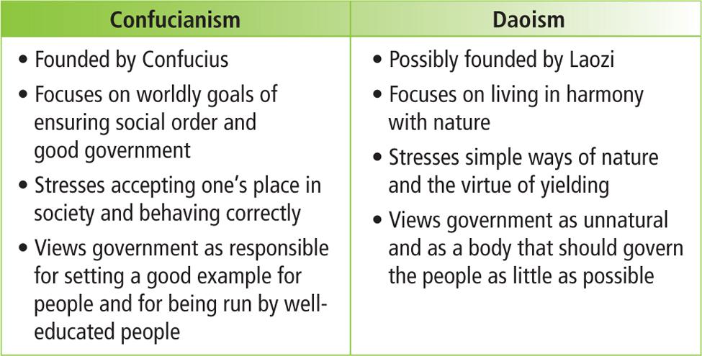
Laozi lived at the same time as Confucius and founded a philosophy called Daoism.

Slide 21
The Shang and Zhou periods produced many cultural achievements.
The Chinese learned to make silk by 2640 B.C.
It became their most valuable export.
Chinese writing appeared 4,000 years ago on oracle bones.
Chinese writing became the art form calligraphy.
Notes:
21

Slide 22
Zheng, leader of the state of Qin, unified China. Proclaimed himself Shi Huangdi,
“First Emperor.”
Ending feudalism, he unified China using a harsh
system called Legalism to impose order.
He also:
Standardized weights and measures
Produced Qin coins
Built roads

Slide 23
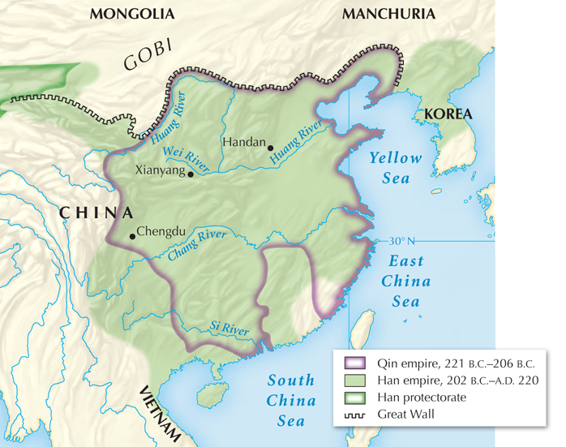
One of Shi Huangdi’s greatest accomplishments was to link existing feudal walls into the Great Wall.

Slide 24
With the death of Shi Huangdi in 210 B.C., the Qin dynasty ended. Emperor Gao Zu rose to power and the Han dynasty began.
The most famous Han emperor, Wudi, strengthened government and the economy.
He improved canals and roads and imposed a monopoly on
iron and salt.

Slide 25
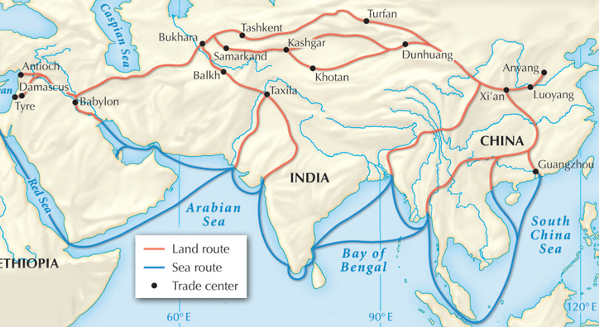
Wudi pursued expansionism, fighting battles to extend China’s borders.
He linked China to the West with the creation
of the Silk Road trade route.
Notes:
25

Slide 26
The Han emperors made Confucianism the official belief system of the state.
Under this system, a man would start in a clerical job. He could then take tests to advance to higher levels in the civil service.
They also held that civil servants should get their
jobs by merit.
Notes:
26

Slide 27
The Han dynasty eventually weakened and could no longer control warlords.
Peasants paid heavy taxes and, burdened by debt, abandoned their villages and joined groups of bandits.
Warlords overthrew the Han emperor in A.D. 220 and China broke up into several kingdoms.
Invaders moved in from the north and set up their own states.

Slide 28
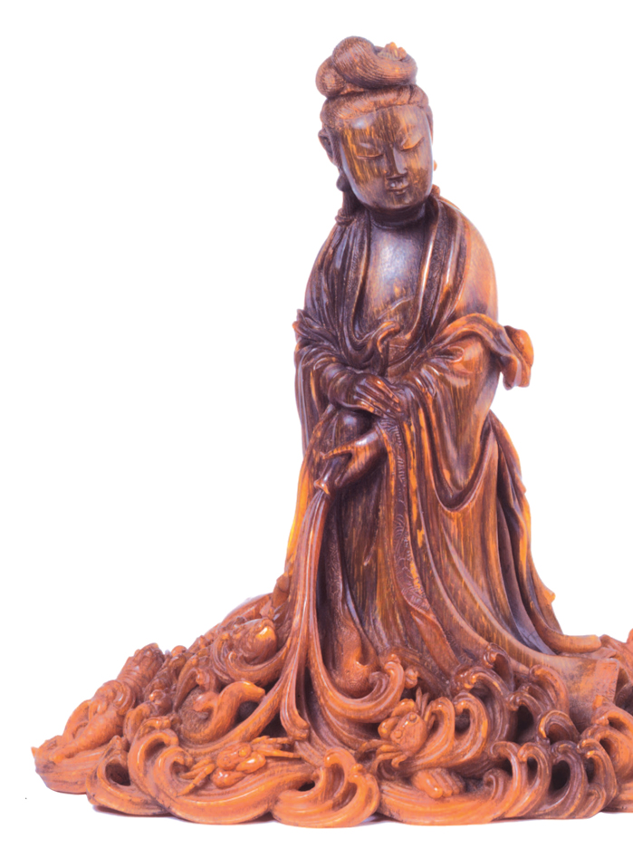
Buddhism became increasingly popular, spreading through China
by A.D. 400.
It absorbed many Confucian and
Daoist teachings.
Bodhisattva
of compassion
and mercy
Notes:
28

Slide 29
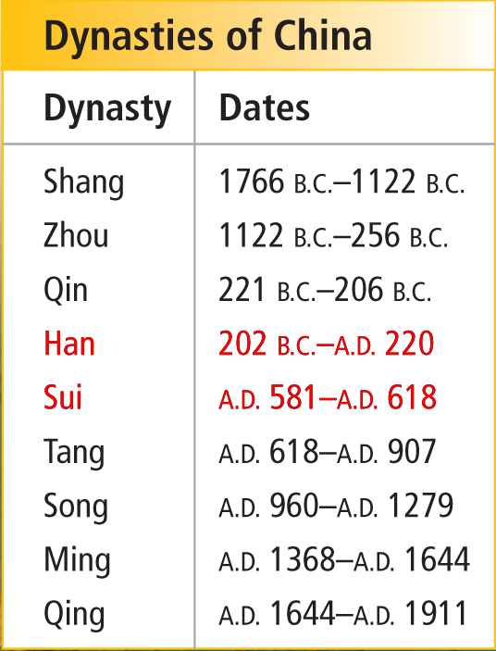
Shi Huangdi and the Han rulers united China and its civilization flourished.
China would break up and be united many times through the centuries.
After centuries of disunity, the Sui dynasty appeared in A.D. 581.

