Slide 1
Unit 10
Nationalism, Militarism and Imperialism
Part 1

Slide 2
22-1
Building a German Nation

Slide 3
Napoleon’s invasions into German-speaking states produced changes in these territories.
He dissolved the Holy Roman Empire.
He organized several German states into the Rhine Confederation.
He made trade easier in the region.
German-speaking people fought together to free themselves from French rule and began to consider creating a united German state.
Notes:
3

Slide 4
Creating a united Germany was difficult.
It required dissolving the small governments of each German state.
Instead, leaders created a weak alliance called the German Confederation.
Prussia created an economic union in the 1830s called the Zollverein, but Germany remained fragmented politically.

Slide 5
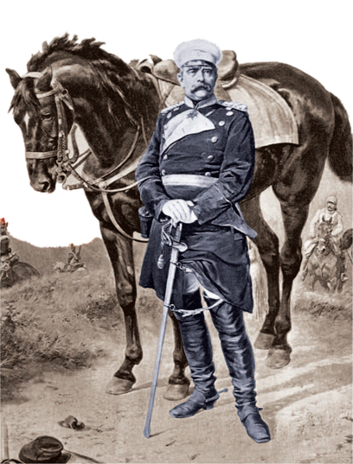
This changed when Otto von Bismarck rose to power in Prussia.
He became prime minister in 1862, then rose to chancellor.
Bismarck was determined to unite Germany under Prussian rule and used a policy of “blood and iron” to do so.

Slide 6
Realpolitik was
an ideology that favored power
over principle.
He then led Prussia into three wars.
These actions all paved the way for German unification.
Bismarck mastered Realpolitik and strengthened the Prussian army.

Slide 7
Otto von Bismarck took methodical steps to increase Prussia’s power and territory.
He formed
an alliance with Austria,
then seized provinces from Denmark.
Next, he attacked Austria and annexed several states.
He dissolved the German Confederation and replaced it with one led by Prussia.

Slide 8
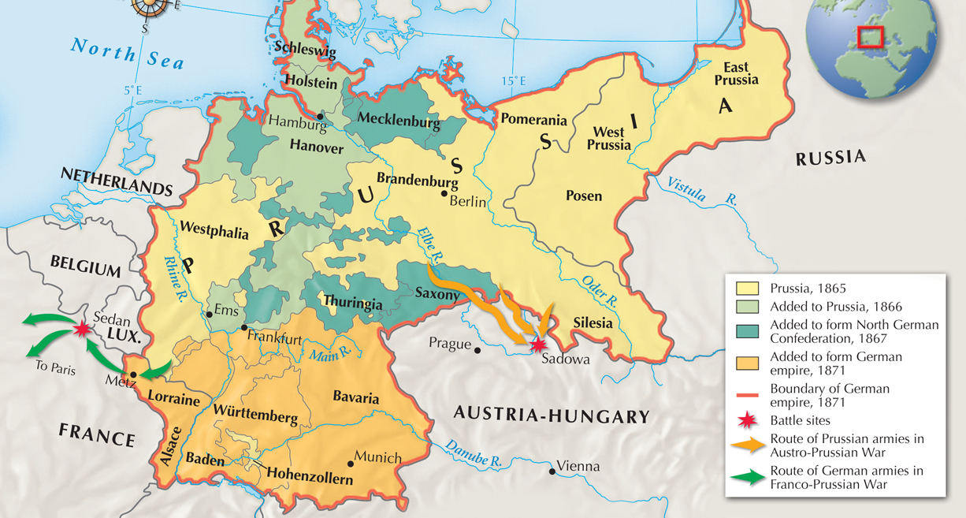
The unification of Germany under Prussian rule occurred mainly between 1865 and 1871.

Slide 9
The Franco-Prussian War broke out in 1870.
After a furious Napoleon III declared war, Prussia and other German states easily defeated the French within weeks.
Bismarck stoked the rivalry between the two states by editing a telegram to make it appear that King William I of Prussia had insulted a French ambassador.

Slide 10
Leaders in many German states urged William I
of Prussia to take the title kaiser.
German nationalists celebrated the beginning of the second Reich, the second German empire after the Holy Roman Empire.
Bismarck wrote a constitution and set up a two-house legislature. However, real power remained with the emperor and chancellor.

Slide 11

How did Otto von Bismarck, the chancellor of Prussia, lead the drive for German unity?

Slide 12
22-2
Germany Strengthens

Slide 13
After Germany unified, it became the industrial leader of the European continent.
Germany’s iron and coal resources, as well as its disciplined workforce, helped make this possible.
The nation had a rapidly growing population, which fed industrialization.
Germany had also laid the groundwork for progress
in the 1850s and 1860s by founding large companies and building railroads.
Notes:
13

Slide 14
Both the government and industrialists supported scientific research and economic development.
Scientists were encouraged to develop new materials and were hired to solve technical problems in factories.
At the same time, the government pursued sound economic policies such as issuing a single currency and raising tariffs to protect home industries.

Slide 15
He wanted to keep France weak and sought strong links with Austria and Russia.
He did not want to compete with British naval power.
Bismarck pursued several foreign
policy goals as the “Iron Chancellor”
of Germany.
On the domestic
front, Bismarck
was ruthless.
He wanted to ensure complete loyalty to the state.

Slide 16
Bismarck began a campaign against the Catholic Church in 1871.
He distrusted Catholics because he believed their first loyalty was to the pope instead of the German state.

Slide 17
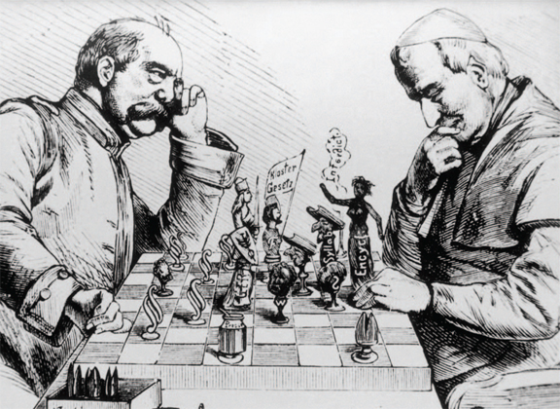
Bismarck launched the Kulturkampf, which lasted between 1871
and 1878.
He had laws passed that increased state power
over Church actions.
When the faithful rallied behind the Church, however, Bismarck retreated.

Slide 18
In addition to Catholics, Bismarck targeted socialists.
He worried that socialists would create a revolution among German workers.
Bismarck dissolved socialist groups, shut down their newspapers, and banned their meetings.

Slide 19
When these measures failed, Bismarck sponsored laws to protect workers and thereby woo them away from socialists.
Germany became a leader in social reform
with its health and old-age insurance.
Still, the socialist party grew.

Slide 20
William II succeeded his grandfather William I as kaiser in 1888.
He asked Bismarck to resign as chancellor, saying “There is only one master in the Reich, and that is I.”
He believed that his right to rule came from God.

Slide 21
William was very confident and wanted to leave his mark.
His government provided social welfare programs and services, such as public transportation, electricity, and excellent public schools.
He also developed the already huge German military, hoping to win an overseas empire like those of Britain and France.

Slide 22
How did Germany increase its power after unifying in 1871?

