Slide 1
Unit 10
Nationalism, Militarism and Imperialism
Part 2

Slide 2
22-3
Unifying Italy

Slide 3
There were many obstacles to Italian unity in the early 1800s.
People identified mainly with their local regions due to frequent foreign rule.
At the Congress of Vienna, Italy was partitioned by Austria, the Hapsburg monarchs, and others.
Nationalist revolts were continually crushed by Austria.

Slide 4
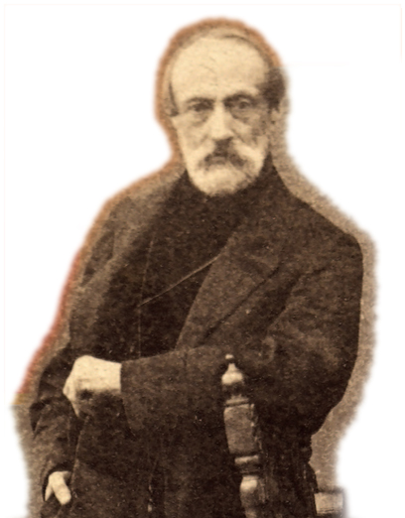
Giuseppe Mazzini, a nationalist leader, founded Young Italy in the 1830s.
It was a secret society whose goal was to establish a united Italy.
The ideas of nationalists such as Mazzini soon spread.
Notes:
4

Slide 5
Victor Emmanuel II, the monarch of Sardinia, wanted to join other states to his own and increase his power.
Cavour was a skilled politician who reformed Sardinia’s economy and ultimately sought to throw Austria out of Italy and annex more provinces.
He made Count Camillo Cavour his prime minister in 1852.

Slide 6
Sardinia helped Britain and France fight Russia
in the Crimean War.
In the aftermath, Cavour got
France to agree
to help Sardinia
if it ever went
to war with Austria.
Cavour then provoked that war and defeated Austria with France’s help.

Slide 7
There, a nationalist
leader named Giuseppe Garibaldi put together
a volunteer force of
1000 “Red Shirts.”
Using ships and weapons from Cavour, the force invaded Sicily and won control of it.
Now that Sardinia controlled northern Italy, Cavour turned his attention southward.

Slide 8
Cavour feared Garibaldi would set up his own republic in the southern part of Italy.
However, when Victor Emmanuel sent Sardinian forces to confront Garibaldi, he turned over Naples and Sicily. Victor Emmanuel II was crowned king of Italy in 1861.
Italy won the province of Venetia during the Austro-Prussian War and won Rome during the Franco-Prussian War. It was finally a united land.

Slide 9
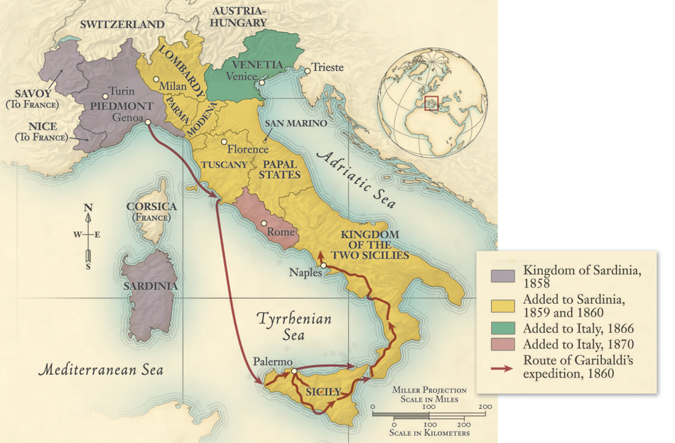
Italy became
a unified state between 1858 and 1870.

Slide 10
Regional rivalries and differences made it hard to solve problems.
The north was rich and had
a tradition of business and culture, whereas the south was rural and poor.
Further, popes urged Italian Catholics not to cooperate
with the Italian government.
Italy faced many problems once it was unified.

Slide 11
Turmoil broke out in the late 1800s as the left struggled against a conservative Italian government.
Socialists organized strikes and anarchists turned to violence.
In response, the government extended suffrage to more men, passed laws to improve social conditions, and set out to win an overseas empire in Africa.

Slide 12
Italy developed economically, particularly after 1900.
Industries developed in northern regions and people moved to cities.
Though a population explosion created tensions, many people chose to emigrate, which calmed things at home.

Slide 13

How did influential leaders help to create a unified Italy?

Slide 14
24-1
Building Overseas Empires

Slide 15
In the late 1800s, Western imperialism expanded aggressively.
Imperialism is the domination by one country of the political, economic, or cultural life of another country or region.
Although Europeans had established colonies earlier, they had previously had little direct influence over people in China, Africa, or India.

Slide 16
The strong, centrally governed nation-states of Europe were greatly enriched
by the Industrial Revolution.
Encouraged by their new strength, these nations embarked
on a path of expansion—the new imperialism.

Slide 17
Causes of the “New Imperialism”
Economic needs | New sources of raw materials New markets to sell goods New ventures and enterprises
Political and military needs | Naval refueling bases Stopping the expansion of rivals Promoting national security and prestige

Slide 18
Missionaries, doctors, and colonial officials saw it as their duty to spread the blessings of Western civilization.
These included medicine, law, and religion.
Imperialism
was also driven by genuine humanitarian and religious goals.

Slide 19
Behind the West’s civilizing mission was also a sense
of racial superiority.
Social Darwinists applied Darwin’s theory of natural selection to societies.
They saw imperialism as nature’s way of improving the human race.
A result was that many people lost their cultural heritage.

Slide 20
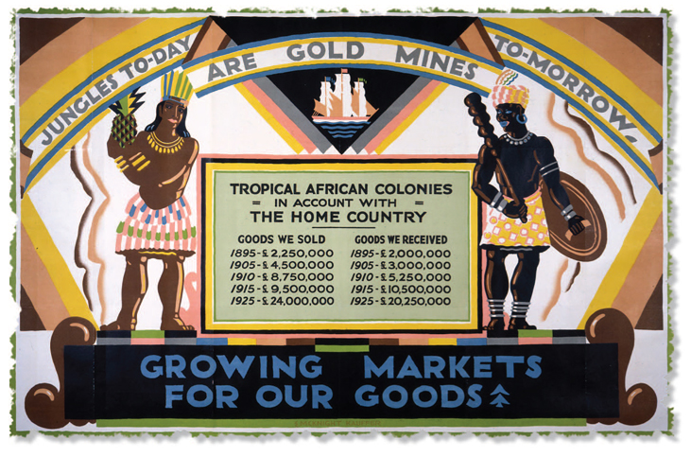
National pride
and aggressive foreign policy came to be known as jingoism.
A driving force behind imperialism was the desire for new markets. This British propaganda poster boasts that Africa would become a gold mine for British-made products.

Slide 21
Between 1870 and 1914, imperialist nations gained control over much of the world.
Leading the way were explorers, missionaries, soldiers, merchants, and settlers.
Imperialists found support among all classes of society, including bankers, manufacturers, and workers.

Slide 22
Western expansion succeeded for
a number of reasons.
Disadvantages of the non-Western nations | The Ottoman and Chinese civilizations were in decline. The slave trade had damaged African nations.
Advantages of the Western nations | They had strong economies and well-organized governments. They had superior technology in weapons, communication, medicine, and transportation.

Slide 23
Asians and Africans resisted, but were over- powered by weapons such as the Maxim machine gun.
Some tried
to strengthen their societies by reforming their Hindu, Muslim, or Confucian traditions.
Educated Africans and Asians tried to form nationalist movements to expel the imperialists.

Slide 24
In the West, a small group opposed imperialist actions.
Some saw imperialism as a tool of the rich.
Some felt it was immoral.
Others saw it as undemocratic. Westerners were moving toward greater democracy at home, they noted, but were imposing undemocratic rule on others.

Slide 25
France and Britain ruled with different approaches.
France generally ruled directly. | French administrators were sent. The goal was to impose French culture.
Britain generally ruled indirectly. | Local rulers were left in charge. The children of the ruling class were educated in England. The goal was to groom or “Westernize” future leaders.

Slide 26
Colonial powers used additional methods to rule.
They often used protectorates. | Local leaders were kept in office. Colonial advisors told them what to do. This method was less costly.
Spheres of influence were carved out. | Colonial powers claimed exclusive right to trade or invest in a particular area. The goal was to prevent conflict with other colonial powers.

Slide 27
How did Western nations come to dominate
much of the world in the late 1800s?

