Slide 1
Unit 11
WWI and the Russian Revolution
Part 1

Slide 2
26-1
The Great War Begins

Slide 3
Alliances within Europe were created in the late nineteenth century to promote peace.
Triple Alliance or Central Powers | Triple Entente or Allies
Germany Austria-Hungary Italy Eventually added: Ottoman empire | France Russia Britain Eventually added: Japan
Notes:
3

Slide 4
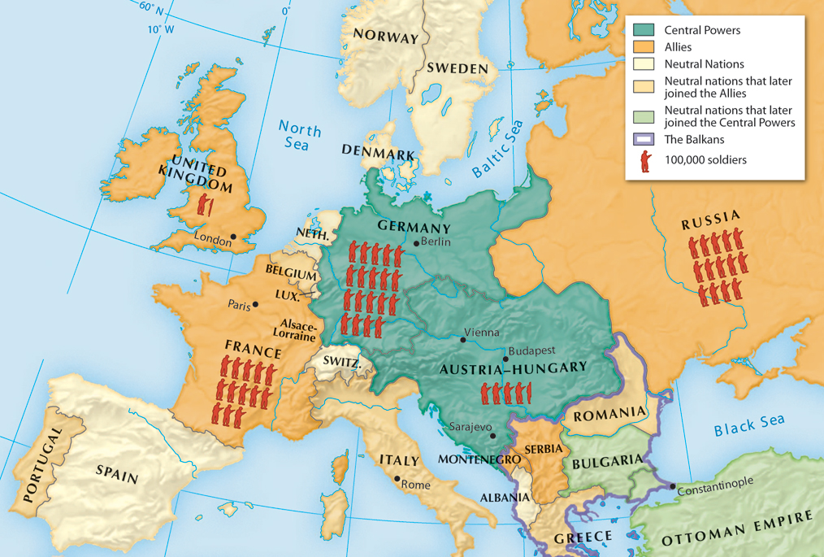
These alliances were based on previous wars, new economic rivalries, and competition for colonies.
These rivalries increased militarism, and the great powers began to increase the size of their armies and navies.
Notes:
4

Slide 5
Growing nationalism and economic competition also caused tensions within countries and across European borders.
Austria-Hungary and the Ottoman empire were threatened by nationalism and struggled to survive.
Britain was threatened by Germany’s industrial advances. Germany believed that Russian industry was not far behind them.
Notes:
5

Slide 6
Nationalism grew in different ways in each country in Europe.
France was bitter about the loss of Alsace and Lorraine during the Franco-Prussian War and wanted it returned.
Russia supported Pan-Slavism, which held that all Slavic people, regardless of borders, shared a common nationality.

Slide 7
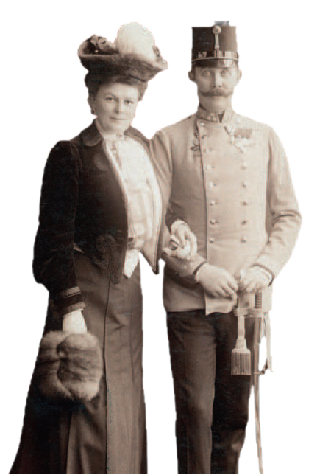
The Great War began when Austrian Archduke Francis Ferdinand and his wife Sophie were assassinated by a Serbian nationalist.
Shortly after, on July 28, 1914, after issuing
an ultimatum, Austria declared war on Serbia.
Notes:
7

Slide 8
The war between Austria and Serbia soon drew the great powers into the conflict.
Serbia sought help from its ally Russia, who began
to mobilize.
Germany declared war on Russia.
France gave backing to Russia, despite German demands that it stay out of the conflict.
Notes:
8

Slide 9
Germany declared war on France.
Days later, Germany marched through Belgium and headed south to attack France.
With Belgium’s neutrality violated, Britain declared war on Germany on August 4.
Horrible Histories explains how WWI began
Notes:
9

Slide 10
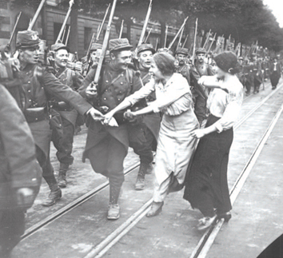
At the onset, the war brought a renewed sense of patriotism.
Young men rushed to enlist in what seemed like an exciting adventure.
Patriotic fever helped governments divert
attention from labor
disputes or nationalist disturbances within
their borders.
Notes:
10

Slide 11

Why and how did World War I begin
in 1914?
Notes:
11

Slide 12
Why and how did World War I begin
in 1914?
By 1914, Europe had enjoyed a century of relative peace. Two alliances were formed with the intention of keeping that peace.
When the Austrian Archduke was assassinated
a local conflict became an international war because of alliance obligations.
Notes:
12

Slide 13
26-2
A New Kind of War

Slide 14
Germany utilized their Schlieffen Plan to attack France. The plan failed.
The goal was to create a quick victory in the west while Russia was mobilizing and thus avoid a two-front war.
Russia mobilized on the Eastern Front more quickly than Germany had expected.
German generals responded by shifting troops from the Western Front to fight the Russians.
The British fought with French troops in the Marne, making a quick German victory impossible.

Slide 15
Both sides dug vast systems of deep trenches for protection, creating a four-year-long deadly stalemate on the Western Front.
The area between opposing trenches became a “no man’s land.”
Each side would launch attacks and counterattacks but very little territory would be gained.
Notes:
15

Slide 16
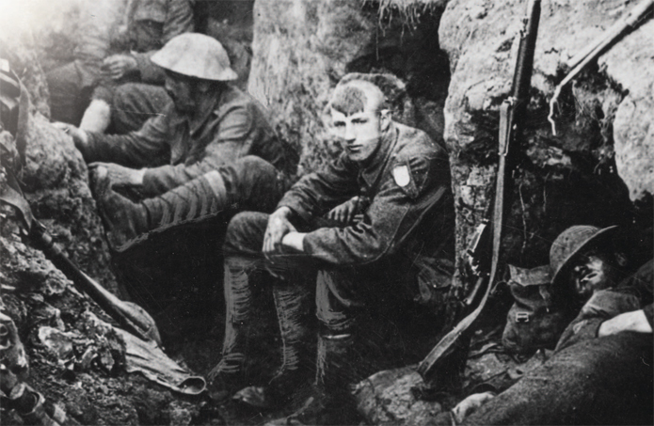
Millions of soldiers ate, slept, and fought in the trenches.
Horrible Histories
In the Trenches
Notes:
16

Slide 17
Newly developed weapons made the fighting
much more deadly. In some battles, hundreds
of thousands were killed.
Weapon
Results
Rapid-fire machine guns
Waves of soldiers were mowed down.
Long-range artillery guns
Flying debris killed or wounded many.
Poison gas
Blinding and choking caused many fatalities.
Notes:
17

Slide 18
New technology changed the sites of battles,
from the ground to the air and under water.
Technology
Results
Tanks
Moved above and through trenches
Zeppelins
Observed enemy movements
Airplanes
Engaged in dramatic fights but did not affect the outcome of the war
U-boats
Sank ships carrying vital supplies; Allies organized convoys to defend against them
Notes:
18

Slide 19
On the Eastern Front, the casualties were also
high and the outcome was just as indecisive.
Russia suffered disastrous losses.
Russia was not as industrialized as other European nations. Soldiers were poorly equipped but were sent out anyway, sometimes even without rifles.
Notes:
19

Slide 20
Fighting broke out in the Balkans and southern Europe in 1915.
Bulgaria sided with the Central Powers against Serbia.
Romania joined the Allies to fight against Hungary.
Italian troops joined the Allies in 1915, but needed help from British and French troops to protect their positions.
Notes:
20

Slide 21
The Ottoman empire sided with the Central Powers in late October 1914. They soon cut off a crucial Allied supply route to Russia.
The Allies became trapped trying to open up the Dardanelles connecting the Black Sea to the Mediterranean.
The Allies suffered defeat and withdrew after sustaining more than 200,000 casualties.
Notes:
21

Slide 22
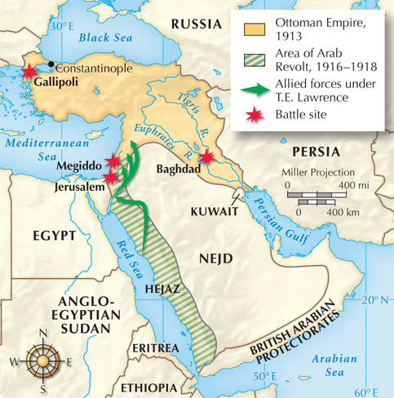
Turkish Armenians, living in the Ottoman empire, tried to help the Russians and as a result endured massacres and deportations.
The Ottoman empire also faced an Arab uprising in the Middle East.
After fighting with British troops led by T. E. Lawrence, the Ottoman empire lost territory to Arab nationalists.
Notes:
22

Slide 23
World War I spread to include many European colonies throughout the world:
French West Africa
India
Australia
New Zealand
Canada
Notes:
23

Slide 24
How and where was World War I fought?
Notes:
24

Slide 25
How and where was World War I fought?
New weapons such as tanks, airplanes, and submarines changed the way war was fought. In addition, the stalemate created by trench warfare made this the deadliest conflict in history up to that time.
The Great War was called World War I because it was fought primarily in Europe but spread to the colonies, Asia, and the Middle East.
Notes:
25

