Slide 1
Unit 11
WWI and the Russian Revolution
Part 2

Slide 2
26-3
Winning the War

Slide 3
The nations involved in World War I needed to commit to a strategy of total war to support a modern mechanized war. They:
Imposed universal military conscription
Set up systems to arm, transport, and supply armies
Raised taxes and borrowed money
Rationed food and other products
Set prices and forbade strikes
Notes:
3

Slide 4
International law permitted wartime blockades to confiscate contraband, but not items such as food.
Britain’s navy blocked ships from carrying any goods to Germany, and many Germans went hungry.
In 1915, Germany said
it would use U-boats to sink all ships carrying goods to Britain.

Slide 5
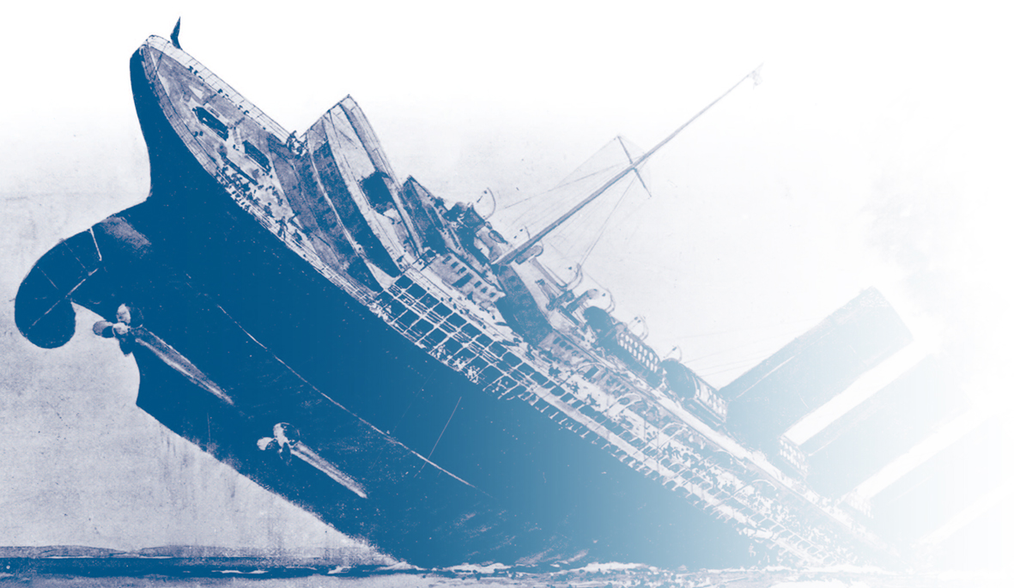
A German U-boat torpedoed and sank the British passenger ship Lusitania in May 1915.
U.S. President Woodrow Wilson threatened to cut off diplomatic relations with Germany over the issue.
Germany agreed to warn passenger ships, thus stopping submarine warfare for the moment.

Slide 6
Both sides in the conflict waged a
propaganda war. They:
Exhorted civilians to enlist or to loan money to the government
Played up atrocities committed by the
opposing side
Censored the press and the arts to keep upsetting war news from the public
Notes:
6

Slide 7
Total war meant that women had to take over the jobs of men who left to serve in the military.
War industries
Manufacturing
Nursing
Farming
Armed forces
Women worked in:
Their work helped convince many governments to finally give them the vote.
Notes:
7

Slide 8
In 1917, as morale fell, soldiers from many countries began to mutiny or revolt, and civilians called for peace.
In Russia the protests set off a revolution that brought down the Russian monarchy.
Early in 1918, Russia’s new leader signed a treaty with Germany that withdrew Russia from the war.
Russia’s withdrawal meant that Germany only needed to fight on the Western Front.
Notes:
8

Slide 9
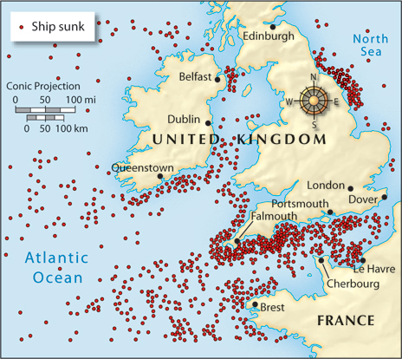
Before Germany could strike a decisive blow,
the United States joined the war.
Cultural ties between
the U.S. and the Allies
were strong.
Germany resumed U-boat attacks in early 1917.
The 1917 Zimmerman
note proved Germany
was trying to rally Mexico against the U.S.
Ships sunk by U-boats,
May 1917–Jan. 1918
Notes:
9

Slide 10
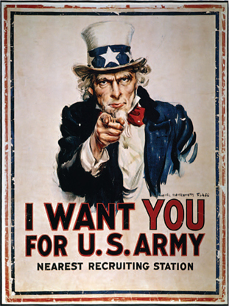
In April 1917, President Wilson asked the United States Congress to declare war on Germany.
Before the Americans arrived, Germany made one last big push on the Western Front.
Notes:
10

Slide 11
By 1918, two million U.S. soldiers had joined
the fighting on the Western Front and helped reverse any gains the Germans had achieved.
German generals told William II that the war could not be won; William II fled into exile in
the Netherlands.
Austria-Hungary was already on the verge of collapse. The empire broke apart.
Bulgaria and the Ottoman empire asked for peace.
Notes:
11

Slide 12
The new German government sought an armistice with the Allies, and the Great War officially ended on November 11, 1918.
Wilson’s Fourteen Points included:
  Freedom of the seas
  Free trade
  Arms reductions
  An end to secret treaties
  Self-determination for Eastern Europe
  An association of nations to keep
  the peace
Hoping to resolve WWI and all future wars, Wilson urged adoption of his Fourteen Points.
Notes:
12

Slide 13

How did the Allies win World War I?
When Russia exited the war, Germany gained ground against the Allies because the Germans were no longer fighting on two fronts.
Once the Americans joined on the side of the Allies, however, they were able to reverse the German gains and then push the Germans back out of France and Belgium. The German generals told their government that they could not win.
Notes:
13

Slide 14
26-4
Making the Peace

Slide 15
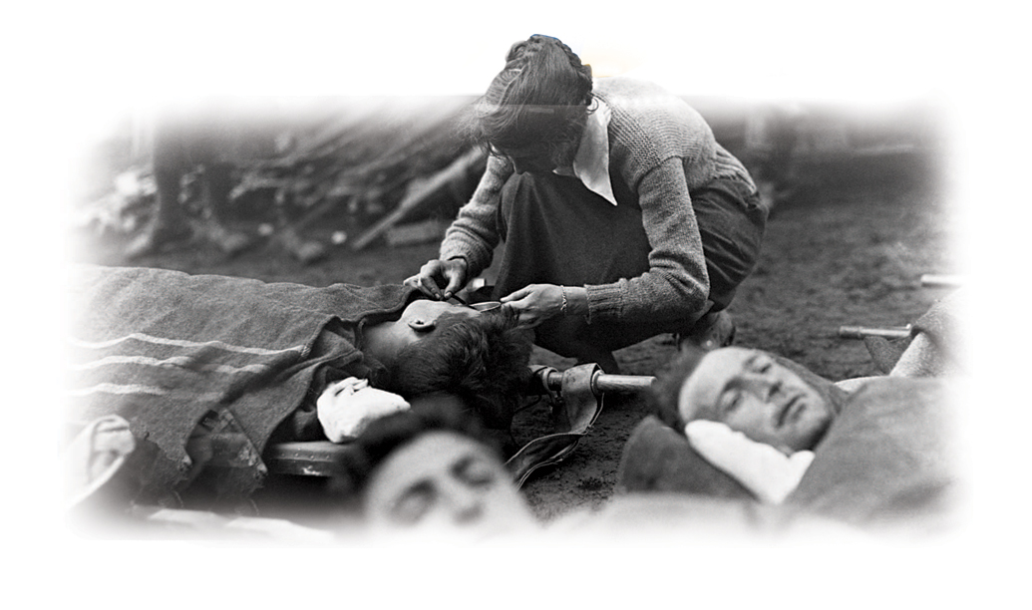
All nations faced the devastation caused
by World War I.
More than 8.5 million men died and more than
16 million were wounded fighting in the war.
Many of the wounded were disabled for life.
Six to thirteen million civilians also died in the war.
Many others became refugees.

Slide 16
Buildings all over Europe had been bombed into rubble.
Countries faced huge war debts and the cost of reconstruction.
Refugees had to rebuild.
The situation was worsened by a 1918 influenza pandemic that killed 20 million people worldwide.

Slide 17
The governments in Russia, Germany, Austria-Hungary, and the Ottoman empire had collapsed under the stresses of war.
Political radicals dreamed of instituting new social and political systems, including bolshevism (communism).
Colonial troops hoped for independence for their occupied countries.

Slide 18
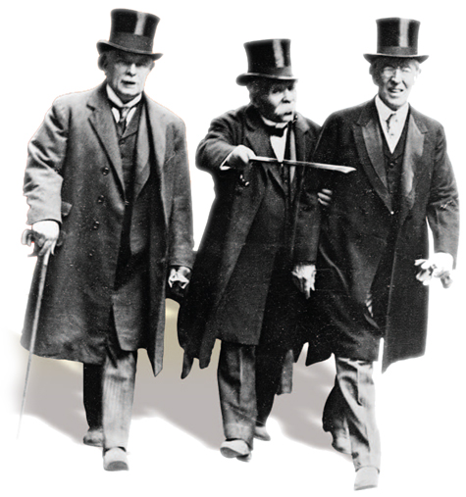
British Prime Minister David Lloyd George, French Prime Minister Georges Clemenceau, and U.S. President Woodrow Wilson met at the Paris Peace Conference after the war ended.

Slide 19
The Paris Peace Talks
The three leaders met with the leaders of the other Allied countries to discuss the fate of Europe, the former Ottoman empire, and various colonies.
The Central Powers and Russia were not allowed to take part in the negotiations at the conference.

Slide 20




Goals of the Allies at the Paris Peace Conference
 | Woodrow Wilson | “Peace without victory” based on the Fourteen Points
 | David Lloyd George | Money to rebuild and improve Britain
 | Georges Clemenceau | A weakened Germany
 | Vittorio Orlando | Italian ownership of lands promised
People of Eastern European empires |  | National states of their own

Slide 21
In June 1919, the Allies forced Germany
to sign the Treaty of Versailles.
The German delegates were horrified because the Allies:
Forced Germany to accept full blame for the war Imposed reparations of $30 billion on Germany Severely limited the size of the German military Took land and overseas colonies from Germany

Slide 22
The Allies drew up separate treaties with the other Central Powers. New countries were created.
Poland
Latvia, Lithuania, and Estonia
Czechoslovakia, Austria, and Hungary
Yugoslavia
The treaties denied independence to European colonies, making them mandates instead.

Slide 23
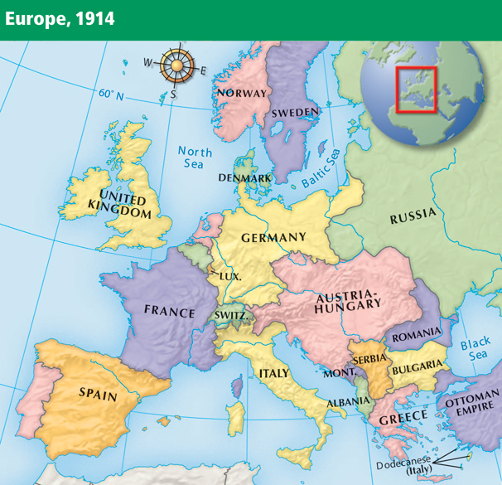
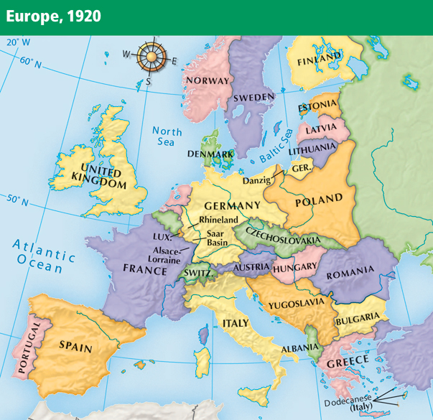
Notes:
23

Slide 24
Many of President Wilson’s Fourteen Points were not implemented in the treaties.
Germany, the other Central Powers, and other countries and colonies were angered by their treatment.
German resentment of the Treaty of Versailles would later spark World War II.

Slide 25
Wilson did succeed in establishing the League of Nations, a group of more than 40 countries formed to negotiate disputes in an effort to avoid future wars.
Although the League offered collective security, the U.S.
Senate refused to ratify the Treaty of Versailles.
The United States never joined the League of Nations.

Slide 26
What factors influenced the peace treaties that ended World War I, and how did people react to the treaties?
The Allies wanted to punish Germany and the Central Powers. The United States came to the negotiations wanting to create a lasting peace and offer Eastern Europeans self-determination.
Germans were shocked at the reparations
they were faced with.

