Slide 1
Unit 11
WWI and the Russian Revolution
Part 3

Slide 2
26-5
Revolution and Civil War in Russia

Slide 3
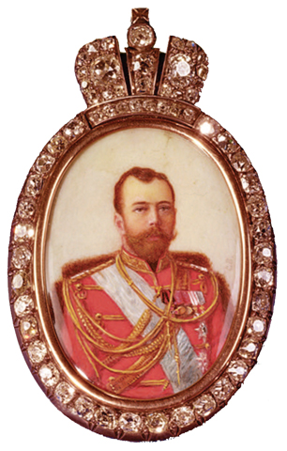
Despite talk of reform after the Revolution of 1905, Tsar Nicholas
did little to solve Russia’s problems.
Rulers lived in luxury while their people lived in poverty.
Corruption was rampant.
The Duma had no real power.
Tsar Nicholas II
Notes:
3

Slide 4
WWI united many Russians, but the war strained the country’s mismanaged resources.
Factories couldn’t produce enough military supplies.
The transportation system couldn’t deliver food
and supplies to the battlefields.
Many soldiers had no guns and no ammunition.
Millions of soldiers died.
Notes:
4

Slide 5
People lost confidence in the government.
Tsar Nicholas traveled to the front but proved to be a poor military leader.
Tsarina Alexandra ignored continued food and fuel shortages at home.
The tsarina’s reliance on the “mad monk” Rasputin further eroded public confidence in the government.
Notes:
5

Slide 6
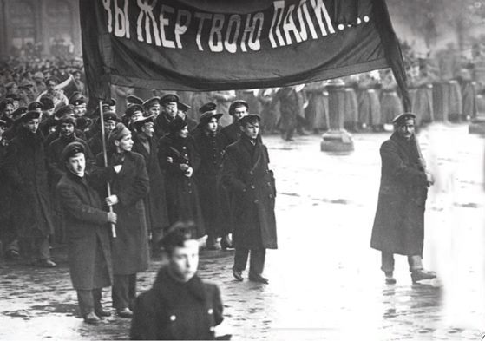
In March, 1917, workers went on strike, and people filled the streets chanting, “Bread, bread!”
Notes:
6

Slide 7
With disaster on the battlefield and protests at home, Nicholas abdicated.
The Duma set up a temporary government and began to write a constitution to create
a Russian republic.
Revolutionaries had other ideas.
Notes:
7

Slide 8
There were two socialist revolutionary groups
in Russia.
Mensheviks | Bolsheviks
Favored gradual reform Favored higher wages, increased suffrage, and welfare programs | Believed in radical change Favored total revolution
Notes:
8

Slide 9
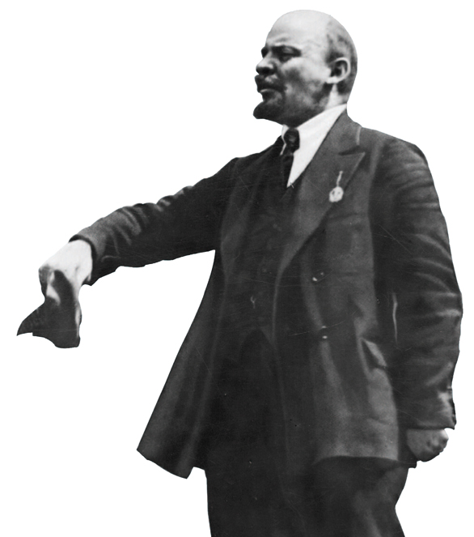
The Bolsheviks were led by
V. I. Lenin, a Marxist, who:
Called for workers to unite
and overthrow capitalism
Spoke of unity among
workers and farmers
Promised peace,
food, and land
Notes:
9

Slide 10
In November 1917, Lenin’s followers seized power. The Bolsheviks, renamed Communists, made changes quickly.
Changes under Lenin
Ended private ownership of land
Gave land to peasants
Gave control of factories and mines to workers
Withdrew from WWI
Notes:
10

Slide 11
A brutal civil war broke out between the Communists, known as “Reds,” and their opponents, known as “Whites.”
Trotsky created a Red Army using former tsarist officers led by commissars. The army was well led and well positioned in the center of Russia against the Whites.
In 1918, the former tsar and tsarina were shot. In 1920, the Red Army won and took control of Russia.

Slide 12
In the early years of the revolution, Lenin adopted a policy of “war communism” and took over banks, mines, factories, and railroads.
This policy brought the economy to near collapse, and many suffered.
Lenin changed course. His New Economic Policy, a compromise with capitalism, helped the economy recover.
Notes:
12

Slide 13
War Communism | New Economic Policy
State-controlled banks, mines, factories, and railroads | State-controlled banks, trade, and large industries
Small businesses forced to give profits to the state | Small businesses allowed to keep some profits
Farmers forced to give crops to feed the army or the poor | Farmers allowed to sell surplus crops for profit
Notes:
13

Slide 14
In 1922, Lenin united Russian lands into the Union of Soviet Socialist Republics and adopted a new constitution.
The government had an elected legislature.
Citizens were given the right to vote.
Workers were given control of the means of production.
Notes:
14

Slide 15
Realizing that there was no proletariat in Russia, Lenin created a government where the Communists were the leaders, not the people.
Russians lived in fear of secret police and prison camps.
Lenin died in 1924. His successor, Joseph Stalin, would prove to be a more ruthless dictator than any of those before him.
Notes:
15

Slide 16

How did two revolutions and a civil war bring about Communist control of Russia?
During the war years, Russia faced increased problems at home. Initially, the goals of the revolution were to end the war and solve the problems that the Revolution of 1905 had not.
The March Revolution brought the overthrow of
the tsar and the November Revolution brought
the end of the provisional government. Lenin and his successor, Stalin, created a Communist Russia.
Notes:
16

