Slide 1
Unit 12
Interwar Period
28-3
Fascism in Italy

Slide 2
Terms and People
fascism – any centralized, authoritarian government that is not communist whose policies glorify the state over the individual
and are destructive to basic human rights

Slide 3
Peasants seized land.
Workers went on strike
or seized factories.
Returning veterans
faced unemployment.
Trade declined.
Taxes rose.
The government split
into feuding factions.
Following World War I, Italy was in chaos.
Notes:
3

Slide 4
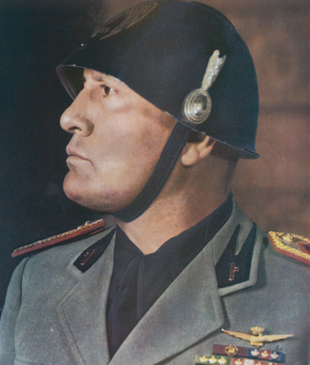
As a young man, Benito Mussolini had rejected socialism for extreme nationalism. He was a fiery
and charismatic speaker.
His followers, the Black Shirts, used intimidation and terror to oust elected officials.
After the March on Rome, Mussolini was asked
to become Italy’s prime minister.

Slide 5
Suppressed rival parties
Muzzled the press
Rigged elections
Replaced elected officials with his supporters
By 1925, Mussolini had taken the title “The Leader” and ruled Italy as a dictator. He:

Slide 6
Mussolini preserved capitalism, but took control
of the state. He favored the wealthy at the expense of the workers.
Men were urged to be selfless warriors fighting for Italy.
Women were pushed out of paying jobs to bear more children.
Children were taught to obey strict military discipline.
To Fascists,
the glorious state was
all-important.
Notes:
6

Slide 7
Mussolini built the first totalitarian state in which he regulated every aspect of the peoples’ lives.
Fascism encouraged extreme nationalism and loyalty to the state.
It glorified violence, war, and discipline.
It aggressively pursued foreign expansion.
Notes:
7

Slide 8
Features of German, Russian, and Italian Totalitarian States
Single-party dictatorship with blind obedience to a leader
State control of the economy
Use of police spies and terror to enforce the will of the state
Government control of the media
Use of schools to spread ideology to children
Strict censorship of artists and intellectuals

Slide 9
For many in Italy, fascism promised a strong stable government and an end to the political feuding.
Mussolini projected a sense of power and confidence
that was welcome amid the disorder and despair of postwar Italy.
Once Mussolini embarked on foreign conquest, Western democracies protested.
Notes:
9

Slide 10
Fascists were sworn enemies of socialists and communists, yet they shared some goals.
Fascists | Communists
Pursued nationalist goals | Worked for international change
Supported a society with defined classes | Spoke of creating a classless society
Blind devotion to the state | Blind devotion to the state
Used terror for power | Used terror for power
Flourished in economic hard times | Flourished in economic hard times
Rule by an elite | Rule by an elite
Notes:
10

Slide 11
Three governmental systems competed for influence in postwar Europe.
Democracy in Britain and France
Communism in Russia and elsewhere
Fascism in Italy
With the Great Depression and the difficulties that faced the Western democracies, other nations looked to fascist leaders for guidance.
Notes:
11

Slide 12

How and why did fascism rise in Italy?
After World War I, Italy faced economic chaos and political corruption. The country was ripe for an ambitious strongman to rise to power.
Benito Mussolini’s rejection of socialism for intense nationalism brought him a unique coalition of the upper and middle classes and veterans. By bringing the economy under state control, he helped Italy avoid many of the other European states’ internal problems.
Notes:
12

