Slide 1
Unit 12
Interwar Period
28-5
Hitler and the Rise of Nazi Germany

Slide 2
In 1919, moderate German leaders created
a democratic government known as the Weimar Republic.
The Weimar Republic had:
A chancellor, or prime minister
A constitution
A parliamentary system
A bill of rights
A provision allowing women to vote
Notes:
2

Slide 3
The Weimar government was seen as weak because it had signed the Treaty of Versailles.
Communists demanded
radical changes.
Conservatives attacked the government as too liberal.
Germans of all classes hated the Versailles treaty.
The German people looked for scapegoats for their troubles. Many blamed German Jews.
Notes:
3

Slide 4
In 1923, economic disaster fed the unrest.
Germany fell behind in reparation payments,
so France occupied the Ruhr Valley.
Workers in the Ruhr refused to work but were paid with German money the government didn’t have.
Inflation spiraled out of control and the German mark became worthless.
Many middle-class families saw their savings wiped out.
Notes:
4

Slide 5
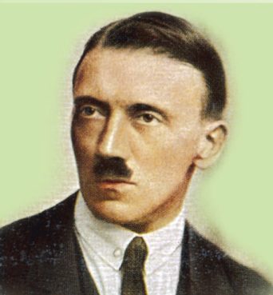
In 1924, with help from Western powers, Germany began to recover and prosper. In 1929, the Great Depression hit Germany.
Germans turned
to an energetic leader, Adolf Hitler.
Hitler had fought in the German army in World War I. By 1919, he was the leader of the National Socialist German Workers, or Nazi, party and worked against
the Weimar government.
Notes:
5

Slide 6
Imprisoned in 1923 for a failed attempt to seize power, Hitler wrote Mein Kampf, which outlined Nazi goals and ideologies.
Hitler’s Ideology | Hitler’s Reasons for German Defeat in WWI
Extreme nationalism Anti-Semitism Germans as a superior master race Racism | Marxists Jews Corrupt politicians Business leaders
Notes:
6

Slide 7
Hitler urged Germans everywhere to unite into one great nation under his leadership.
At the beginning of the Great Depression the Nazi party grew to almost a million.
Hitler promised to create jobs, end reparations, and defy the Versailles treaty by rearming Germany.
Notes:
7

Slide 8
Hitler was appointed chancellor in 1933, and within a year, he was dictator of Germany. He demanded unquestioning obedience.
Hitler planned a Third Reich that
would dominate Europe for a thousand years.
To achieve his goals, he organized an efficient but brutal totalitarian rule enforced by the Gestapo.
Notes:
8

Slide 9
In 1935, he set out to deprive Jews of German citizenship through the Nuremberg Laws.
Could not marry non-Jews
Could not attend or teach school
Were banned from government jobs
Were banned from practicing law or medicine
Could not publish books
The Nuremberg Laws restricted Jewish life in Germany. Jews:
Many German Jews fled, seeking refuge in other countries.
Notes:
9

Slide 10
On November 9 and 10, 1938, Hitler used a minor incident as an excuse to stage an attack on all Jews.
On the night known as Kristallnacht, Jewish communities were attacked all over Germany, Austria, and Czechoslovakia
Hitler and his henchmen then started making plans for a “Final Solution” where all Jews would be exterminated.

Slide 11
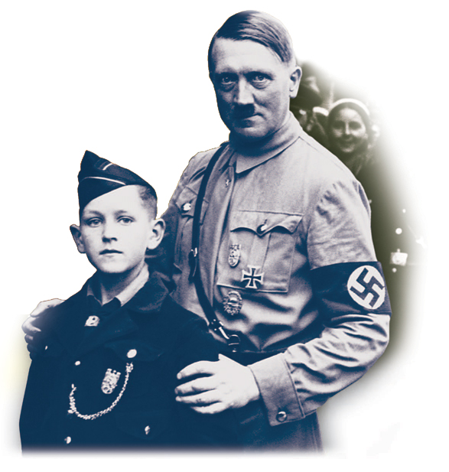
To build for the future,
the Nazis indoctrinated young people with their ideology. Hitler urged young Germans to
pledge absolute loyalty
to Germany and to
destroy their enemies.
Notes:
11

Slide 12
Hitler and the Nazis also sought to “purify” German culture.
They condemned jazz and modern art.
They sought to replace Christianity with Hitler’s racial creed.
They closed Catholic schools and limited clergy.
They glorified German myths.

Slide 13
As in Germany, new nations in Eastern Europe moved from democracy to authoritarian rule
after World War I.
These small countries lacked the capital to develop industry.
Each country tried to be independent from its neighbors.
None had much experience with the democratic process.
Eventually, right-wing dictators emerged in most of these countries.
Notes:
13

Slide 14

How did Hitler and the Nazi party establish and maintain a totalitarian government
in Germany?
After World War I ended, the German government crumbled under the threat of a socialist revolution.
Moderate leaders created a democratic government which was unable to manage Germany’s problems. Hitler and his Nazi party rose to power.
Notes:
14

