Slide 1
Unit 13 World War 2
Chapter 29 Section 1
From Appeasement to War

Slide 2
Dictators took aggressive action in the 1930s.
Japan | Military leaders | Overran much of eastern China
Germany | Hitler | Rebuilt the military and invaded the Rhineland
Italy | Mussolini | Invaded and conquered Ethiopia

Slide 3
Western democracies denounced these invasions but chose a policy of appeasement, for several reasons:
France could not take on Hitler without British support, and Britain did not want to confront him.
Both countries viewed Hitler’s fascism as a defense against the spread of Soviet communism.
The Great Depression led to widespread pacifism.

Slide 4
Italy, Germany, and Japan became the
Axis powers.
The Axis agreed to
fight Soviet communism and not to interfere
with each other’s territorial expansion.
By the mid-1930s, the antidemocratic aggressive powers formed an alliance.

Slide 5
In 1936, a conservative general, Francisco Franco, led a revolt in Spain that touched off a bloody civil war.
Nationalists | Fascists and the right wing | Supported conservative Franco
Loyalists | Communists, socialists, and those wanting democracy | Supported the republic

Slide 6
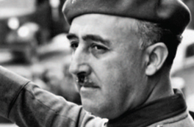
More than 500,000 lives were lost in the ruinous struggle. By 1939, Franco had triumphed. He created a fascist dictatorship similar to those of Hitler and Mussolini. He used terror
to maintain his power.
Francisco Franco

Slide 7
Meanwhile, Hitler pursued his goal of bringing all German-speaking people into the Third Reich. He threatened to annex the Sudetenland.
At the Munich Conference in 1938, British and
French leaders surrendered to Hitler’s demands.
After the conference, British Prime Minister
Neville Chamberlain told a cheering crowd that
he had achieved “peace for our time.”

Slide 8
Europe rapidly plunged toward war.
Hitler broke his promises, and the democracies accepted that appeasement had failed.
In August 1939, Hitler and Stalin announced the Nazi-Soviet Pact. This was a shaky alliance and neither Hitler nor Stalin trusted each other.
Notes:
8

Slide 9
On September 1, 1939, a week after the
Nazi-Soviet Pact, German forces invaded Poland.
Two days later, Britain and France declared war on Germany.
World War II
had begun.
Notes:
9

Slide 10
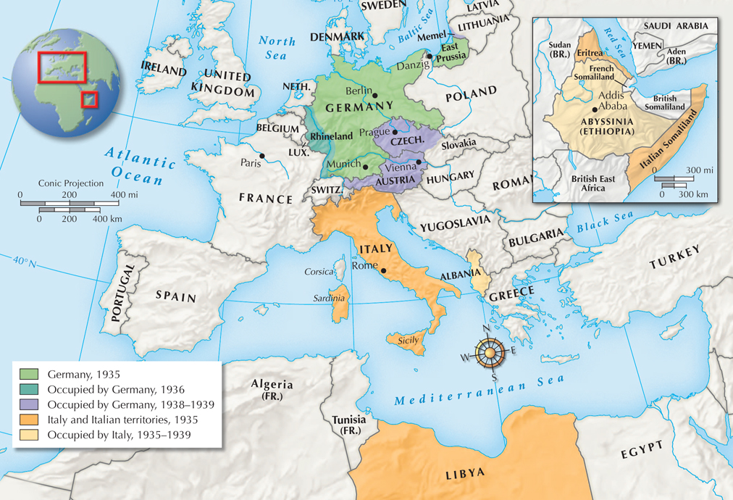
Aggression in Europe and Africa to September 1939
Notes:
10

Slide 11

What events unfolded between Chamberlain’s declaration of “peace for our time” and the outbreak of a world war?
After the horrors of World War I, Western democracies tried to preserve peace.
However, Germany, Italy, and Japan were preparing to build new empires, and the world was headed to war again.

