Slide 1
Unit 13 World War 2
Chapter 29 Section 2
The Axis Advances

Slide 2
The German air
force, the Luftwaffe, bombed airfields, factories, and cities
in Poland. Then, fast-moving tanks and troops pushed their
way in from the west.
Meanwhile, Stalin’s forces invaded Poland from the east. Within a month, Poland ceased to exist.

Slide 3
Hitler waited out the winter. Then
in the spring of 1940, German forces attacked Norway, Denmark, the Netherlands, and Belgium.
Next, German troops poured into France, trapping the retreating British forces at Dunkirk.
British vessels crossed the English Channel and ferried
more than 300,000 British troops to safety.

Slide 4
Germany continued to attack Western Europe.
German forces headed to Paris. With Italy attacking from the south, France was forced to surrender.
Next Hitler set his sights on Britain, calling this target “Operation Sea Lion.”
In September of 1940, the Luftwaffe began 57 straight nights of showering high explosives and firebombs on London.
Notes:
4

Slide 5
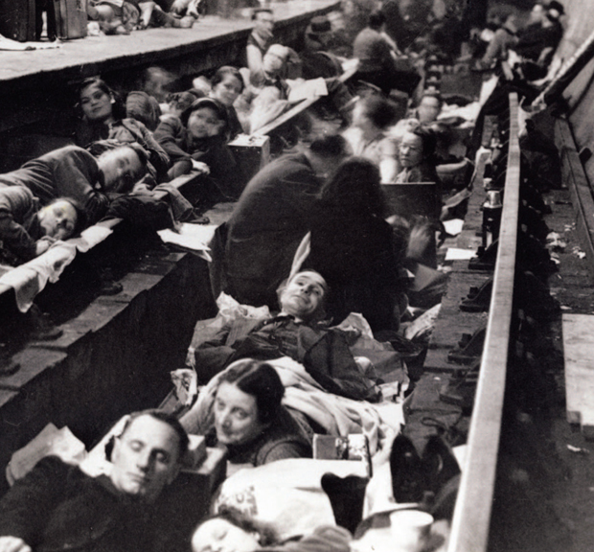
London did not break under the blitz. Citizens carried on their daily lives, seeking protection in shelters and subways. The Luftwaffe could not gain superiority over Britain. Operation Sea Lion was a failure.

Slide 6
Hitler seemed unstoppable.
Axis armies also pushed into North Africa and the Balkans.
In addition, they invaded Greece, Yugoslavia, Bulgaria, and Hungary.
By 1941, the Axis powers or their allies controlled most of Europe.

Slide 7
In June 1941, Hitler broke the Nazi-Soviet Pact when he attacked the Soviet Union.
The attack stalled during the winter when thousands of unprepared Germans froze to death.
Leningrad withstood the attack. Stalin made an agreement to work with Britain.

Slide 8
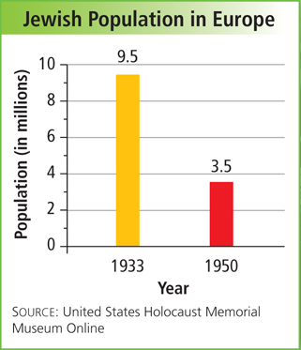
As Hitler’s forces conquered most of Europe,
the Nazis sent millions of Jews and political opponents to concentration camps.
They also targeted Slavs, Gypsies, homosexuals, and the disabled as “racially inferior.” The scale and savagery of the Holocaust are unequaled in history.

Slide 9
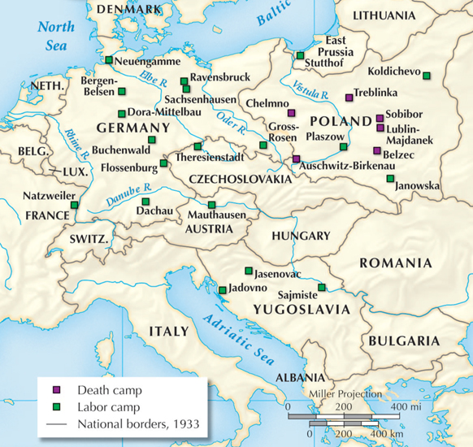
The Nazis ran labor camps and death camps throughout
their conquered territory in Europe.

Slide 10
At the beginning of the war, the
United States declared its neutrality.
However, in August 1941, President Roosevelt met secretly with Britain’s Churchill.
They created the Atlantic Charter, which
established the goal of destroying the Nazi reign.
Meanwhile, tensions between the United States and Japan grew.

Slide 11
The United States declared war on Japan after Japanese airplanes bombed the American fleet
in Hawaii at Pearl Harbor on December 7, 1941.
On December 11, Germany and Italy, Japan’s allies, declared war on the United States.
Japan’s thirst for expansion led them deeper into Asia as
the United States mobilized for war.
Notes:
11

Slide 12
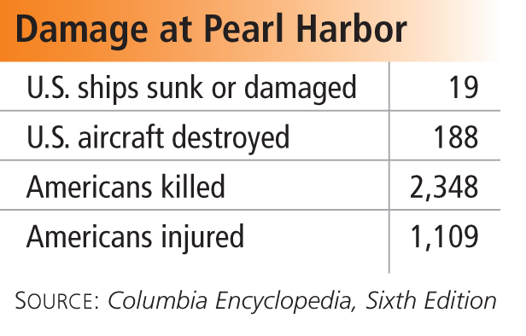
The Japanese attack on Pearl Harbor brought the United States into World War II.

Slide 13

Which regions were attacked and occupied by the Axis powers, and what was life like under their occupation?
Diplomacy and compromise did not bring peace with Nazi Germany, Fascist Italy, or imperial Japan.
The Axis powers advanced, attacking countries in eastern and western Europe. In the Pacific, Japan captured countries and colonies on the islands and the mainland of Asia. The Axis powers brought misery to the peoples they conquered.

