Slide 1
Unit 13 World War 2
Chapter 29 Section 3
The Allies Turn the Tide

Slide 2
The allies had to commit to total war, a policy in which nations use all of their resources for the war effort.
The United States raised money by selling bonds and regulating prices.
Factories ceased producing consumer goods and turned out airplanes and tanks instead.
Although shortages meant consumers learned to live with less, the increase in production ended the unemployment of the Depression era.

Slide 3
British and American women served in the armed forces in many auxiliary roles:
Driving ambulances
Delivering airplanes
Decoding messages
The Allies mobilized all of their resources for
the war effort.

Slide 4
The turning point in the war was the significant victories of 1942-1943.
Pacific front | The Japanese Navy suffered a serious setback in the Coral Sea. Four Japanese carriers and 250 planes were destroyed at Midway.
European front | In North Africa, Allied forces drove Axis powers back into Tunisia. In southern Italy, Allied forces defeated Italian forces.

Slide 5
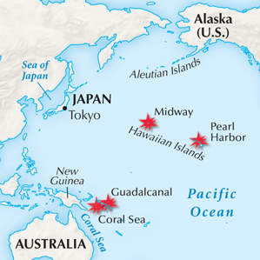
Allied victories in the Pacific in 1942 helped to turn the tide of the war.

Slide 6
The Allies planned their strategy.
The “Big Three”—Roosevelt, Churchill, and Stalin—agreed to focus on finishing the war in Europe before trying to end the war in Asia.
Though the Allies distrusted one another— Churchill and Roosevelt feared Stalin, and Stalin feared the destruction of communism—the unsteady alliance continued.
Notes:
6

Slide 7
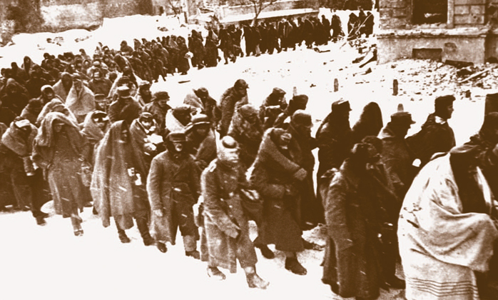
Hitler launched an offensive to gain the rich oilfields of the Soviet Union. His troops got only as far as Stalingrad, where Hitler’s forces suffered terrible losses of troops and equipment.
German prisoners marched to Stalingrad after their defeat by the Soviet army.

Slide 8
By 1944, the Allies were ready to invade France. To prepare,
Allied bombers targeted and destroyed railroads and bridges.
The invasion, known as
D-Day, occurred on June 6, 1944. Allied forces
broke through German lines
and advanced
to Paris.
By the
end of the summer, all of France was free.

Slide 9
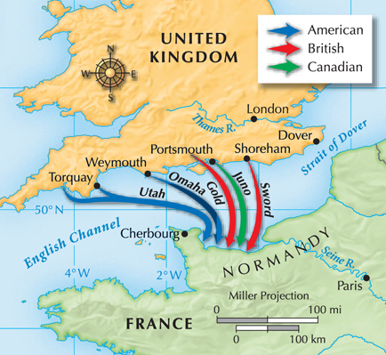
Allied forces landed at the beaches of Normandy, France, on
June 6, 1944.

Slide 10
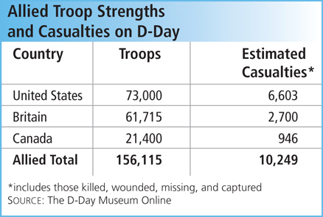
Overcoming German
defenses on the
beach proved
very challenging,
but the Allies were successful.

Slide 11
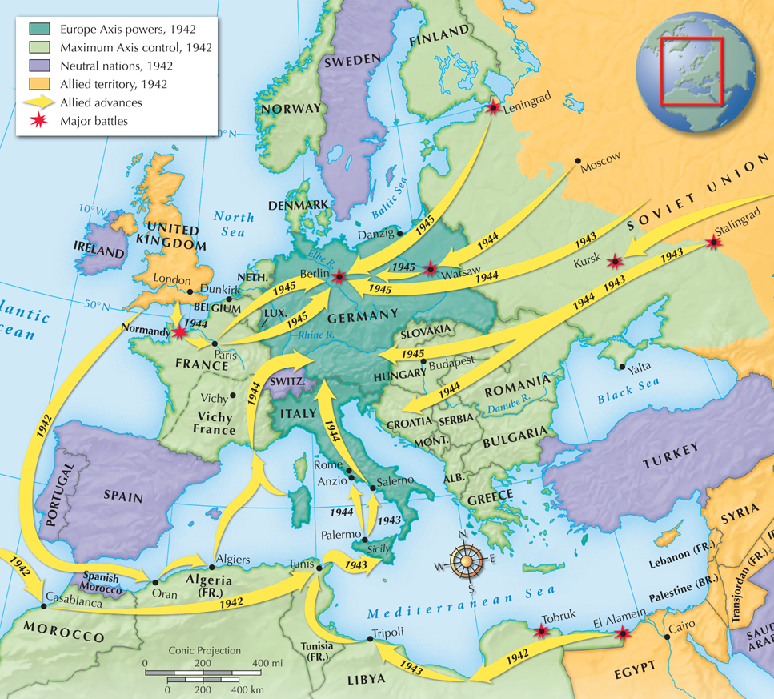
By this time, Germany was reeling under round-the-clock bombing.
After freeing France, Allied forces battled by land into Germany.
By early 1945 Germany’s defeat seemed inevitable.

Slide 12
They agreed that the Soviet Union would enter the war against Japan within three months of Germany’s surrender.
In 1945, Roosevelt, Churchill, and Stalin met for the Yalta Conference.
Additional agreements were made, including the split of Germany into four zones governed by the United States, Britain, France, and the Soviet Union.

Slide 13

How did the Allies begin to push back the Axis powers?
By 1942, the Allies were in trouble. Germany was bombing Britain relentlessly, German forces had pushed far into the Soviet Union, and
the Japanese were advancing in the Pacific.
However, through extraordinary efforts and a few key victories, the tide of the war began
to turn. American forces battered the Japanese navy, and the Germans were defeated at Stalingrad and in North Africa.

