Slide 1
Unit 13 World War 2
Chapter 29 Section 4
Victory in Europe and the Pacific

Slide 2
In the spring of 1945, the Nazis were surrounded and defeated.
From the west, Allies surged into Germany and from the east, and Soviet troops closed in on Berlin.
In Italy, guerrillas captured and executed Mussolini. Hitler committed suicide.
The Allies proclaimed May 8, 1945, V-E Day.

Slide 3
Germany’s geographic location left it open to invasion from
all sides.
Hitler made some poor military decisions.
The Soviet army proved far stronger than expected.
The United States had an enormous capacity for industrial production.
There were several reasons why the mighty Axis powers fell to the Allies.

Slide 4
With victory in Europe, the Allies turned to defeating Japan in the Pacific.
Until mid-1942,
the Japanese
were undefeated
in battle.
However, after the battles of Midway and the Coral Sea, the United States took the offensive.

Slide 5
In the summer of 1942, the U.S. Marines defeated the Japanese at Guadalcanal. Led by General Douglas MacArthur, they moved north toward Japan.
As the Allies poured all of their resources into defeating Japan, bloody battles ensued.
Kamikaze pilots undertook suicide missions, attempting to crash their planes into
American warships.

Slide 6
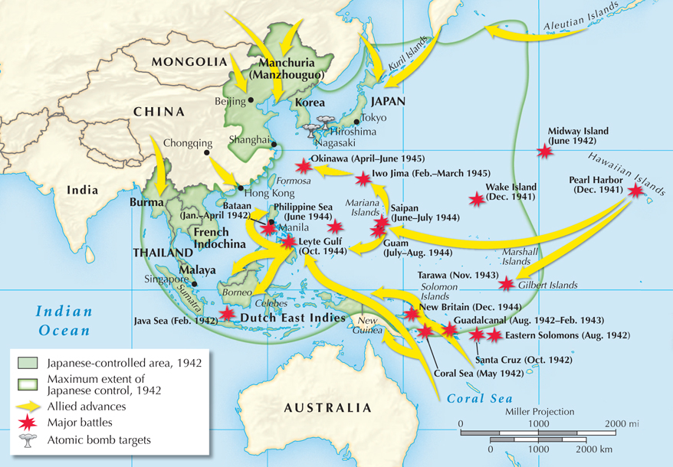
The Allied advance toward Japan

Slide 7
Meanwhile, Allied scientists offered another
way to end the war.
They worked on splitting the atom to create a new kind of bomb.
In July 1945, the Manhattan Project successfully tested the first atomic bomb in New Mexico.
President Harry Truman realized that it was a terrible new force for destruction. Nevertheless,
he decided to use the new weapon against Japan.
Notes:
7

Slide 8
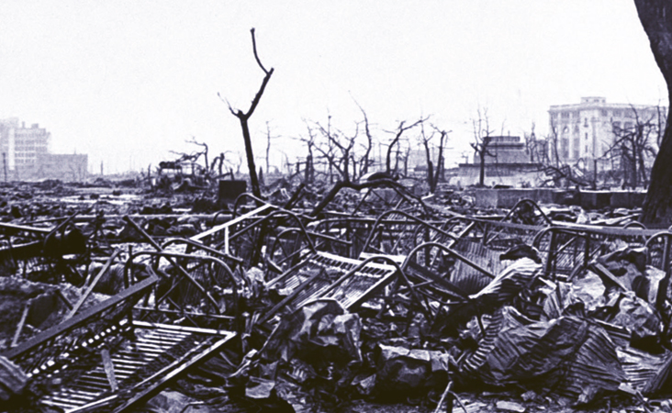
The Allied leaders issued a warning to Japan
to surrender or face destruction. Japan ignored the warning.
On August 6, 1945, the first atomic bomb was dropped
on Hiroshima, instantly killing more than 70,000 people.

Slide 9
August 8: The Soviet Union invaded Manchuria. The Japanese did not respond.
August 9: The United States dropped a second atomic bomb on Nagasaki. This time, more
than 40,000 people were killed
August 10: Emperor Hirohito intervened and forced the government to surrender.
September 2, 1945: A formal peace treaty
was signed.

Slide 10

How did the Allies finally defeat the Axis powers?
By 1945, the war in Europe was nearing its end. Germany was being attacked from east and west, and Axis armies were surrendering.
In the Pacific, a series of bloody battles continued on the islands as Allied military leaders planned
a land invasion of Japan. World War II finally ended when the United States dropped atomic bombs on two Japanese cities.

