Slide 1
Unit 13 World War 2
Chapter 29 Section 5
The End of World War II

Slide 2
Estimated Casualties of World War II
 | Military Dead | Military Wounded | Civilian Dead
Allies
Britain | 264,000 | 277,000 | 93,000
France | 213,000 | 400,000 | 350,000
China | 1,310,000 | 1,753,000 | 1,000,000
Soviet Union | 7,500,000 | 14,012,000 | 15,000,000
United States | 292,000 | 672,000 | 6,000
Axis Powers
Germany | 3,500,000 | 5,000,000 | 780,000
Italy | 242,000 | 66,000 | 153,000
Japan | 1,300,000 | 4,000,000 | 672,000

Slide 3
The full extent of the inhumanity of the Holocaust was revealed.
The Allies tried and executed a handful of the many Axis war criminals.
The Allies built new democratic governments in Germany and Japan to promote tolerance and peace.
The horrors committed
by the Axis powers became apparent to the world.

Slide 4
In 1945, Germany, Japan, China, the Soviet Union, and other countries were destroyed.
Cities, factories, harbors, bridges, and railroads
lay in ruins.
Twenty million refugees wandered through Europe.
Hunger, disease, and mental illness were rampant.
The Allies needed to help these devastated countries.

Slide 5
The Marshall Plan was a U.S. aid package that provided food and economic assistance to decimated countries
in Europe.
Stalin refused the aid and forbade Eastern European countries to accept aid as well.
The United States helped relieve postwar hunger and poverty in Western Europe.

Slide 6
In April 1945, delegates from 50 nations met to form a United Nations charter.
Each nation had one vote. However, a smaller body of five nations, called the Security Council, had greater power: the United States, Soviet Union, Great Britain, France, and China.
The goal was to give these great powers the authority to ensure peace.
Notes:
6

Slide 7
However, all the plans for world peace
did not go smoothly.
Differences grew among the Allies.
Conflicting ideologies and mutual distrust soon led
to the Cold War.

Slide 8
The rift grew between Stalin and the Western Allied leaders. By 1948, pro-Soviet communist governments were ruling in Eastern Europe.
New conflicts developed outside of Eastern Europe. Stalin was menacing Greece, and Turkey in the Dardanelles.
The United States developed the Truman Doctrine. This policy said that communism should be limited to the areas already under Soviet control.

Slide 9
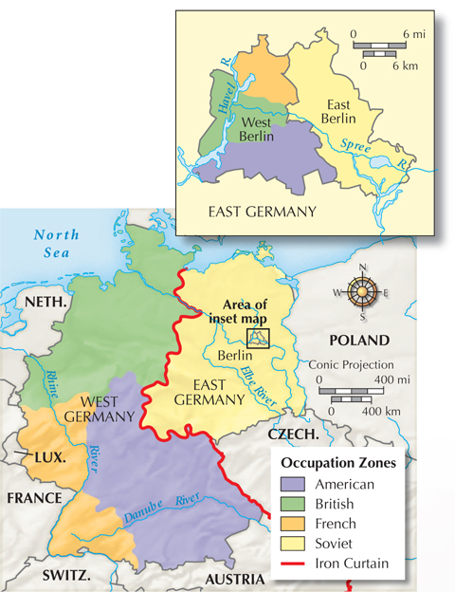
Germany became a focus of the Cold War.
Western Allies united their zones of control and extended the Marshall Plan.
The Soviets were furious at Western efforts to rebuild the German economy; they held on to eastern Germany.

Slide 10
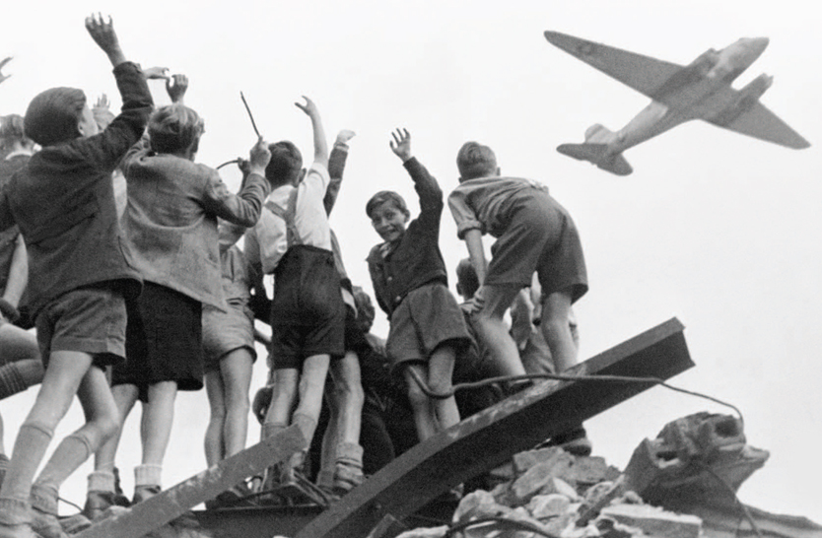
In an effort to drive Western powers out of Berlin, Stalin blocked delivery of supplies to the parts of the city they controlled.
Stalin’s attempt at a blockade failed. Cargo planes from the West supplied West Berliners with food and supplies.
Children greeted planes delivering supplies during the Berlin Airlift.

Slide 11
Twelve countries, including the U.S. and nations in Western Europe, formed a new military alliance called NATO.
The Soviets formed their own military alliance called the Warsaw Pact with their satellites in Eastern Europe.
Tensions continued to grow. Both sides participated in a propaganda war and sought world power.

Slide 12

What issues arose in the aftermath of World War II and how did new tensions develop?
As many as 50 million people had been killed in World War II. After it ended, the Allies faced difficult decisions about the future.
The United Nations was formed as a peacekeeping and humanitarian group. The U.S. Marshall Plan offered aid in rebuilding. The Soviet Union and the West quickly developed into competing alliances—the beginning of the Cold War.

