Slide 1
Unit 14
Cold War
Chapter 30

Slide 2
After WWII, the United States and the Soviet Union faced off along the Iron Curtain.
The United States
led the North Atlantic Treaty Organization (NATO) in democratic Western Europe.
The Soviet Union led the Warsaw Pact in communist Eastern Europe.
Both sides relied on European alliances: the United States with the West and the Soviet Union with the East.

Slide 3
The city of Berlin in Germany became a focus of the Cold War.
West Berlin was democratic and East Berlin was communist.
East Germans fled into West Berlin in droves before East Germany built a wall in 1961.
The concrete and barbed wire barrier became a symbol of the Cold War.

Slide 4
In 1953, 50,000 workers unsuccessfully stood up to the Soviet Army in East Berlin.
Hungarian leader Imre Nagy tried to pull his nation out of the Warsaw Pact in 1956. He was executed.
The leader of Czechoslovakia introduced limited democracy there in 1968, but Warsaw Pact troops invaded to end it.
As the Soviets extended their domination in Eastern Europe in the 1950s and 1960s, revolts broke out.

Slide 5
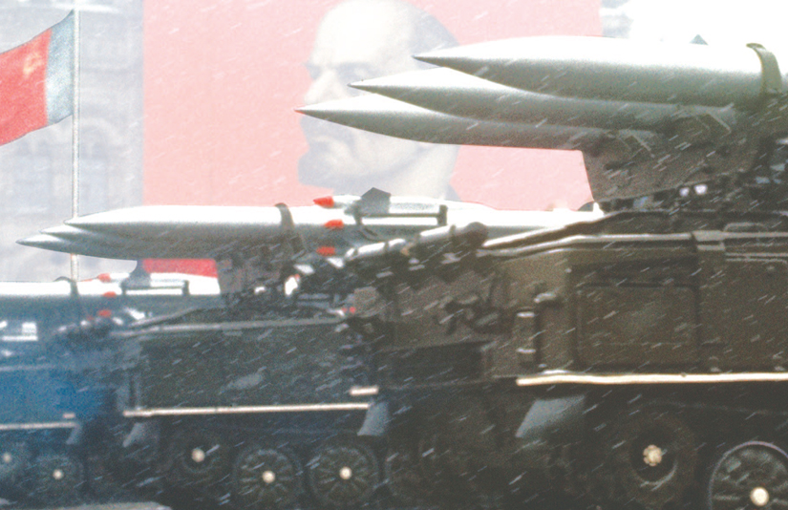
As the Cold War continued, an arms race began.
By 1949, both sides had nuclear weapons, and by 1953, both had hydrogen bombs.
Each side wanted to deter the other from launching its weapons, so they pursued a policy of “mutually assured destruction” that kept all of the world’s people afraid.

Slide 6
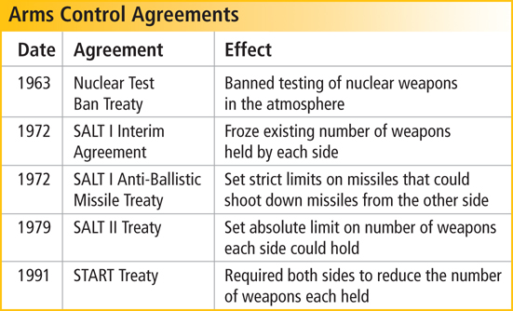
Despite the Cold War tension, the two sides did meet to discuss limiting nuclear weapons.
One agreement limited anti-ballistic missiles (ABMs).
Ronald Reagan supported a “Star Wars” missile defense program that some said went against the treaty.

Slide 7
An era of détente occurred during the 1970s due to the arms control agreements.
This era ended in 1979 when the Soviet Union invaded Afghanistan.
As the Cold War continued, it went global. Each side made new alliances.
America put military bases around the globe.

Slide 8
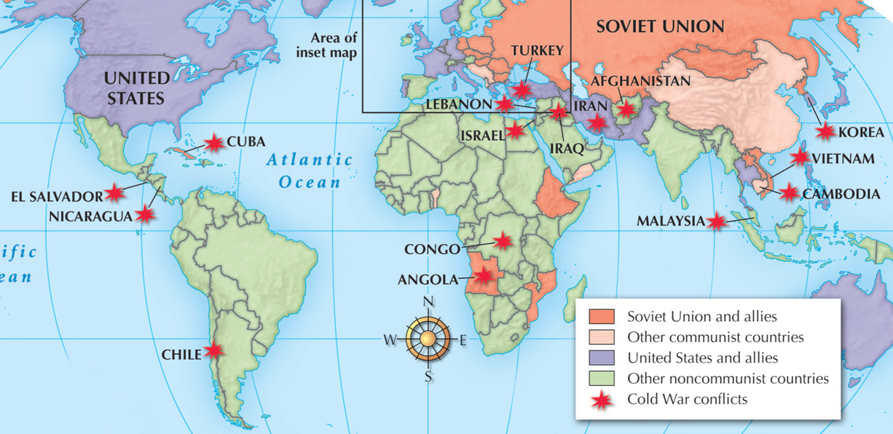
The two superpowers confronted each other indirectly around the world by supporting opposite sides in local conflicts.

Slide 9
Cuba became a communist nation in the 1950s.
Fidel Castro led a revolt against the corrupt dictator there in the 1950s.
Castro took power in 1959, allied with the Soviet Union, and nationalized businesses.
U.S. president John F. Kennedy wanted to bring down the communist regime and supported the Bay of Pigs invasion, which failed.

Slide 10
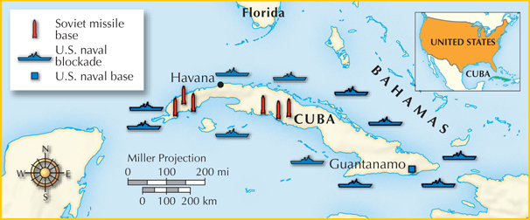
The Soviet Union sent nuclear missiles to Cuba
in 1962, sparking a dangerous standoff.
During this Cuban missile crisis, President Kennedy demanded that the Soviets remove the missiles.
The tense world watched. Finally, Nikita Khrushchev agreed and the crisis was over.

Slide 11
The Soviet Union in the Cold War
The government controlled most parts of public life. Leaders wanted to spread the communist ideology around the world. Some Soviets spoke out against the government but were imprisoned or silenced.

Slide 12
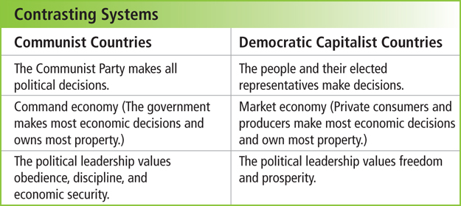
The Cold War was really a struggle between
two different economic and political systems.

Slide 13
This meant the government worked to keep communism within its existing boundaries.
It supported any government facing communist invasion.
During the
Cold War, the United States pursued a policy of containment.

Slide 14
Life in the United States during the Cold War
was marked by a fear of both nuclear fallout
and communism within.
Many people built bomb shelters in their yards.
Public schools conducted air-raid drills.
Americans also looked for enemies at home.
They worried there were communists in the United States. This “red scare” led to many
false accusations and ruined lives.

Slide 15

What were the military and political consequences of the Cold War in
the Soviet Union, Europe, and the United States?
After World War II ended, the United States and the Soviet Union emerged as superpowers.
They engaged in a Cold War that involved most of the world for the next 40 years.

