Slide 1
Unit 2 part 3
9-1 The Byzantine Empire

Slide 2
Objectives
Understand why Constantinople became known as the “New Rome.”
Summarize the ways in which the Byzantine empire flourished under Justinian.
Analyze how Christianity in the Byzantine empire differed from Christianity in the West.
Explain why the Byzantine empire collapsed, and examine the empire’s lasting heritage.

Slide 3
Terms and People
Constantinople – formerly Byzantium; capital
of the eastern Roman empire
Justinian – emperor of the Byzantine empire from 527 to 565, he rebuilt Constantinople and made reforms to the law
Justinian’s Code – The Corpus Juris Civilis,
or “Body of Civil Law”; a comprehensive collection of Roman legal writings assembled by Justinian
autocrat – a sole ruler with absolute power

Slide 4
Terms and People (continued)
Theodora – empress of the Byzantine empire, Justinian’s wife, and a fearless and powerful co-ruler
patriarch – in the Byzantine and Roman empires, the highest church official in a major city
icon – holy image of Christ, the Virgin Mary, or a saint venerated in the Eastern Orthodox Church
Great Schism – the official split between the Roman Catholic and the Byzantine churches
Notes:
4

Slide 5
Emperor Constantine made Byzantium the center of the eastern Roman empire, a “New Rome,” and renamed it Constantinople.
It had an excellent harbor and sat at a crossroad of trade between Asia and Europe.
Constantine expanded the city, with new defenses and magnificent buildings.
A blend of ancient Greek, Roman, and Christian influences, it remained powerful and wealthy long after the fall of Rome.
Notes:
5

Slide 6
Constantinople reached its peak under the Emperor Justinian, who ruled from 527 to 565.
The eastern Roman empire was renamed the Byzantine empire.
Justinian’s armies retook many lands in North Africa and southern Europe.
Following fire and riots in 532, he rebuilt Constantinople.
Notes:
6

Slide 7
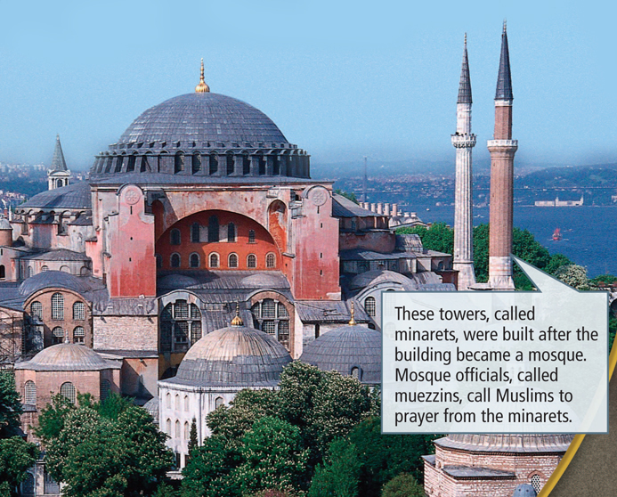
Among Justinian’s personal triumphs was the completion of Hagia Sophia, or “Holy Wisdom.”
Under the Ottomans the church became a mosque. It is now a museum.

Slide 8
Known as Justinian’s
Code, it became a handbook on Roman law for legal scholars.
Justinian’s compilation of Roman law into the Corpus Juris Civilis, or “Body of Civil Law,” was one of his most lasting legacies.
By 1100 European rulers were modeling their
laws on his code.
Centuries later, modern legal scholars used Justinian’s Code as a basis for creating international law.

Slide 9
The Byzantine empire had a centralized government and a strong military.
The emperor strictly controlled the prosperous economy.
Byzantine gold coins circulated from China
to England.
The powerful military and a well-fortified capital turned away invaders.

Slide 10
Justinian was an autocrat who ruled with absolute power.
The emperor was seen as Christ’s co-ruler on earth.
Unlike medieval European monarchs, he combined both spiritual and political power.
He was aided by his wife, Empress Theodora,
a ruthless politician and advisor who often ruled
in his absence.

Slide 11
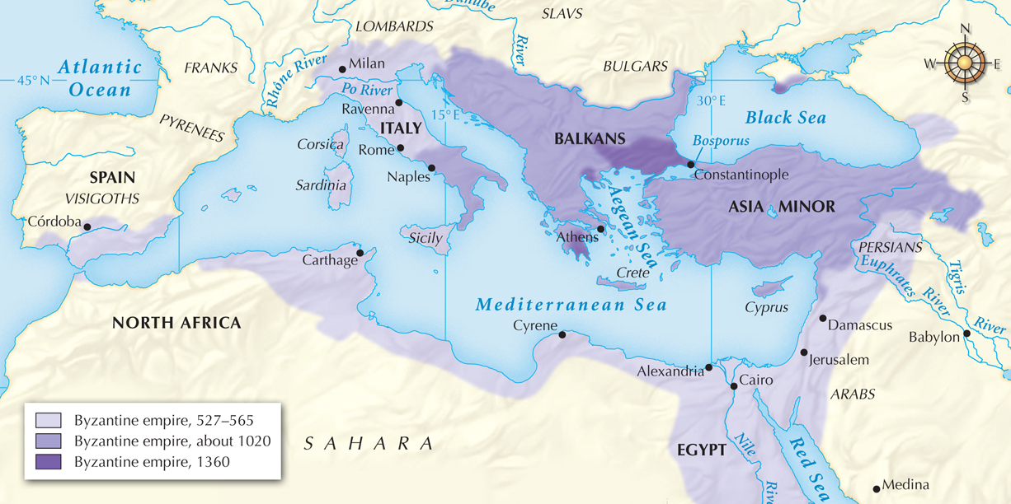
The Byzantine empire from 527 to 1360.

Slide 12
Over time, differences developed between the Byzantine Church and the Church in Rome.
The Byzantine emperor appointed the patriarch and rejected the Roman pope’s authority over his appointment.
The Byzantines used Greek as opposed to Latin
in the services.
Byzantine clergy could marry.

Slide 13
Over time these differences grew into a
Great Schism, a split between the two churches.
In the 700s, a Byzantine emperor outlawed the use of icons, which are holy images of saints or Jesus. This set off a religious battle with Rome.
In 1054 the split hit the breaking point over additional issues. The pope and the patriarch excommunicated each other.
The church divided into rival religions, the Eastern or Greek Orthodox Church and the Roman Catholic Church.

Slide 14
In Europe local lords grew
in power; the Normans took control of southern Italy.
The Seljuk Turks were threatening Byzantine trade routes and territories.
The Byzantine empire was in decline even before the Great Schism.
After Crusaders plundered Constantinople in the 1260s the empire never recovered.

Slide 15
Venetians took over Byzantine trade routes
to the East.
In 1453 the Ottoman
Turks laid siege to Constantinople. The emperor died as the city was taken.
Mehmet II renamed the city Istanbul and made it the capital of the Ottoman empire.
Constantinople was in foreign hands for 57 years. When the emperor regained the city, its power was broken.

Slide 16
The Byzantines influenced later cultures.
Byzantine art influenced Western styles.
Byzantine scholars preserved many Greek and historical works and took them to the West, where they would influence the Renaissance.
For centuries, Justinian’s Code has influenced European law.

