Slide 1
Unit 2-2 Notes
The Roman Republic, Empire and Christianity
Unit 2 Essential Question –
  How did the government and philosophies of the Greek city-states influence the development of Rome and its preservation throughout the scope of the Byzantine Empire?

Slide 2
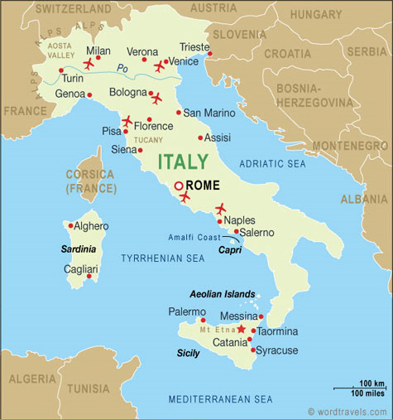
Geography
  Peninsula centrally linking Asia, Africa, and Europe
    Bordered by the Tyrrhenian Sea (west) Adriatic Sea (east)
  Mountainous terrain with fertile fields
    Separated from Europe by the Alps
    Many passes prevent isolation

Slide 3
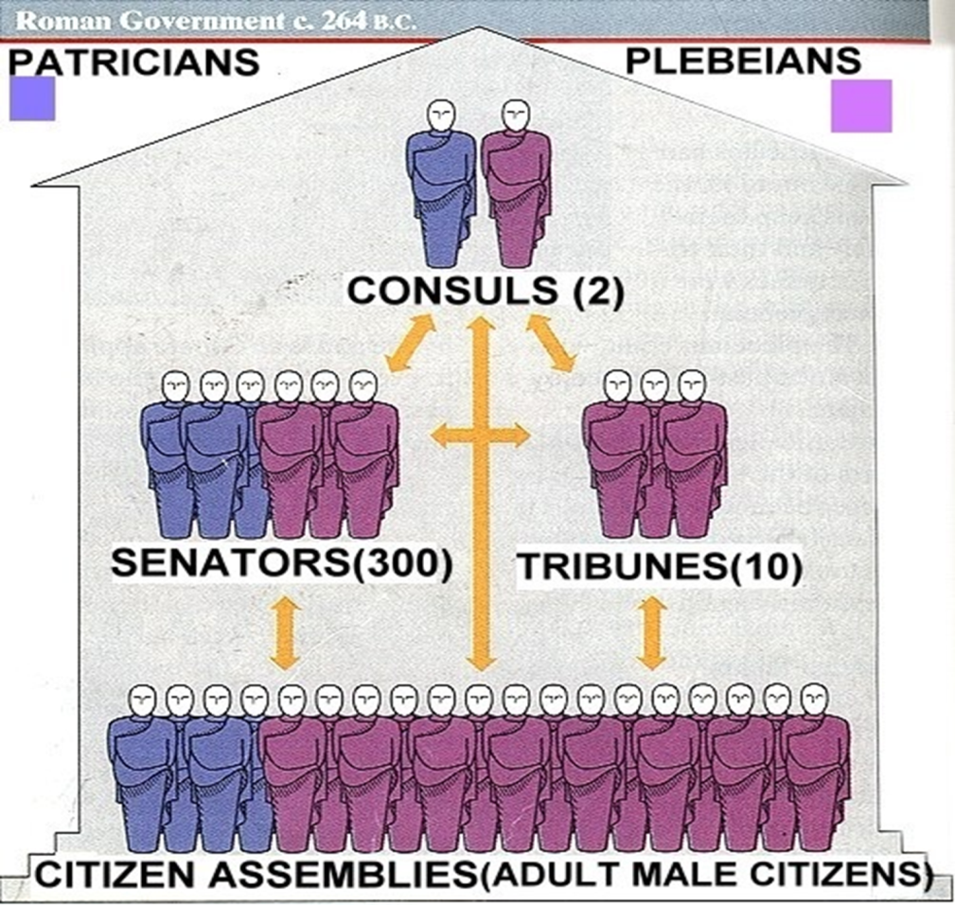
The Roman Republic
  Rome was a small city-state in Italy
    Native Romans were ruled by a foreign (Etruscan) King
    Overthrew the king in 509 B.C.E.
      Established a democratic republic
      In times of crisis a dictator with absolute power would be elected for 6 months

Slide 4
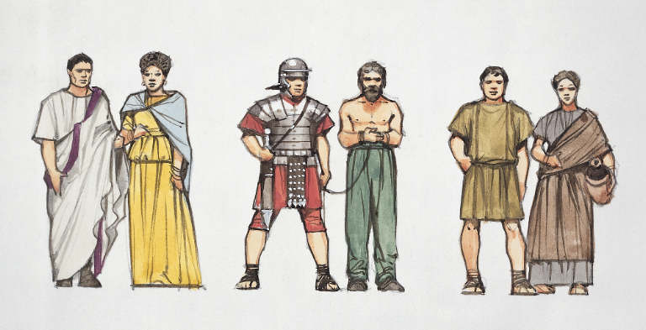
  Class Structure
    Social Classes – Determined at birth
        Patricians – upper class; authority to make laws
        Plebeians – lower class; could vote; couldn’t hold office
        Both required to serve in the army

Slide 5
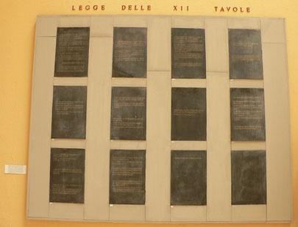
Creating a balanced government
  Plebeians were denied many rights
    Refused to fight in the army until reforms are granted
      Ended debt slavery
      Allowed marriage between classes
    The Twelve Tables
      First Roman written code of law
      Gives both classes equal legal protection
    Reduces number of conflicts

Slide 6
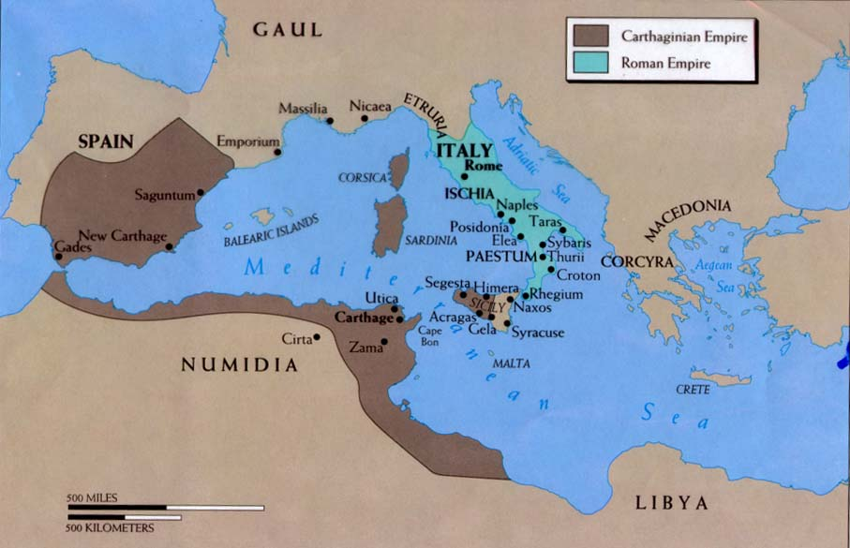
Rome Spreads Its Power
  Rome Conquers Italy by 265 B.C.
  Rome’s Commercial Network
    Central location allows for easy control of trade
    Creates trade conflict with Carthage – The Punic Wars
    Rome won all three (3) Punic Wars against Carthage
    Gain control of all trade in the Mediterranean

Slide 7
Consequences of the Punic Wars
  Soldiers returning from wars find their farms destroyed
    They sold their farms to rich patricians
    Patricians import slave labor from conquered lands
    Former soldiers are now homeless and unemployed
      New homeless class is called the Proletariat
  Generals recruit members of the Proletariat into their armies
    Soldiers would be paid with land from conquests
  Soldiers become more loyal to generals than to Rome

Slide 8
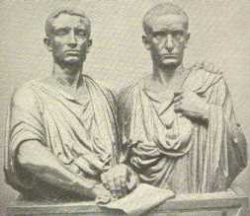
  The Gracchi Brothers - Tiberius & Gaius Gracchus
    Roman Tribunes
    Both propose land redistribution reforms
    Both killed by the Senate

Slide 9
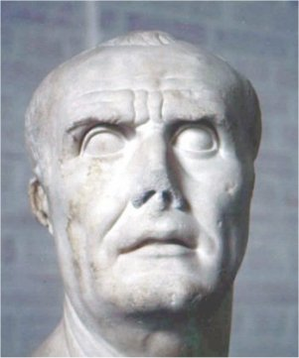
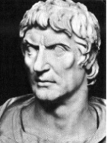
Problems with Dictators
  Marius
    Saved Rome from German invasion
  Sulla
    Defeated Marius in a civil war
    Appointed himself dictator for life

Slide 10
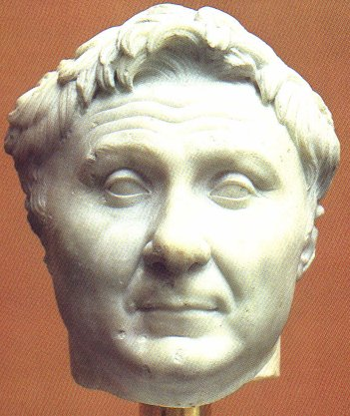
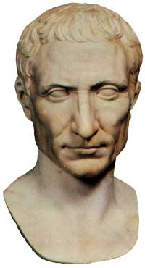
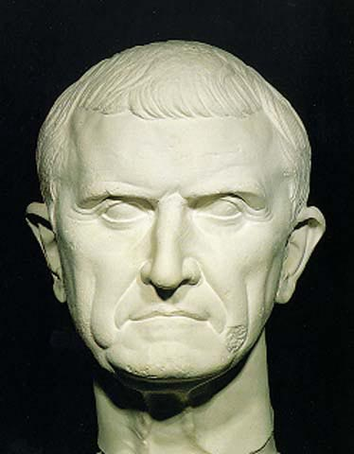
The First Triumvirate
  Pompey emerged as the dominate general after Sulla’s death
  Julius Caesar emerged as the dominate politician
    Caesar was funded by a rich Roman: Crassus
    The three (Pompey, Caesar, and Crassus) rule Rome as a three member consul

Slide 11
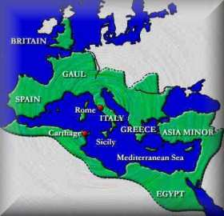
  Caesar lacks military experience
    Takes Pompey’s army and sets out to conquer Gaul
    Crassus died leaving Pompey in control of Rome
    Caesar gained popularity winning many victories
    Pompey grew jealous / married Caesar’s daughter
      Ordered Caesar to disband his army and return to Rome

Slide 12
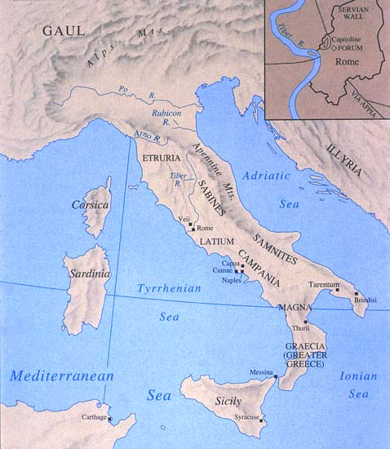
      Caesar refused & crossed the Rubicon River w/ his army and occupied Rome
Rubicon River

Slide 13
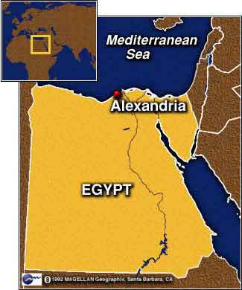
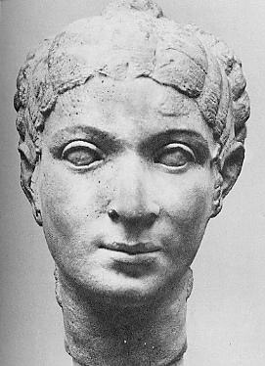
      Pompey fled to Greece and eventually Egypt. (Egypt was in the middle of a civil war between Cleopatra and her younger brother.)

Slide 14
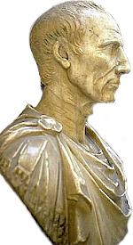
Caesar’s Rise and Fall
  Caesar sought a truce with Pompey and traveled to Egypt
    The younger brother greeted Caesar and gives him Pompey’s head attempting to gain Caesar as an ally
    Caesar becomes furious – sides with Cleopatra
      Stays in Egypt 3 years and has a child with Cleopatra
    Returns to Rome with Cleopatra and Child (Already had a wife in Rome)

Slide 15
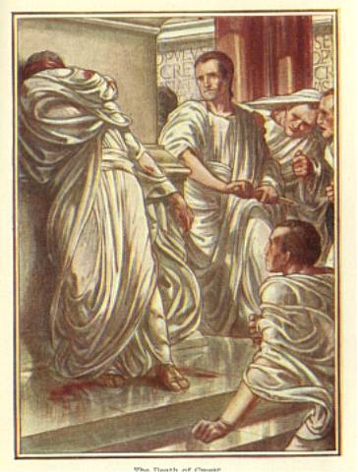
  Senate appointed Caesar dictator for life
    Caesar made many reforms that upset the Patricians (Including land reform)
  Assassinated on March 15, 44 B.C.

Slide 16
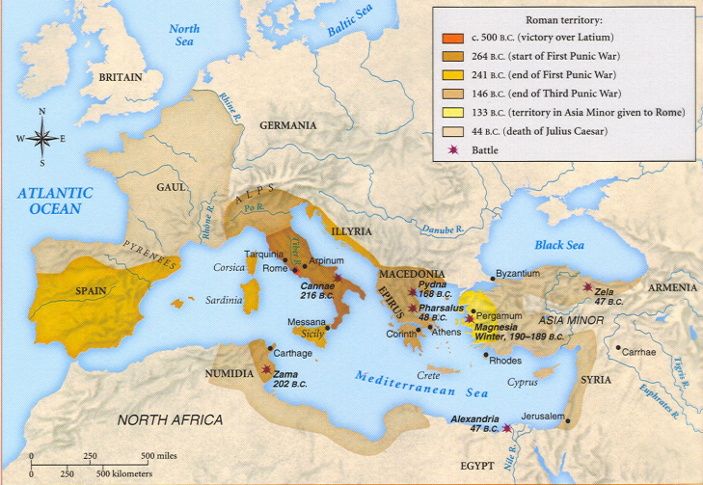
The roman republic at Caesar‘s death

Slide 17
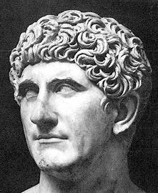
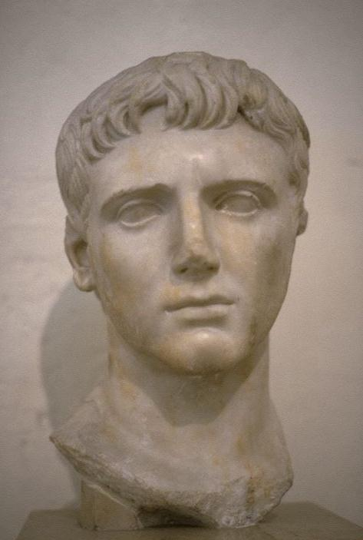
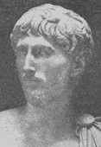
The Second Triumvirate
  Mark Antony, Octavian, and Lepidus vow to avenge Caesar
    Kill more than 100 senators and 2,000 businessmen
    Following their revenge the 2nd Tri. cannot rule jointly
  Octavian defeats Lepidus

Slide 18
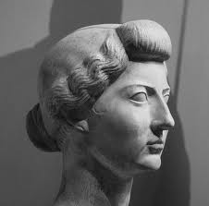
  Mark Antony
    Marries Octavian’s sister (Octavia) as a sign of loyalty
    Has an affair with Cleopatra divorces Octavia
    Octavian defeats Antony at the Battle of Actium
      Cleopatra flees in the middle of the battle
      Antony abandoned his troops to follow her
      Both commit suicide in a Romeo and Juliet scenario
      Octavian makes Egypt another province of Rome

Slide 19
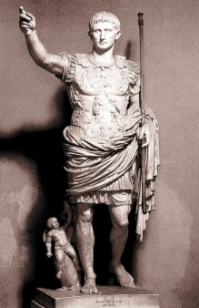
Octavian becomes the First Emperor
  Rules wisely as the “first citizen”
  Given the title of Augutus – “exalted one”
    Marks the beginning of the empire
The senate and the assembly still met although powerless

Slide 20
The rise of christianity

Slide 21
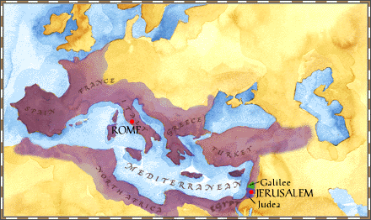
Rome Controls Judea
  Jewish kingdom came under Roman control in 63 B.C.
    Allowed to be an independent kingdom
    A.D. 6 became the Province of Judea
    Jews believed a Messiah would restore the kingdom of God

Slide 22
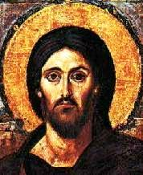
  Jesus
    Born a Jew approximately 6-4 B.C.
    Began a public ministry around the age of 30
    Preached, taught, did good deeds & miracles for 3 years
      Teachings are based on Jewish tradition, but include non-Jewish elements
      Love of all, forgiveness of sins, individual relationship w/ God, & nonviolence

Slide 23
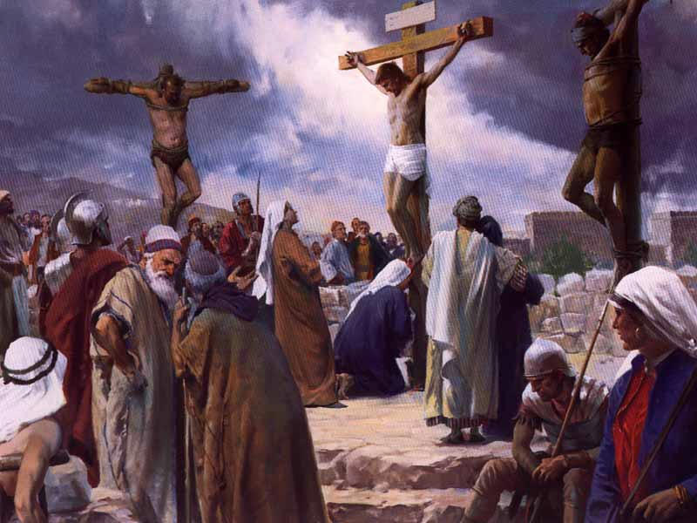
    Arrested by Jewish officials for blasphemy
    Convicted & crucified by the Roman governor Pontius Pilate
    Christians believe he rose from the dead and ascended into heaven and will return to Earth to save humanity.

Slide 24
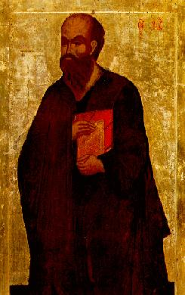
  The Spread of Christianity
    12 Disciples begin teaching following resurrection
      Begins as a new Jewish denomination
    Paul’s Mission
      Persecuted Christians early in his life
      Devoted life to Christianity after seeing a vision of Jesus
        Spreads the Christian message to Jews and Gentiles
    Common language and Roman roads facilitate spread

Slide 25
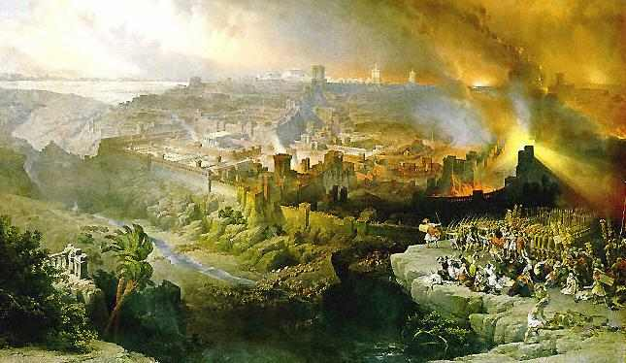
  Persecution of Jews and Christians
    The Jewish Rebellion
      In 66 A.D. the Jews revolted against Roman Rule
        Rome stormed Jerusalem in 70 A.D. and burned the Jewish Temple to the ground
        500,000 Jews killed during the rebellion
    Jews are driven from their homeland (the Diaspora) and would not return for more than 1,800 years

Slide 26
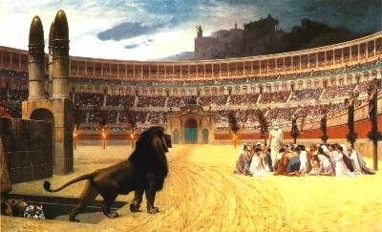
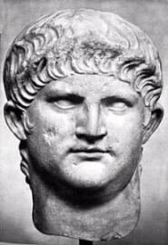
    Christians refused to worship Roman gods and emperors
      Romans see this as a threat to traditional values
    Thousands of Roman Christians were martyred for their beliefs – crucified, burned, or killed in gladiator games

Slide 27
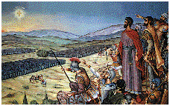
A World Religion
  Constantine Accepts Christianity
    A.D. 312 three generals are competing for control of Rome
      Constantine prayed before the Battle of Milvian Bridge
      Saw a vision of a cross with the words “in this sign conquer” inscribed on it
      Orders troops to paint crosses on their shields – they win

Slide 28
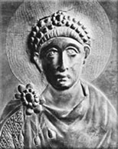
    A.D. 313 issued the Edict of Milan – legalizes Christianity
    A.D. 380 the Emperor Theodosius made Christianity the official Roman religion

Slide 29
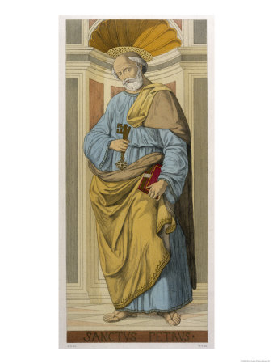
  The Early Christian Church
    Priests led each local community of Christians
    Bishops oversaw several churches within one region
    The Bishop of Rome was established as the Pope
      The Apostle Peter was the first Pope
    Petrine Doctrine – states that the Pope has authority over all Christian churches

Slide 30
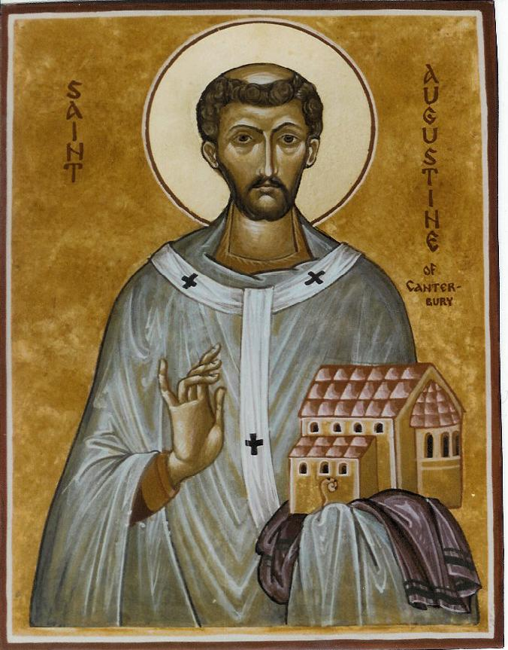
    Conflicts among early churches led to the establishment of the Christian Bible
      A.D. 325 Church leaders composed the Nicene Creed
    St. Augustine Bishop of Hippo – Humans need the “grace of God” to be saved
      The City of God – Earthly cities would be destroyed but the city of God could never be destroyed

Slide 31
The Fall of the Roman Empire

Slide 32
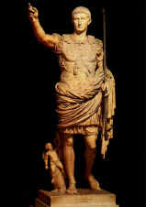
The Rule of Augustus
  The Pax Romana (Roman Peace) / 27 B.C. – 180 A.D.
    Period of peace and prosperity

Slide 33
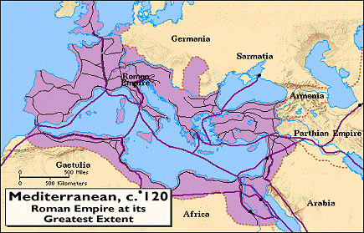
  Constructed a massive system of roads
    Improve both trade and communication
    Created a need for civil service
    Provided jobs for freed slaves to be paid with taxes

Slide 34
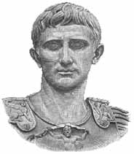
  The Problem of Succession
    A method for choosing a new emperor was never established
    Death of Emperor often decided by civil war

Slide 35
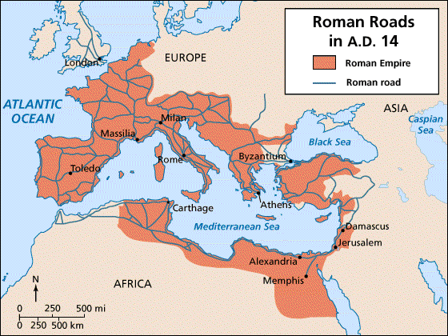
  Crisis of the Third Century
    Economic Decay – Pirates on the Mediterranean and Barbarians north of the Danube disrupt trade – high inflation
    Military Decay – Loyalty replaced by greed, mercenaries hired into the army
    Political Decay – People lost interest in politics, many refused to pay taxes, officials had to repay any lost taxes out of pocket

Slide 36
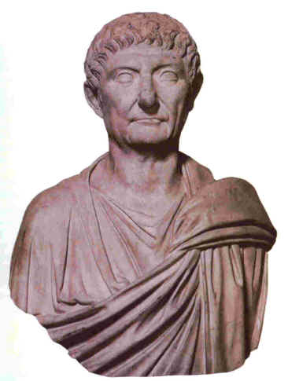
Diocletian
  Issued reforms to end the Crisis of the Third Century
    Enlarged army to better defend borders
    Fixed prices to control inflation
    Persecuted Christians to restore traditional values

Slide 37
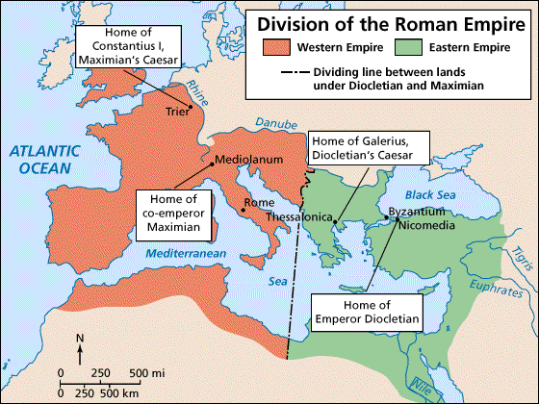
  Divides empire into an eastern and western halves
    Western uses Latin; Eastern uses Greek
    Diocletian takes control of the richer Eastern portion
  Retired in 305 A.D. – Civil War broke out immediately

Slide 38
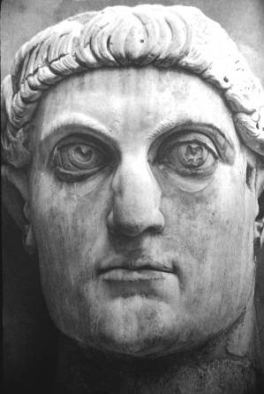
Constantine – (See Rome Notes Part 4) for his impact on Christianity)
  Moves the capital from Rome to Byzantium
    Renames Byzantium, Constantinople
    Allows for a Christian city to replace pagan Rome

Slide 39
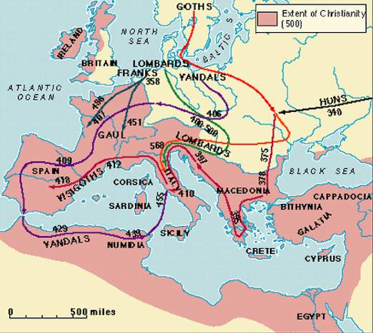
The End of the Western Empire
  The Huns: Asian steppe nomads invade northern Europe
    Germanic tribes flee from the Huns into Roman territory
      Due to lack of infrastructure Rome unable to organize an effective army
      Rome sacked by the Visigoths in A.D. 410
      Rome sacked by the Vandals in A.D. 455

Slide 40
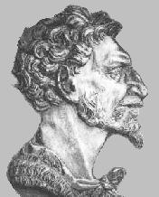
  Attila the Hun
    Sacked 70 cities in the Eastern Empire
    Fails to conquer Constantinople
    Marches on Rome in A.D. 452
    Convinced to retreat by Pope Leo I

Slide 41
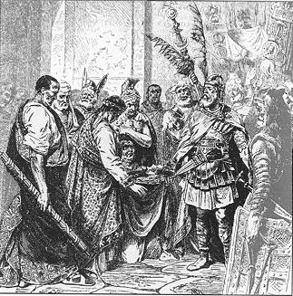
In 476 A.D. Romulus Augustulus , the last Roman Emperor, conquered by Odoacer .
  This marks the end of the Roman Empire in the West.
  The Eastern Empire would survive another 1,000 years as the Byzantine Empire.
  The only institution to survive in the West was the Christian church, governed by popes.

Slide 42
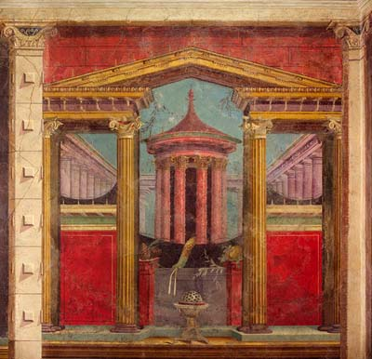
The Legacy of Rome
  Greco-Roman (Classical) culture replaced Hellenism
    Mosaics and frescoes decorated upper class homes
  Latin became the foundation of the Romance Languages
    Half the words in the English language have Latin roots

Slide 43
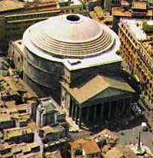
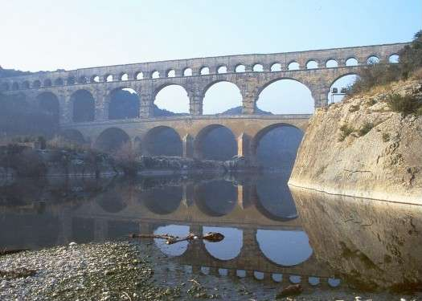
  Roman architecture perfected the arch
    Use of concrete allows for the building of bridges, aqueducts, and domes
  Roman Law became the basis for most Western legal systems

