Slide 1
Unit 4-1
Western Europe
after the
Fall of Rome

Slide 2
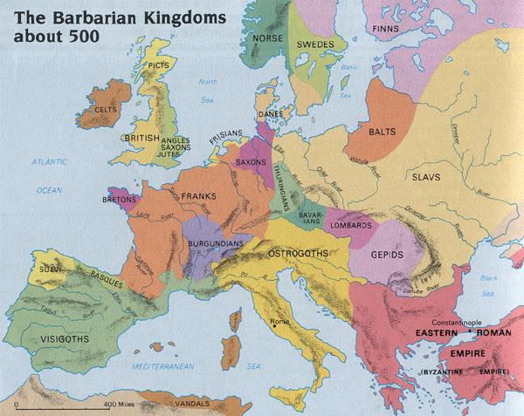

Slide 3
The Effects of the Fall
  Barbarian tribes fought for control of Europe
    People fled from the cities to the countryside
    Taxes were no longer collected
    Education declined
      Only Christian priests could read and write
      Barbarian languages emerged - German, French, etc.
      Loss of a common language

Slide 4
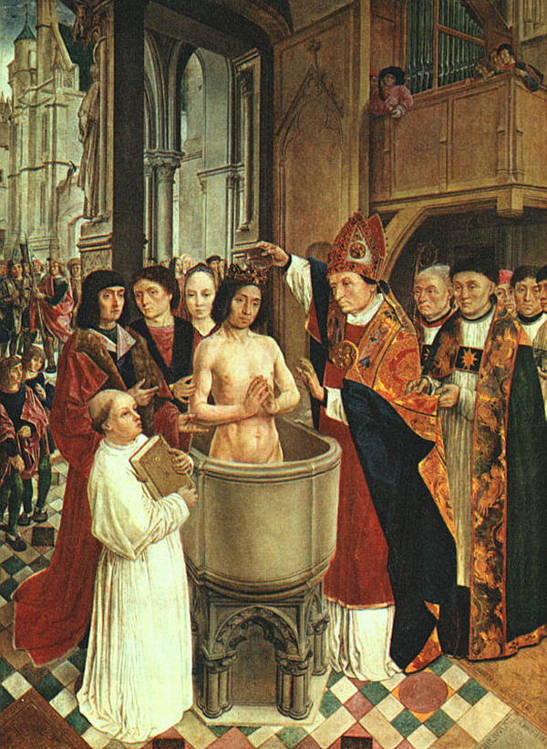
  The Roman Catholic Church
    The Catholic Church was the only political power after the fall of Rome
    Catholic Missionaries spread Christianity to barbarians
    Clovis, king of the Franks, became the first barbarian Christian
      Forms a partnership between the Franks and the Church

Slide 5
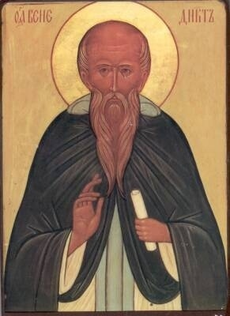
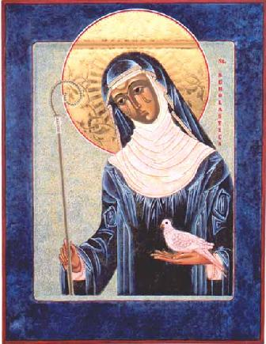
    The Catholic Church built many monasteries to adapt to rural conditions
      Monks gave up possessions and live a life of prayer
      Women became nuns and lived in Convents
      St. Benedict established the rules for monastic living
        His sister, Scholastica, modified the rules for women
    Monasteries became centers of learning

Slide 6
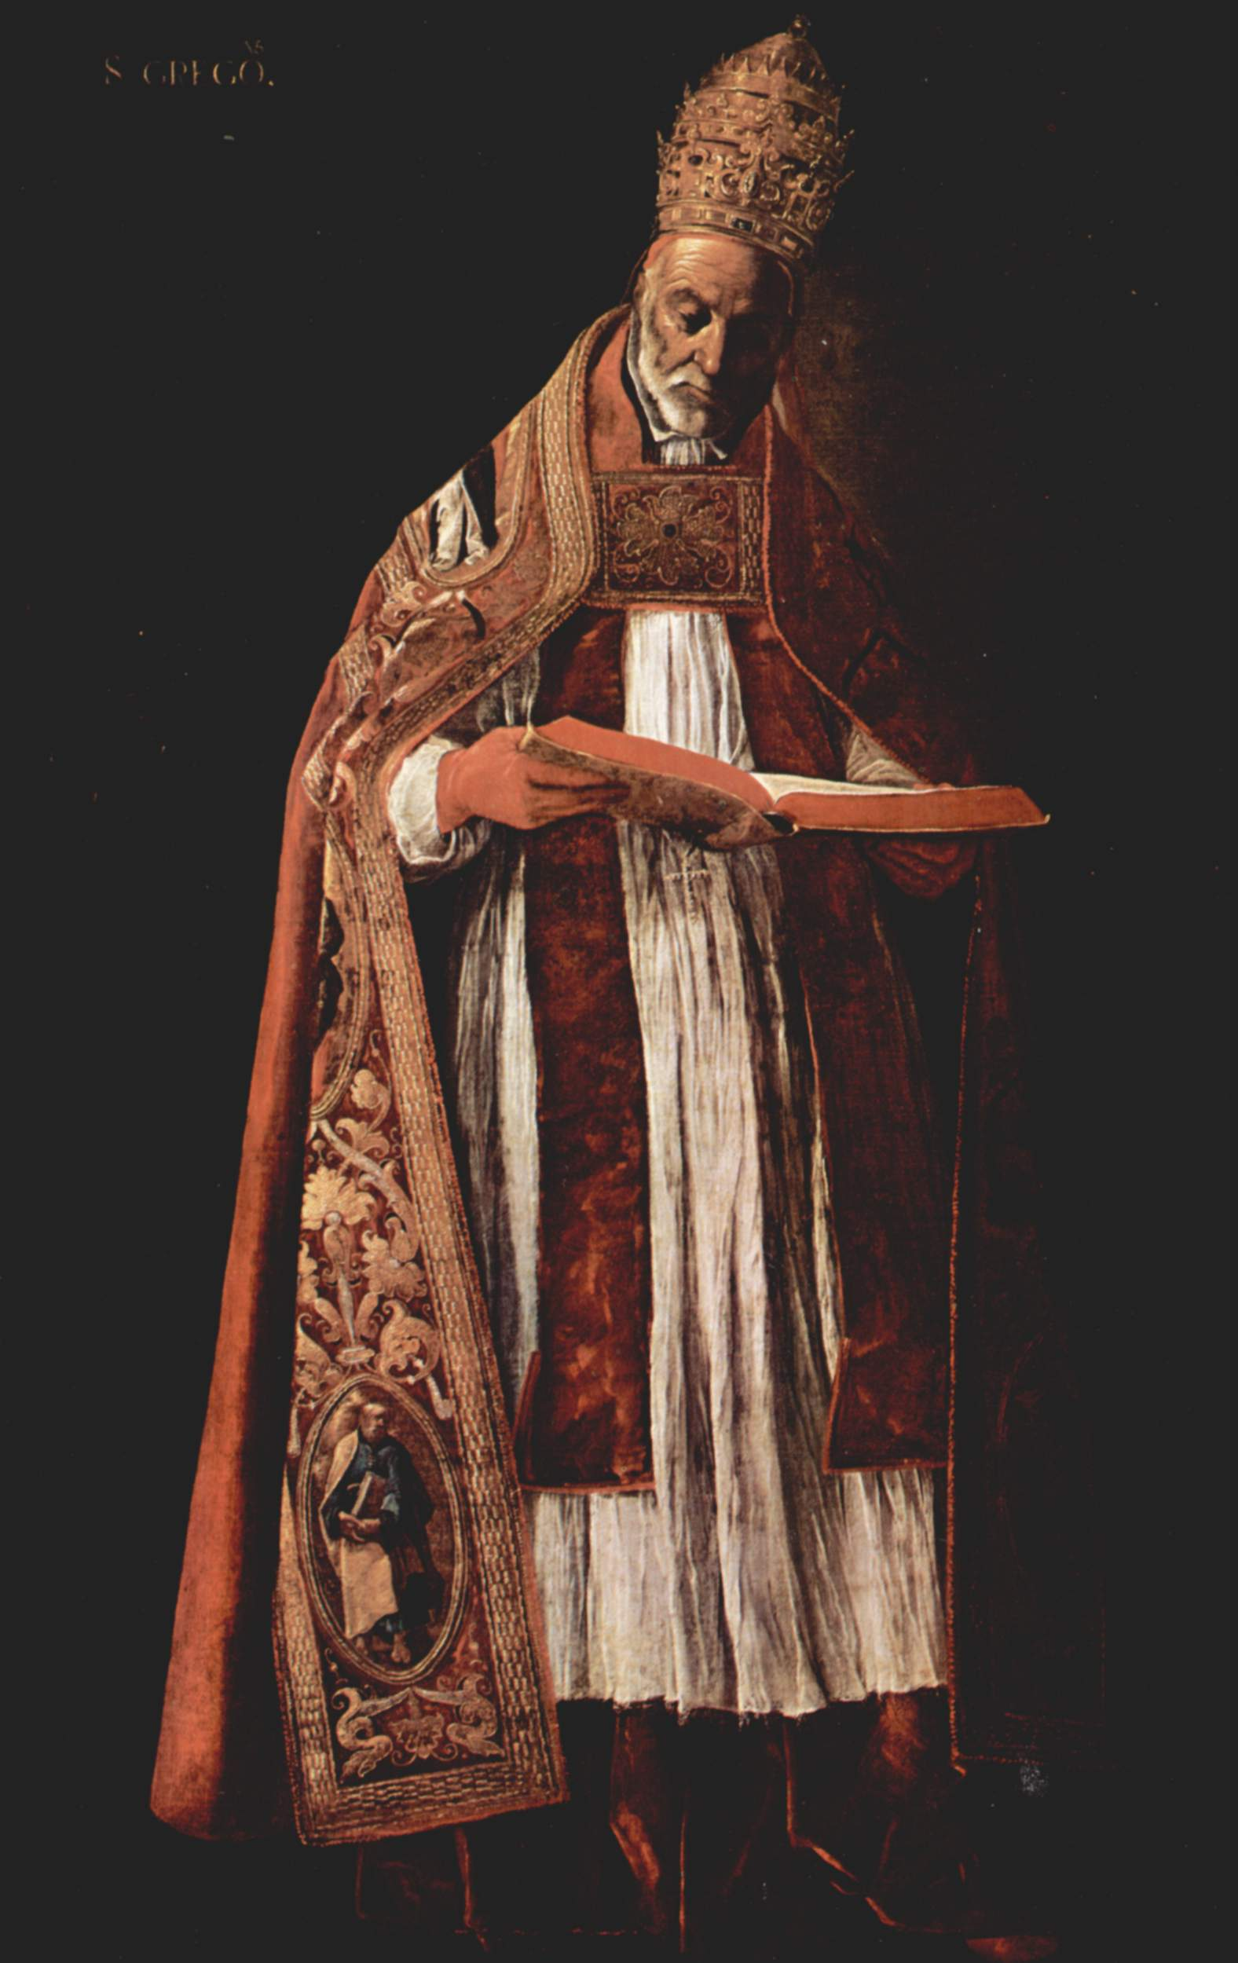
    Gregory I
      1st Pope to exercise both secular and religious power
      Negotiated peace with many barbarians
      Established a churchly kingdom throughout Europe

Slide 7
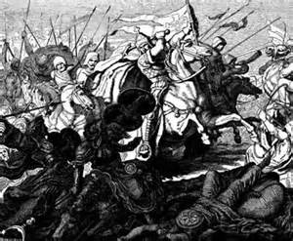
An Empire Evolves
  Clovis died 511 creating chaos amongst the Franks
    Clovis’ successors gave power to command armies a “Major Domo”
      Mayor of the Palace – Military Dictator

Slide 8
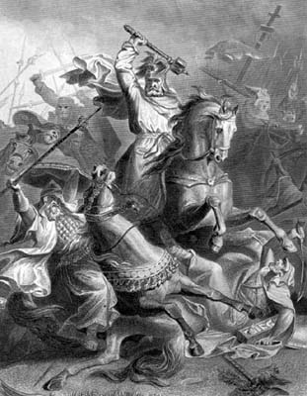
  Charles Martel
    Became major domo in 714
    Stops the Muslim expansion into Europe in 732 at the Battle of Tours\
    Upon his death his son, Pepin the Short, became major domo

Slide 9
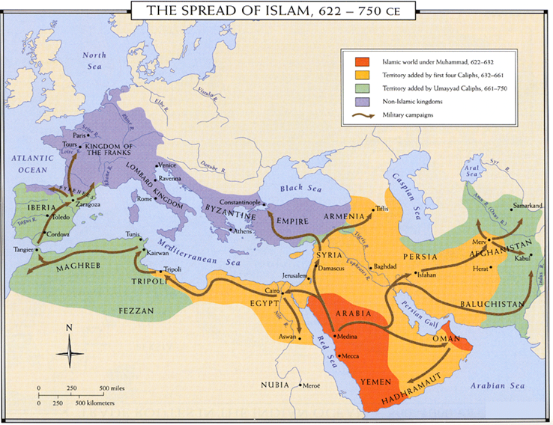

Slide 10
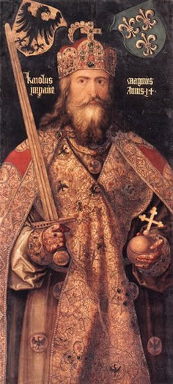
  Pepin the Short
    Agreed to fight the Lombards for the Pope
    Pope made Pepin “king by the grace of God”
    Upon his death his son Carolman became king
      Ruled only 3 years & died – Brother Charles becomes king

Slide 11
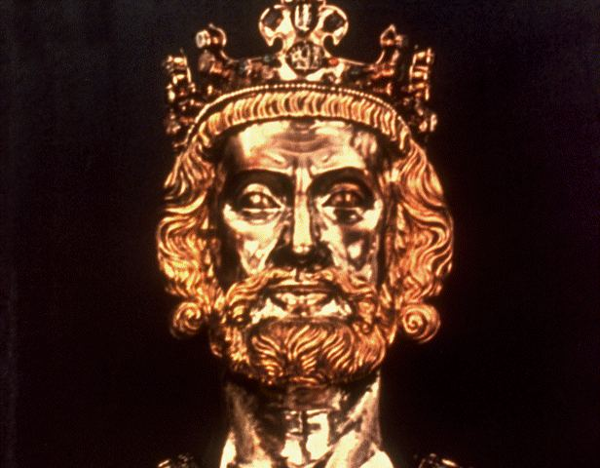
  Charlemagne – Charles the Great
    Believed he was chosen by God to spread Christianity
      Offered conquered people baptism or death
    Encourage the building of monasteries and schools
      Encouraged Jews to enter his empire because they were literate
    800 A.D. traveled to Rome to put down a series of riots
      In return the Pope pronounced him Holy Roman Emperor

Slide 12
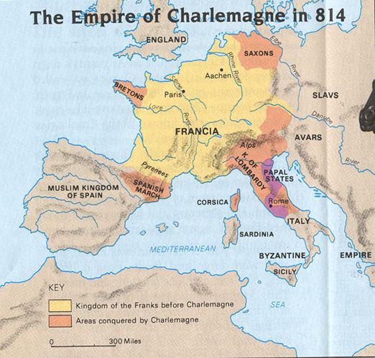

Slide 13
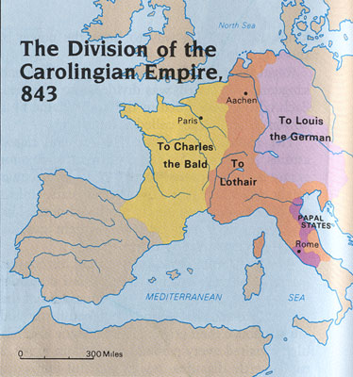
    E. After Charlemagne died his 3 grandsons fought to control the Holy Roman Empire
      The Treaty of Verdun ended the fighting by dividing the empire amongst the three.
      Created a weak and divided Europe.

