Slide 1
Unit 4-2
European Invasions and Feudalism

Slide 2
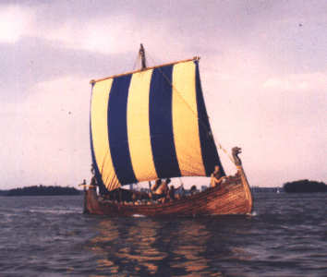
European Invasions
  Vikings originated in the peninsulas of Scandinavia
    Bad harvests & overpopulation caused Viking raids
    Design of ships allowed travel over open sea and shallow rivers while carrying 300 men
    Became feudal lords of Normandy in northern France
    Settlement leads to conversion to Christianity

Slide 3
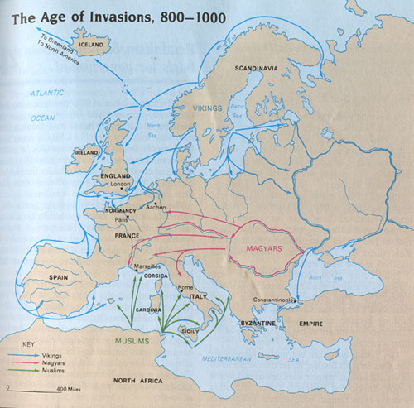
  The Magyars and the Muslims
    Magyars originated in Hungary
      Took captives to sell as slaves
    Muslims attacked from North Africa
      Threatened the Atlantic and Mediterranean coasts
  Local European rulers who could defend their people gained followers and political strength

Slide 4
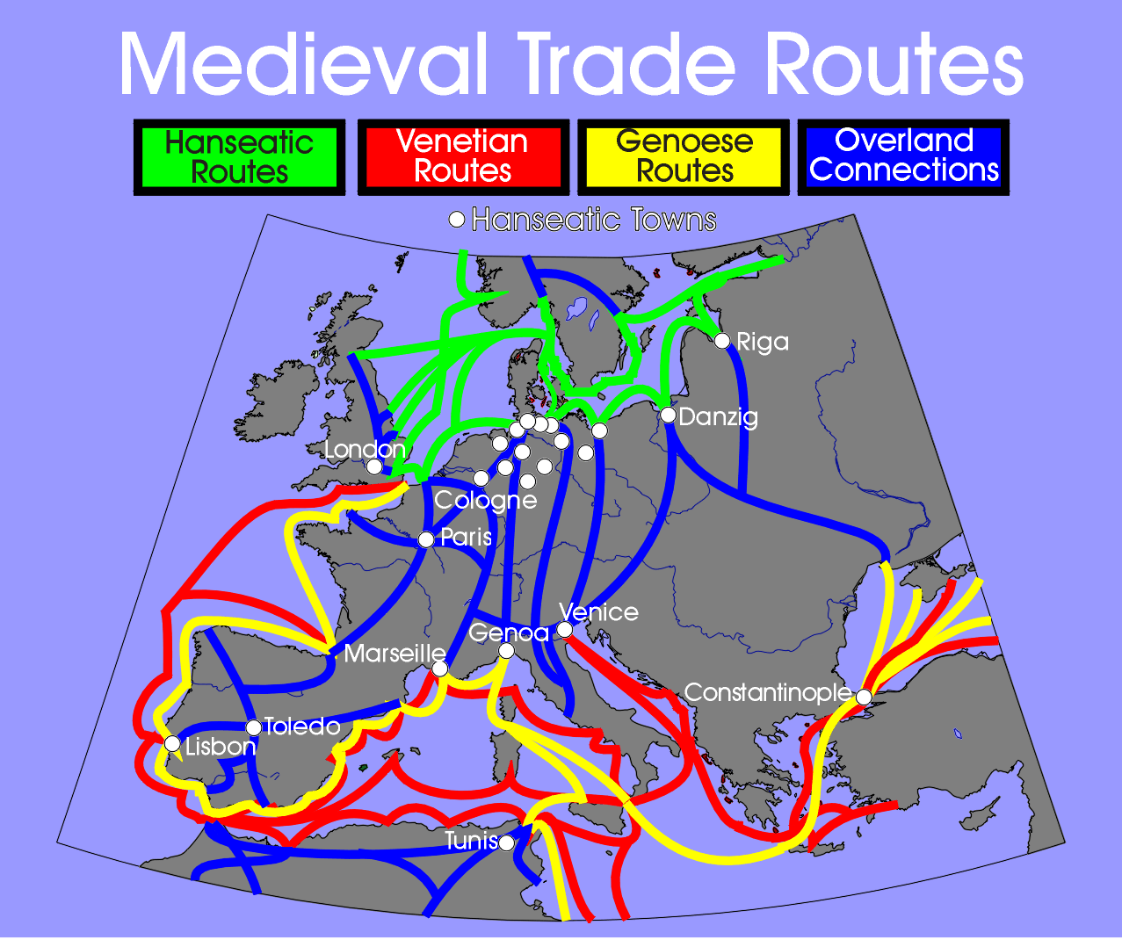

Slide 5
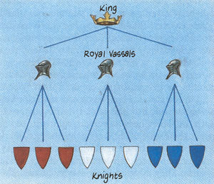


Feudalism
  The period of invasions allowed local lords to seize power
    Lords possessed large amounts of land
    Feudalism developed as a military, political, and economic system based on the holding of land
    Lords would give small pieces of land (fief) to vassals in exchange for military service
    Vassals could become lords by further dividing their land and giving it to knights
      Knights ruled over manors as warrior vassals

Slide 6


Slide 7
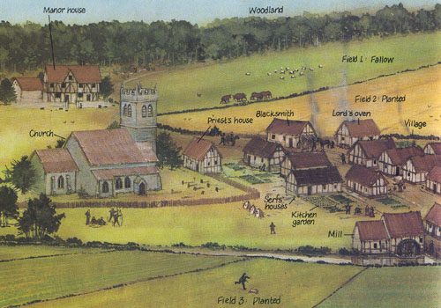

Slide 8
  Manors were self-sufficient economic units
    Manors produced everything they need for survival
    Serfs were peasants who were bound to the manor
      Provided labor to serve the lord, lord protects serfs
    Duties to the manor
      Serfs had to work their own land and their lords
      Serfs could only keep part of their own grain
      Serfs also had to pay tithes to the Church

Slide 9
Changes in Agriculture and Trade
  Between 1000-1300 changes in agriculture led to an increase in population
    New plows, improved harnesses, and switching from oxen to horses helped increase harvests
    The Three Field System
      One field was left fallow all year
      In the winter one field was planted with wheat or rye
      In the spring one field was planted with barley, oats, beans, or peas
    The increase in population resulted in many people moving back into towns

Slide 10
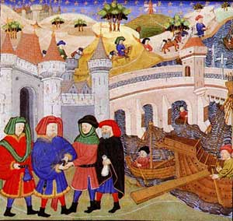
  New Social Classes Developed
    New towns were called burghs
      People who lived in burghs were called burghers or bourgeoisie – these people would create a new educated middle class

Slide 11
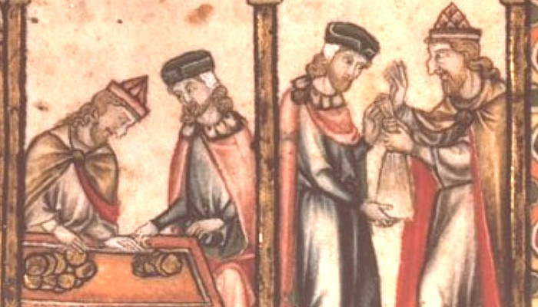
      Jews became the first burghers
        They did not fit into the feudal system
        The Church forbade Christians from loaning money
        Established banks, stores, and trading companies

Slide 12
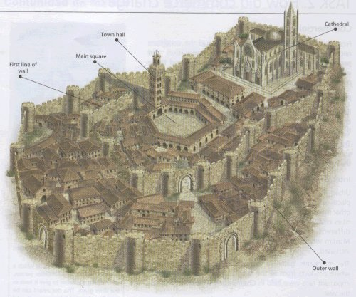
  Towns held trade fairs to sell a variety of items
  Guilds
    Merchant and craft guilds regulated merchandise, services, and prices
    The guilds also trained apprentices and journeymen
  More people moved to town to gain freedom
    Towns gained independence from lords through charters

