Slide 1
Unit 4-3
The Struggle
for Power
Kings vs. Popes

Slide 2
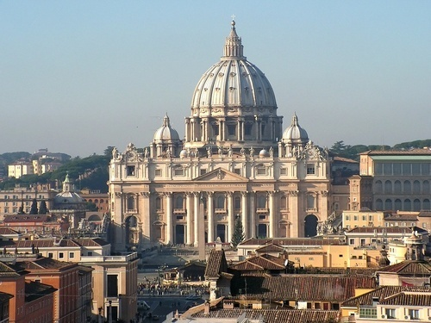
Catholic Reforms
  Between 500 & 1000 the Catholic Church became corrupt
  Reforms were instituted btwn 1000 & 1300 to purify the Church
    Priests denied the right to marry
    Ended simony – the buying and selling of Church offices
    Ended lay investiture-Kings appointing Church officials

Slide 3
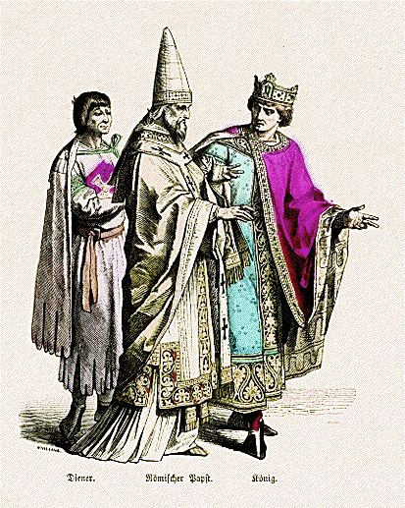
      Henry IV of Germany refused to obey the changes
      Pope Gregory excommunicated Henry
      Bishops appointed by Henry chose to obey the Pope
      Henry traveled to Rome to beg for forgiveness

Slide 4
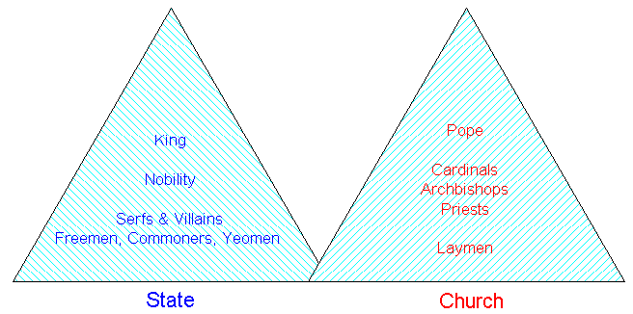
The Structure of the Church
  The Church resembled a kingdom
    Popes served as kings
    Bishops and Cardinals as Nobles
    Priests, Friars, and monks as peasants

Slide 5
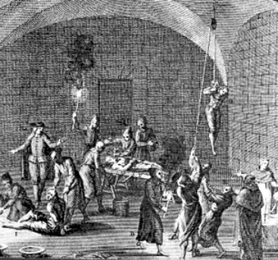
  The Church ran a system of courts based on canon law
  The Church also collected taxes in the form of tithes
  The Inquisition served as the Church’s military
    Stopped the spread of heresy through violence

Slide 6
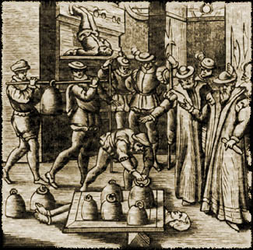
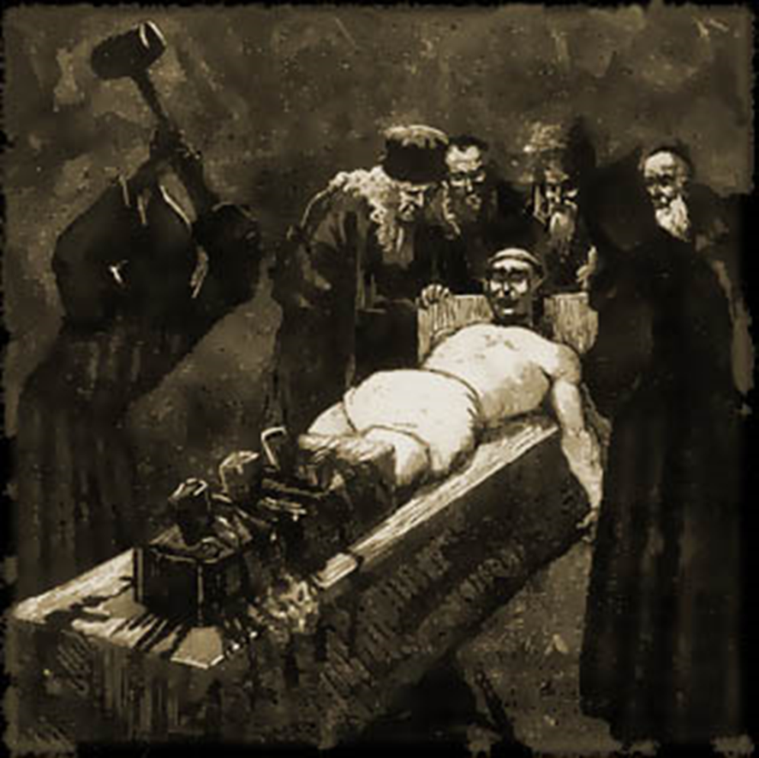

Slide 7
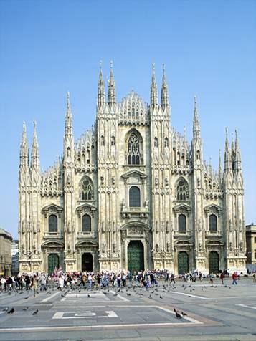
  Gothic cathedrals became the castles of the church

Slide 8
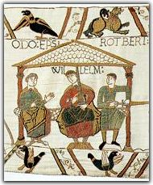
Monarchs Strengthened their Power
  English Monarchs
    William the Conqueror
      William defeated Harold Godwinson at the Battle of Hastings in 1066
      The French Duke of Normandy was now King of England
      William redistributed all of the English land to his vassals
      Appointed Norman Bishops
      England became the most centralized European kingdom

Slide 9
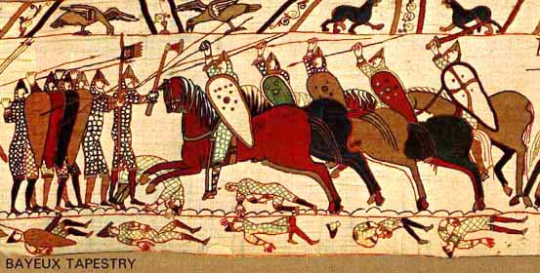
You Tube - The Bayeux Tapestry
Records the Story of Williams Victory at Hastings

Slide 10
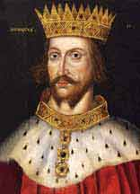
    Henry II
      Introduced the use of jury trials
      Over the centuries a code of laws was built case by case, this became known as English Common Law

Slide 11
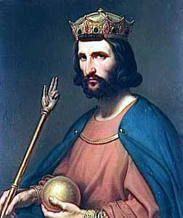
  French Monarchs
    Hugh Capet est. the Capetian Dynasty in 987
    Capetian kings ruled peacefully for 200 years
    Allowed Paris to dominate trade and unite France

Slide 12
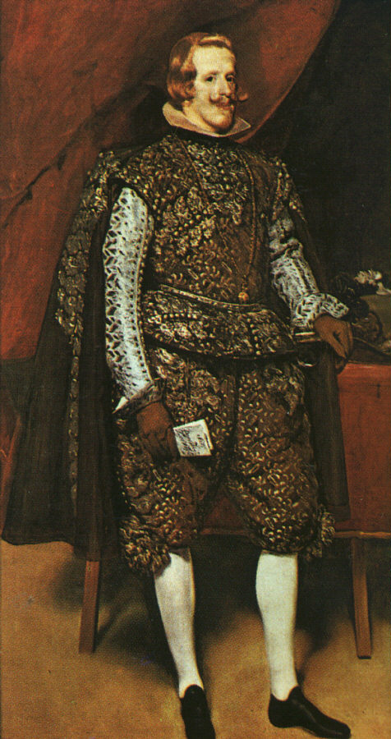
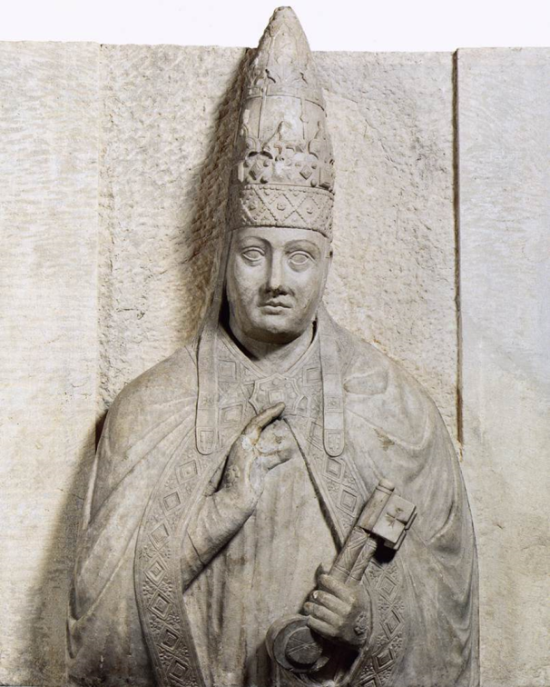
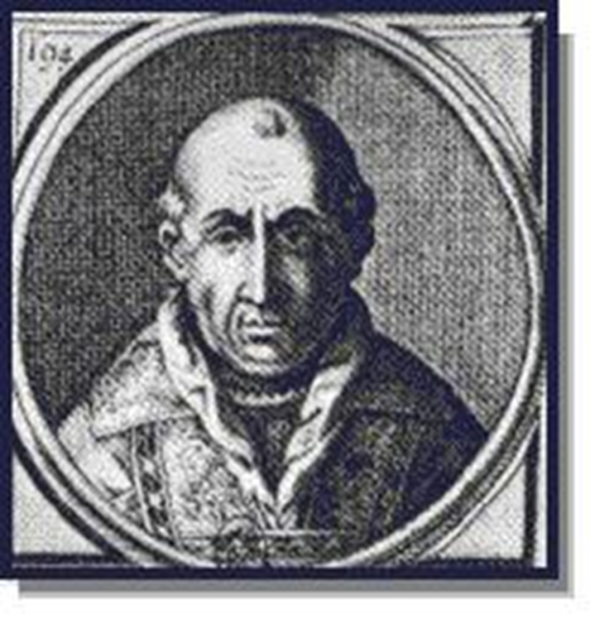
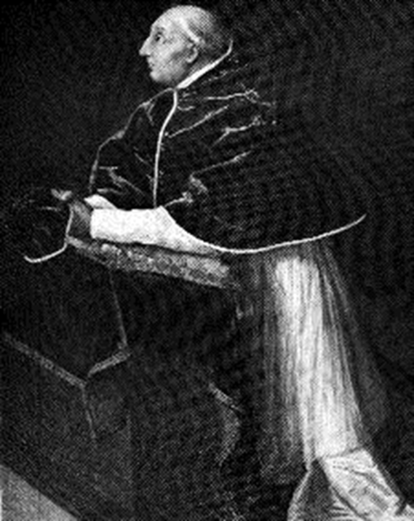
  Phillip IV of France
    Attempted to tax the Church
      Pope Boniface VIII declared Pope’s power supreme
      Phillip kidnapped Boniface; he dies from the ordeal
      Persuades cardinals to elect Clement V Pope
      Clement moves the Church from Rome to Avignon
        Results in two Popes – The Great Schism
        Conflict resolved in 1417 – Martin V chosen as the one true Pope

Slide 13
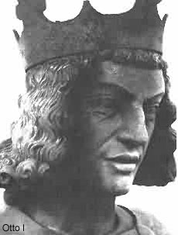
  German Monarchs
    Otto I used his power to dominate the Church
      Defended the Pope and was rewarded by being crowned Holy Roman Emperor
      Italians feared being ruled by Germans

Slide 14
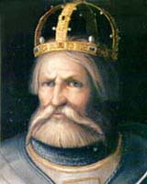
    Frederick Barbarossa
      Invaded Italy several times
      The Pope united with the Lombards to defeat Fred.
      Germany became divided amongst many princes

Slide 15
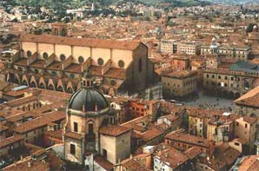
The Revival of Learning
  As trade spread literacy grew
    Universities were built in Paris and Bologna
    Lost works of the Greeks were rediscovered
    Poems written to stress Chivalry
      Results in the idea of Romantic Love

