Slide 1
Unit 4-4
The Crusades and the Revival of Europe

Slide 2
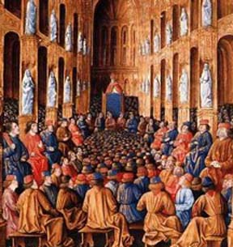
The Crusades
  In 1095 Pope Urban II sought to gain control of the Holy Land
    Urban wanted to reunite the Church under his leadership
    Chance for nobles to claim more land
    Merchants profited from financing crusades

Slide 3
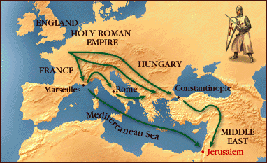
  The Crusades produced mixed results
    1st Crusade captured Jerusalem in 1099
      Four Crusader states were each ruled by European nobles
    2nd Crusade failed to reconquer the city of Edessa
    Jerusalem fell to the Muslim leader, Saladin in 1187
    3rd Crusade resulted in a treaty that allowed pilgrimages
    4th Crusade sacked Constantinople
    Children’s Crusade: 1,000s under 18 died

Slide 4
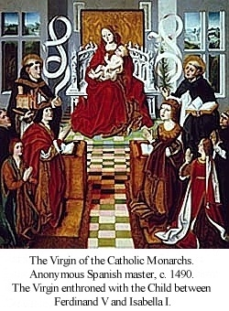
  The Reconquista (Spanish Crusade)
    The marriage of Ferdinand and Isabella created a strong Catholic kingdom
      All Jews and Muslims forced out of Iberia (Spanish Peninsula)

Slide 5
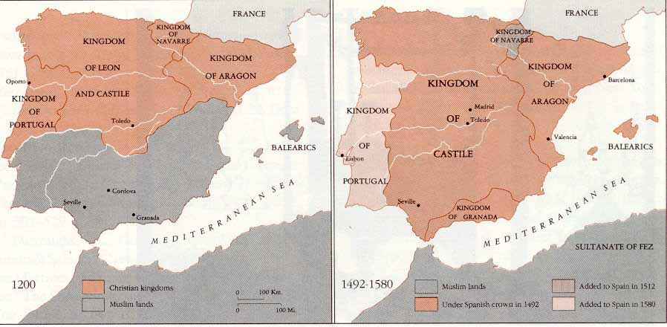
    Isabella defeats the Muslims at Grenada in 1492
    Jews must convert or leave
    Results in a weakened Spanish economy
      Jews and Muslims made up most of the middle class
      Spain has no one left to tax

Slide 6
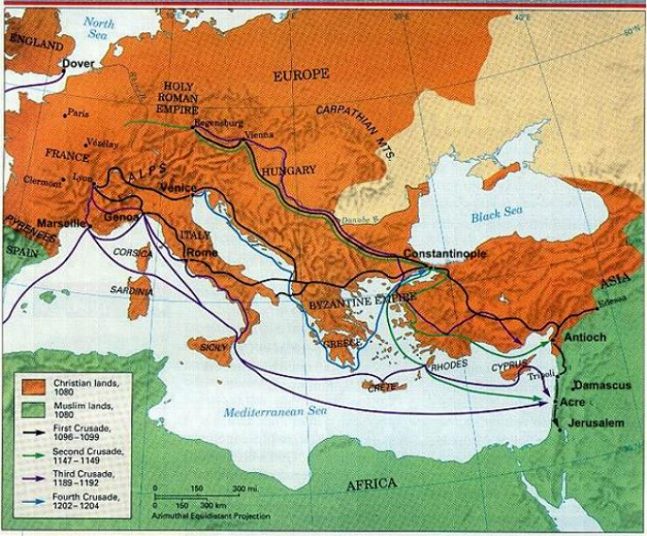
  Crusades had a significant impact on Europe
    Ended Europe’s isolation / Re-discover Greek philosophy
      Arabic achievements in math & medicine spread to Europe
      Europeans desire goods that come through Muslim lands

Slide 7
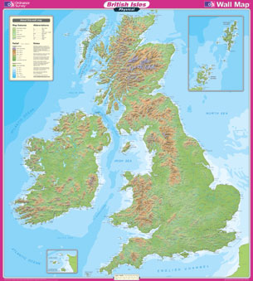

Slide 8
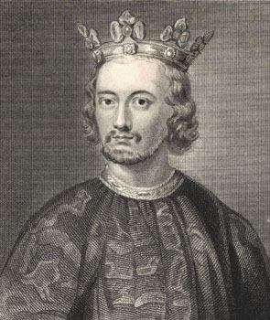
England
  John I grandson of William the Conquer
    Controlled all of England & ½ of France
    Fought a war with France and lost all the English territory in France

Slide 9
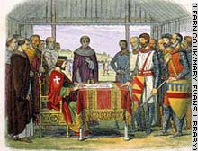
  John had to tax his nobles to pay for the war
    English nobles agreed to the taxes with exceptions
      John had to sign the Magna Carta
        Limits kings power to levy taxes
        Creates a system of due process of law

Slide 10
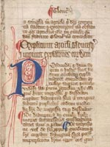

Slide 11
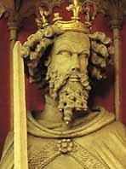
  Edward I – Nobles refused another tax increase
    Lords and Commoners call a meeting - the Model Parliament
    Both Nobles and Burghers now have to consent to new taxes

Slide 12
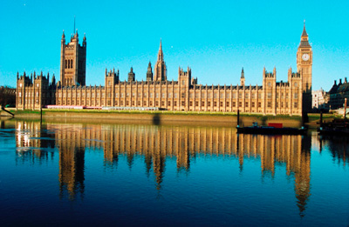

Slide 13
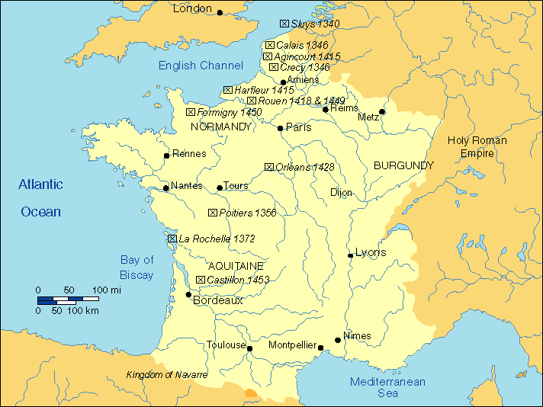

Slide 14
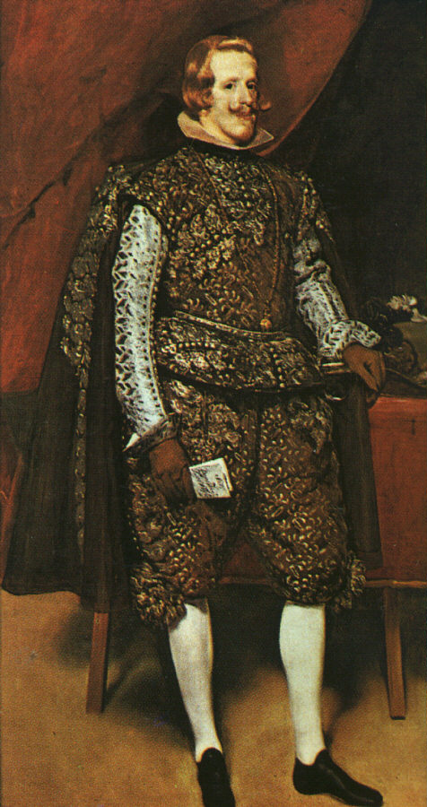
France
  Phillip IV – Creates The Estates General
    1st Estate: The Church; 2nd Estate: Feudal Lords; 3rd Estate: Bourgeoisie
      Monarchy increased power by taxing middle class

Slide 15
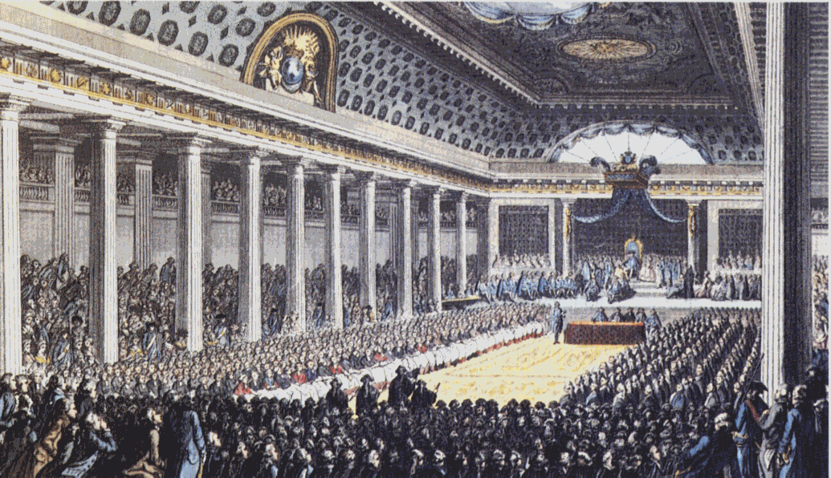

Slide 16
The Black Death and Its Consequences
  A series a bad harvests result in a shortage of food
  The Bubonic Plague was brought to Italy by trading ships
    1/3 of Europe’s population died within 5 years
    Creates a labor shortage / survivors have to do more work
      Results in a demand for higher wages
      Severely weakens feudalism

Slide 17
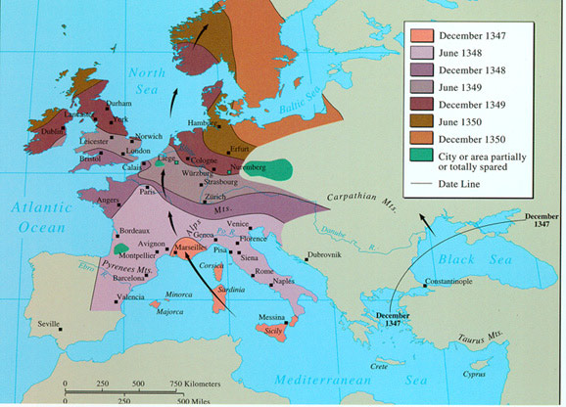


Slide 18
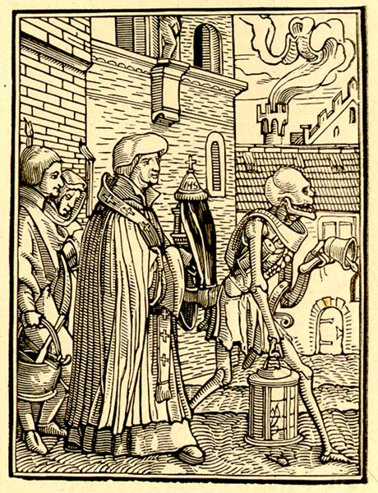
The Black Death

Slide 19
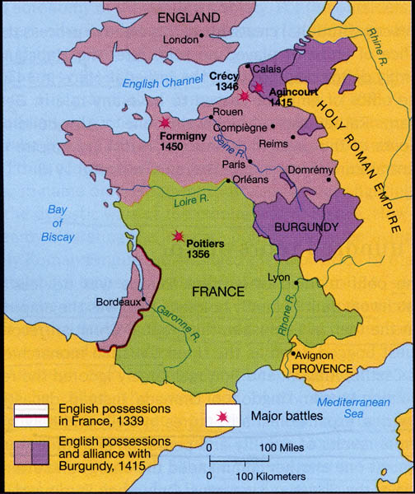
The Hundred Years War – 1337-1453
  Fought between France and England over disputed territory
  Heroes create a new sense of nationalism

Slide 20
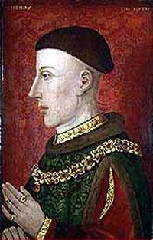
    Henry V – Defeats 50,000 French troops with 8,000 English long bowmen

Slide 21
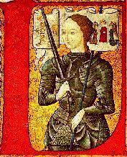
    Joan of Arc – French shepherd girl who gained command of an army: won the Battle of Orleans

Slide 22
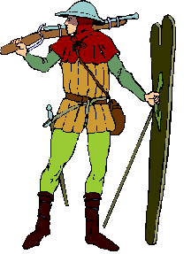
  Use of firearms reduces the power of knights
  French win because of superior cannons
    Nations begin to avoid fighting costly wars and encourage trade

