Slide 1
Unit 5-1 Notes
The Italian
Renaissance

Slide 2
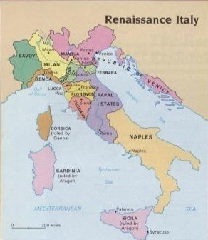
Italian City States
  Genoa and Venice
    Early cities that emerged around 1300
    Dominated Mediterranean trade
    Venice financed the 4th Crusade
    Most of Europe remained rural

Slide 3
  Merchants Gained Power
    Weaknesses in the Holy Roman Empire and Catholic Church allowed merchants to operate w/out regulation
    Merchants competed for control of trade routes
    Merchants financed art as a means of social status

Slide 4
    The Medici
      Controlled Florence as traders and bankers
      Never held an official office
      Used wealth to beautify Florence

Slide 5
Expression Through Art
  Early Artists and Writers
    Giotto painted frescoes that displayed human emotion

Slide 6
    Dante wrote the Divine Comedy
      Questioned the political and moral culture of the Renaissance
      Written in the vernacular not Latin

Slide 7
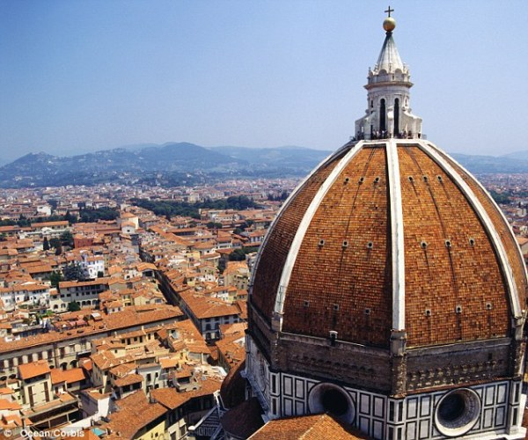
    Brunelleschi constructed Florence’s cathedral’s dome

Slide 8
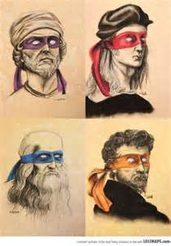
The Four Most Famous Artists

Slide 9
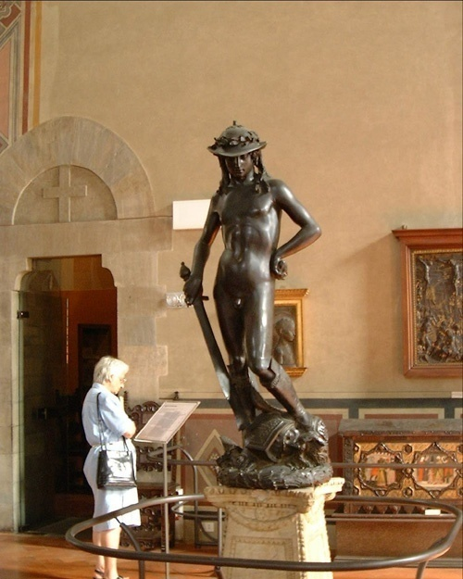
Donatello sculpted free standing statues – Mary Magdalene and David

Slide 10
    Machiavelli wrote politics in The Prince
      Most people are selfish, fickle, and corrupt
      Leaders may have to trick their enemies and their own people for the good of the state
      Leaders should do what is politically effective not what is morally correct

Slide 11
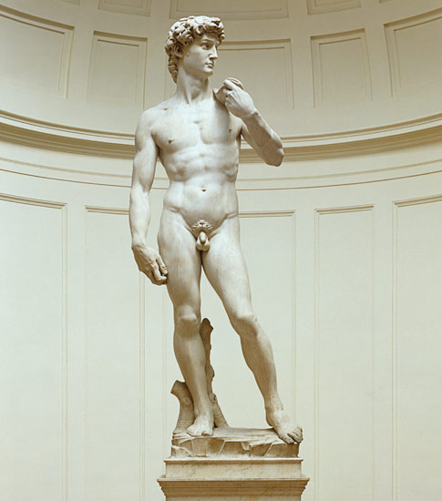
  Renaissance Art Spread
    Popes used the wealth of the Church to beautify Rome
      Michelangelo hired by Pope Julius II to paint the Sistine Chapel – also sculpted the Pieta and another David

Slide 12
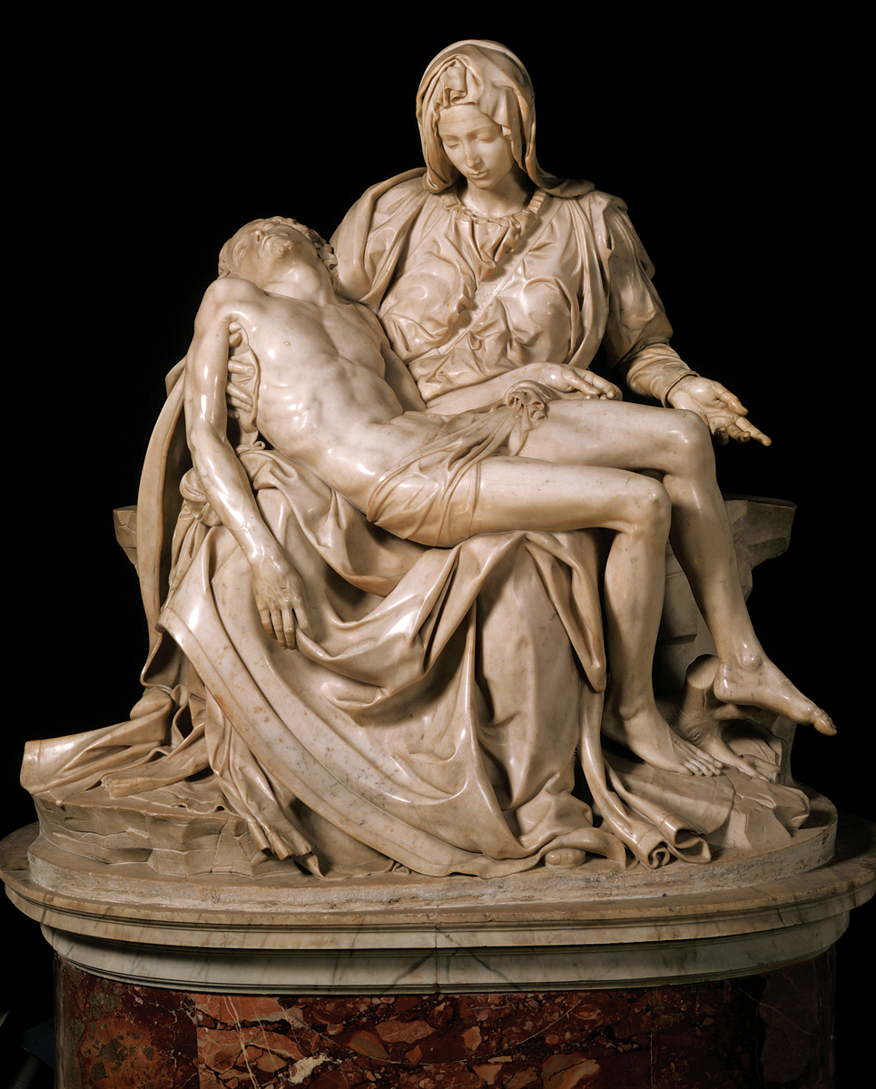

Slide 13
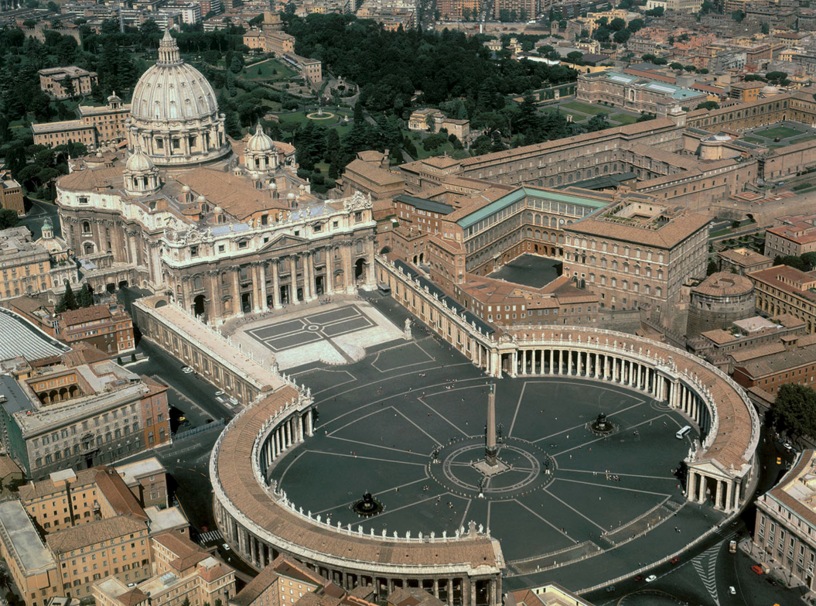
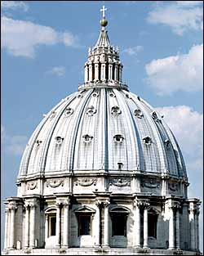
Michelangelo also designed a new church for the Pope in Rome – St. Peter’s Basilica
  The Pope was jealous of Brunelleschi's cathedral in Florence

Slide 14
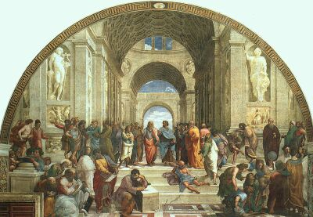
      Raphael hired by Julius II to paint the Papal Library

Slide 15
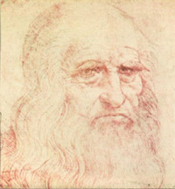
      Leonardo da Vinci, artist & inventor: Renaissance Man
        Painted the Mona Lisa and Last Supper

Slide 16
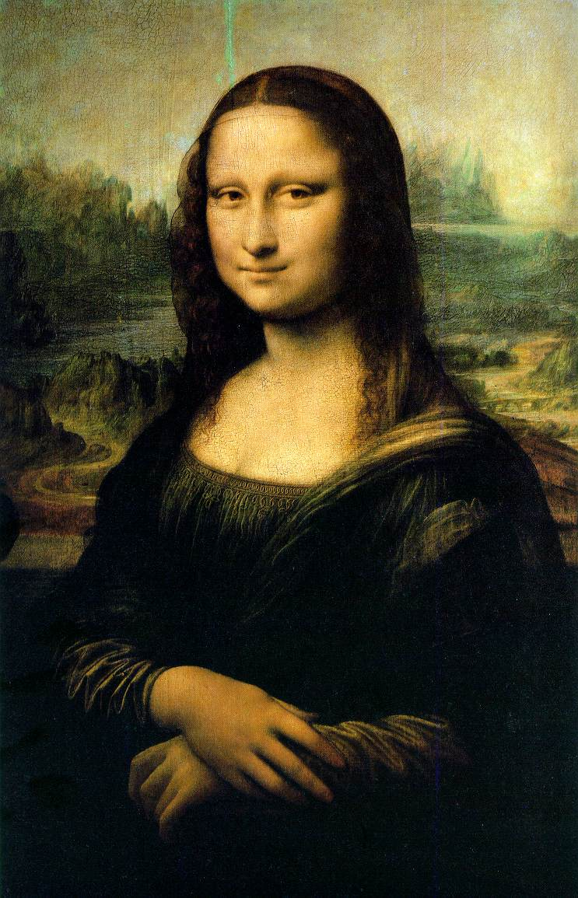

Slide 17
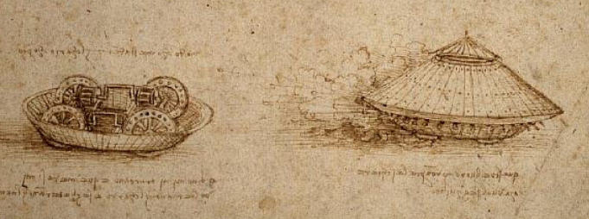
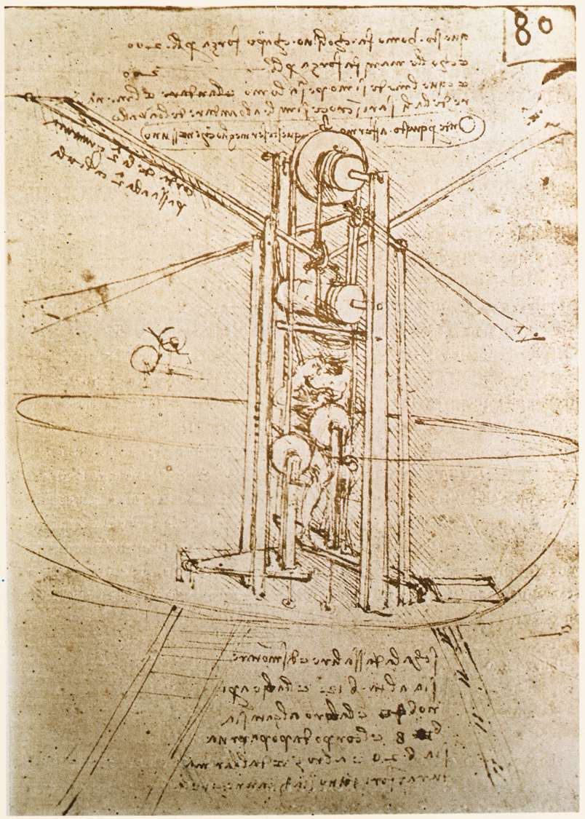
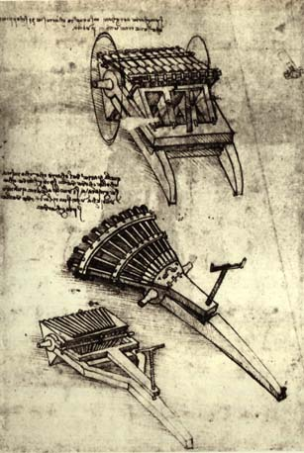
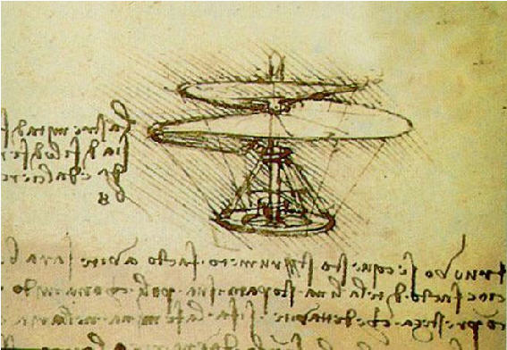
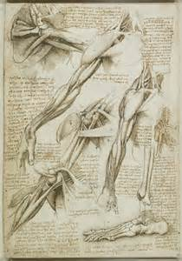
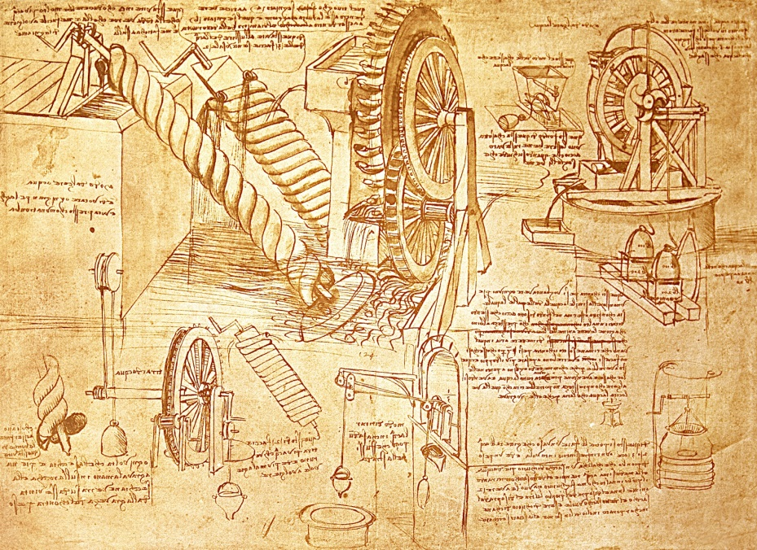
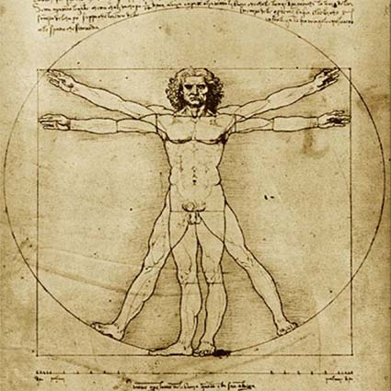

Slide 18
Renaissance Ideals
  The Renaissance saw a return to the ideals of the Greeks and Romans
    Humanists carried on the ideals of the Classical Period
  People openly enjoyed worldly pleasures
    Conflicts with the Church’s ideas on morality and piety
    The Renaissance’s focus on the individual eventually leads to the rebirth of democratic ideals

Slide 19
Unit 5-2 Notes
The
Protestant
Reformation

Slide 20
The Early Reformation
  Problems Within the Catholic Church
    Popes began to concern themselves with earthly and not spiritual affairs
      Many popes lived a lavish lifestyle

Slide 21
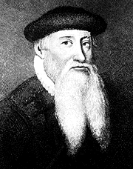
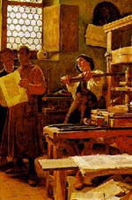
  The Print Revolution
    The printing press was imported from China
      1455 Johann Gutenberg prints many Bibles
      Allows more people to READ the Bible
    Books criticizing the Church were also widely circulated

Slide 22
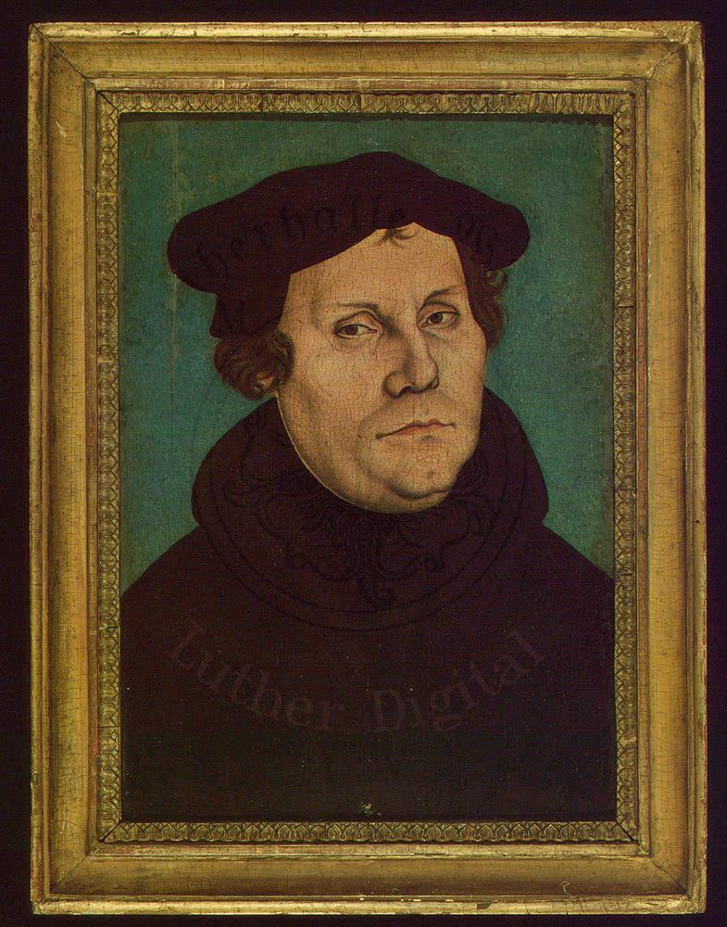
Martin Luther 1483-1546
  Extremely pious German Monk
    Studies the Bible at length
    Receives a revelation that salvation is gained through faith

Slide 23
  Johann Tetzel began selling letters of indulgence
    A way to “buy your way into heaven”

Slide 24
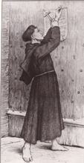
  October 31, 1517 – Martin Luther nails 95 theses to the church door
    Marks the beginning of the Protestant Reformation

Slide 25
    Luther’s theses were based on three main ideas:
      Salvation is achieved by faith alone
      All people, not just priests, were capable of reading and interpreting the Bible
      Bible is the final authority for Christians NOT the Pope

Slide 26
Pope Leo X excommunicates Luther

Slide 27
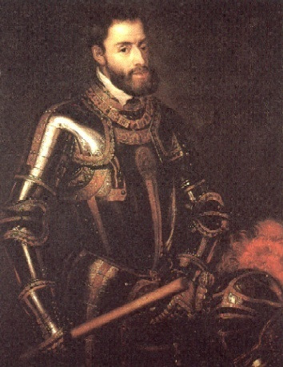
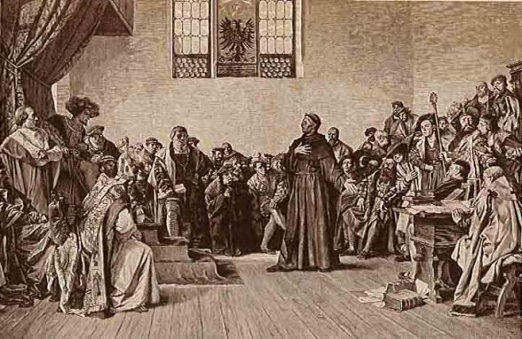
  Holy Roman Emperor Charles V
    Edict of Worms labels Luther a heretic and an outlaw
    German people ignored the ruling and protect Luther
      By 1530 many German’s began to call themselves Lutherans

Slide 28
      Luther encouraged peaceful reform; serfs used violence
      German princes crushed the revolt
        Princes favored Lutheranism to avoid Catholic tithes
        Signed a “protest” against the Pope = Protestants

Slide 29
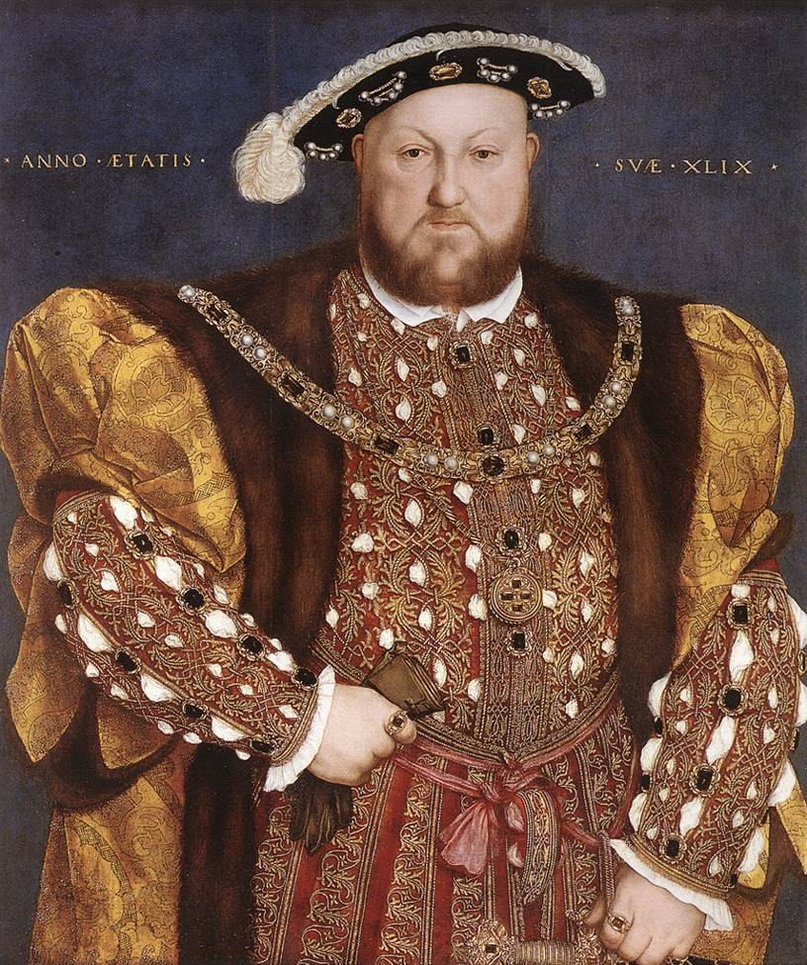
England Reforms Under Henry VIII
  Lived most of his life as a devout Catholic
  Denounced the teachings of Luther
    Married to Catherine of Aragon – HRE Charles V’s aunt
      Catherine produced no male heir
      Pope refused to grant a divorce

Slide 30
  Parliament stripped the Pope of any power in England
    Appointed Henry head of the English (Anglican) Church, - The Act of Supremacy
    Henry seized all Catholic lands in England and redistributed them among his nobles

Slide 31
French Protestants - John Calvin
  Institutes of the Christian Religion proposed the idea of predestination
    Those chosen as the elect should rule as a theocracy
    Became as oppressive as the Catholic Church
    Followers in France became known as Huguenots

Slide 32
  John Knox formed the Presbyterian Church in Scotland based on Calvin’s teachings

Slide 33
Unit 5-3 Notes
The Catholic Reformation & The Scientific Revolution

Slide 34
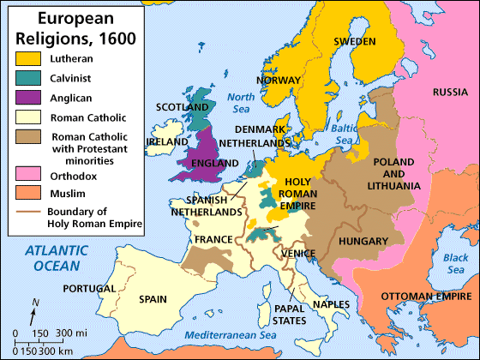

Slide 35
  Catholic Reforms
    Reforming Popes Attempted To:
    Stop the spread of Protestantism
    Strengthen and purify the Catholic Church

Slide 36
  Pope Paul III
    created the Society of Jesus (Jesuits)
      Jesuits believed in strict discipline
      Willing to travel around the world to gain converts
      Built schools that taught the classics and theology

Slide 37
    Ordered an investigation into Catholic abuses
    Called the Council of Trent
      Only the Pope’s interpretation of the Bible is correct
      Christians could be saved by faith and good works
      Both the Bible and Church tradition should be used as guides for Christians
    Selling of indulgences was banned

Slide 38
II. H.R.E. Charles V
  Wages a war against the Protestant German Princes attempting to stop the spead of Protestantism
    Catholic German Princes refused to fight for Charles
    All Princes ordered to meet at Augsburg
      The Peace of Augsburg: allowed German Princes to choose either Lutheranism or Catholicism

Slide 39
      Charles views treaty as a failure
        Abdicates H.R.E. throne to his brother Ferdinand
        Abdicates Spanish throne to his son Philip II
Phillip II of Spain

Slide 40
The Scientific Revolution
  Nicolas Copernicus
    Questioned Aristotle’s and Ptolemy’s geocentric theory
      On the Revolutions of the Heavenly Bodies proposed a heliocentric theory
      Angered both Protestant and Catholic leaders

Slide 41
  Johannes Kepler
    Proposed three laws of planetary motion
      Planets revolve around the sun in elliptical orbits
      Planets move faster as they approach the sun
      Time to orbit the sun varies proportionately with their distance from the sun
    Leads to the creation of the Scientific Method
      Logical procedure for gathering and testing ideas
      Many begin to question Christian faith and values

Slide 42
  Galileo Galilee
    Early mathematician and physicist
      Built several telescopes to study the heavenly bodies
        Observations prove the heliocentric theory
    Seen as a threat to the Catholic & Protestant churches
      Spent the last 9 years of his life under house arrest

Slide 43
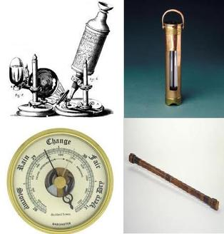
  Invention of the microscope, thermometer, and barometer allowed scientists to make accurate measurements

