Slide 1
Unit 6
The Americas and European Exploration

Slide 2
Unit 6 Part 1
Chapter 6 sections 1 and 2
Civilizations of Mesoamerica
Andean Cultures of South America

Slide 3
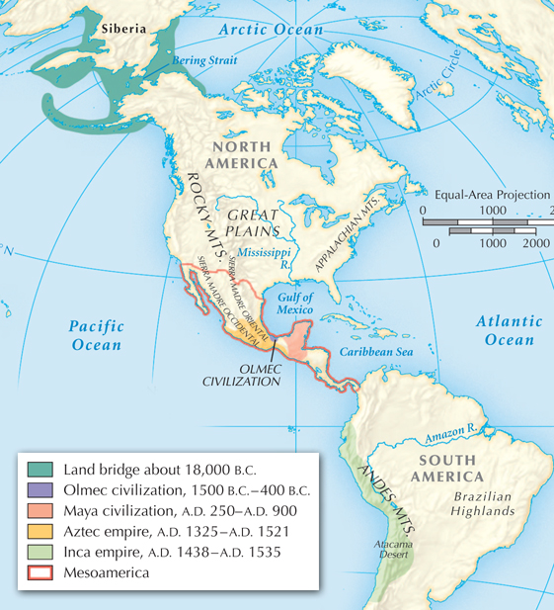
The first people to arrive in America may have walked over a land bridge connecting Siberia and Alaska during the last Ice Age, about 10,000 years ago.
They walked or possibly paddled southward along the coast.

Slide 4
The first people found a wide range of environments
in the Americas.
Neolithic people
began to domesticate animals and raise crops between
8500 B.C.
and 2000 B.C.
In tropical parts of Mesoamerica they raised beans, squash, peppers, tomatoes, sweet potatoes, and maize.
Mesoamerican farmers had settled into villages by about 1500 B.C.
Notes:
4

Slide 5
The earliest American civilization emerged in the tropical forests along Mexico’s Gulf Coast.
Olmec civilization lasted from 1500 B.C. to 400 B.C.
They developed a calendar and artistic styles that were copied by later civilizations.
They carved huge heads and hieroglyphics in stone.
Notes:
5

Slide 6
Maya civilization flourished on the Yucatán Peninsula and through much of Central America.
By 300 B.C. there were Mayan cities.
The golden age of Mayan culture began in about A.D. 250.
The Maya never formed an empire, but they had many powerful city-states. Tikal and Calakmul were the strongest.

Slide 7
Agriculture was at the base of Mayan civilization.
Two farming methods allowed the Maya to thrive in their tropical environment.
Forests were burned, cut, and planted. When they became infertile, farmers moved to another site while the soil recovered.
Along river banks, fields were planted on raised areas built to keep the crops above the rainy season high-water mark.

Slide 8
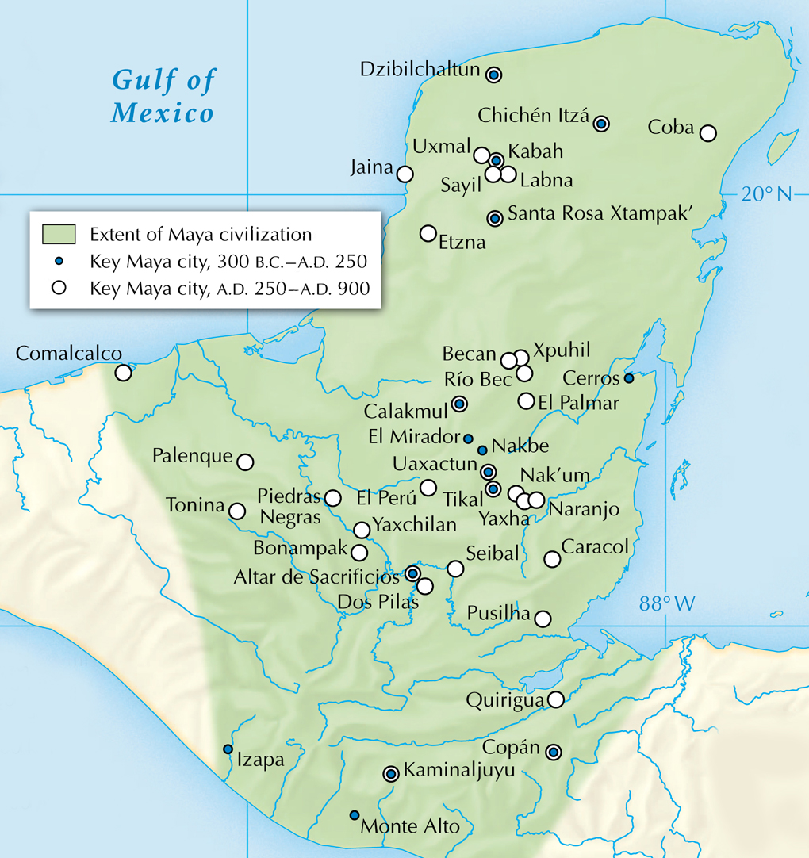
Mayan cities traded along roads made of packed earth.
They traded food items such as honey and fruit and luxury goods such as jaguar pelts, feathers, and jade.

Slide 9
Most Mayan
leaders were men,
though women
did rule at
times in
some cities.
Nobles
served as
military leaders
and administrators.
Scribes, painters, and sculptors were a respected class of workers.
Merchants may have formed a middle class.
Most Mayans were farmers. They paid taxes
and worked on city construction projects.
Slaves were commoners captured in war.

Slide 10
Mayan culture included sculpture and stone architecture.
Large stone temples on pyramid-shaped platforms were the site of ceremonies and sacrifices.
Tall sculpted stone monuments, each of which is called a stela, preserved images of rulers and gods.

Slide 11
Mayan Achievements
Scribes recorded
events in stone using carved hieroglyphics.
Scribes made books of bark pages, but most of these were destroyed by Spanish priests.
They developed a
365-day calendar and a numbering system with place values and a zero.
Mayan civilization declined after A.D. 900, but their descendants still live in Guatemala and Mexico.

Slide 12
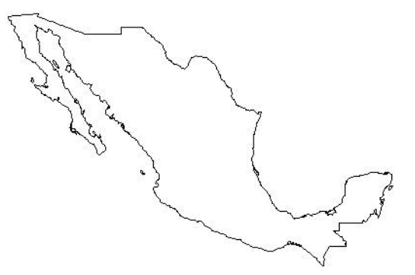
About A.D. 1200 the Aztecs settled in the Valley of Mexico.
In A.D. 1325, they built their capital at Tenochtitlán on Lake Texcoco.
Tenochtitlán

Slide 13
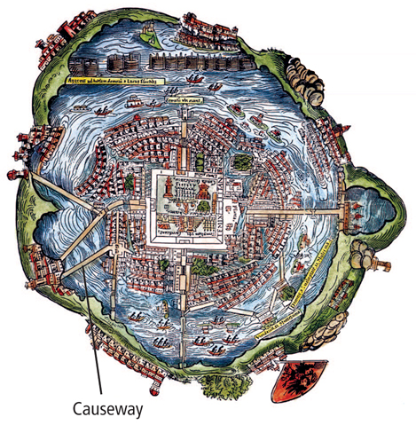
Tenochtitlán was built on an island connected by stone causeways to the mainland.
This Spanish sketch
of the city, made in
the 1500s, shows crowded buildings
and causeways.

Slide 14
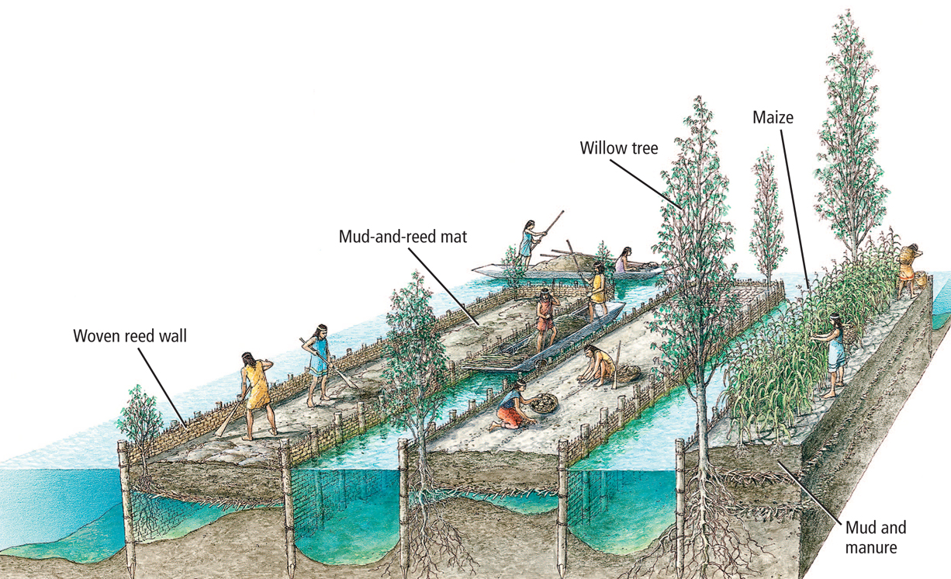
Aztec farmers supported a large urban population.
Chinampas, artificial islands, were built to allow farming on the shallow lake.

Slide 15
The Aztecs had
a structured society:
The
emperor
was the
military leader.
Nobles were
government officials.
Great warriors became nobles.
Priests were a separate class.
The middle class included wealthy traders.
The largest group, commoners, were mostly farmers.
Serfs and slaves were prisoners of war and debtors.

Slide 16
Aztec religion was influenced by the previous culture at Teotihuacán.
Teotihuacán dominated valley life from A.D. 200 to A.D. 750.
The two groups worshipped some of the same gods, including Quetzacoatl, the god of earth and water, and Tlaloc, the rain god.
Aztecs believed the gods had created their world in Teotihuacán.

Slide 17
The Aztecs were frequently at war.
Conquered neighbors were forced to pay tribute.
Prisoners of
war might be sacrificed to Nanahuatzin,
the sun god.
Neighboring tribes allied themselves with the Spanish in the 1500s to gain revenge on the Aztecs.

Slide 18
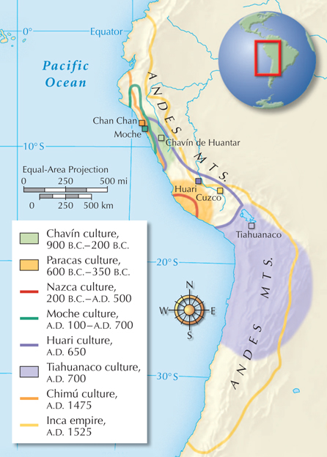
The first cultures of South America developed in the Andes Mountain region along the Pacific coast of Peru and Chile.
Beginning along the coast, people moved inland, first
into river valleys and then
on to the high plateaus.

Slide 19
Over 2,000 years, several civilizations arose.
The Chavín
900 B.C.–200 B.C.
Built a large temple complex; may have united the people of northern and central Peru.
The Moche
A.D. 100–A.D. 700
Built adobe structures, roads, and irrigation canals in Peru; artists created fine ceramics, textiles, and
gold work.
The Nazca
200 B.C.–A.D. 500
Etched mysterious,
huge geoglyphs of animals into the desert by moving miles of soil and rocks.

Slide 20
Over 2,000 years, several civilizations arose.
Hauri
A.D. 650
A large city east
of the Nazca;
it controlled much of Peru’s mountain and coastal area.
Tiahuanaco
A.D. 700
Became a powerful city south of Lake Titicaca in Bolivia;
it ruled over parts of Peru, Argentina, and Chile, and traded with Hauri.

Slide 21
The most powerful Andean civilization belonged
to the Inca.
From his capital of Cuzco, Pachacuti
began the conquest of an Andean empire that stretched 2,500 miles.
It was continued by
his son Topa Inca Yapanqui.
In 1438 Pachacuti
Inca Yupanqui proclaimed himself Sapa Inca, or emperor.

Slide 22
The Sapa Inca had absolute power.
Since there was no private property, all worked
for the Sapa Inca doing public works.
He exacted a labor tax and efficiently organized
and fed his people.
He claimed to have descended from the sun.
Gold, the “sweat of the sun,” was his symbol.
The Coya, his queen, ruled in his absence.
He owned all land, herds, and mines in the empire.

Slide 23
The Inca rulers ran an efficient government.
Nobles ruled the provinces along with local chieftains.
Officials enforced the law and organized labor.
Specially trained officials kept records on quipus.
Quipus were collections of knotted strings that represented various numbers. The Incas had no
writing system.

Slide 24
The Inca unified their empire using language, religion, a system of roads, and their army.
All citizens had to use the language, Quechua, and practice the Inca religion.
An extensive network of over 14,000 miles of roads crossed the empire. Ordinary citizens could not use the roads, and trade was limited.
Bridges over high gorges, tunnels, and numerous military outposts allowed troops to move quickly.

Slide 25
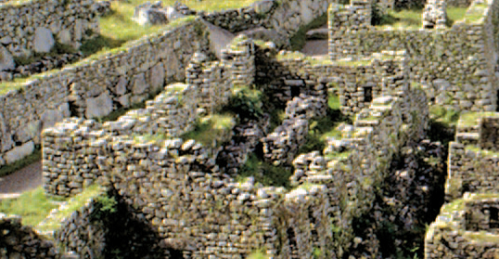
The Inca system of roads all led to Cuzco, the capital.
People from all over the empire lived in Cuzco.
They practiced many traditional crafts.
In the heart of the city was the Sun temple, which had walls lined with gold.
Forts and temples were constructed of huge stones placed so precisely that they have withstood centuries of earthquakes.

Slide 26
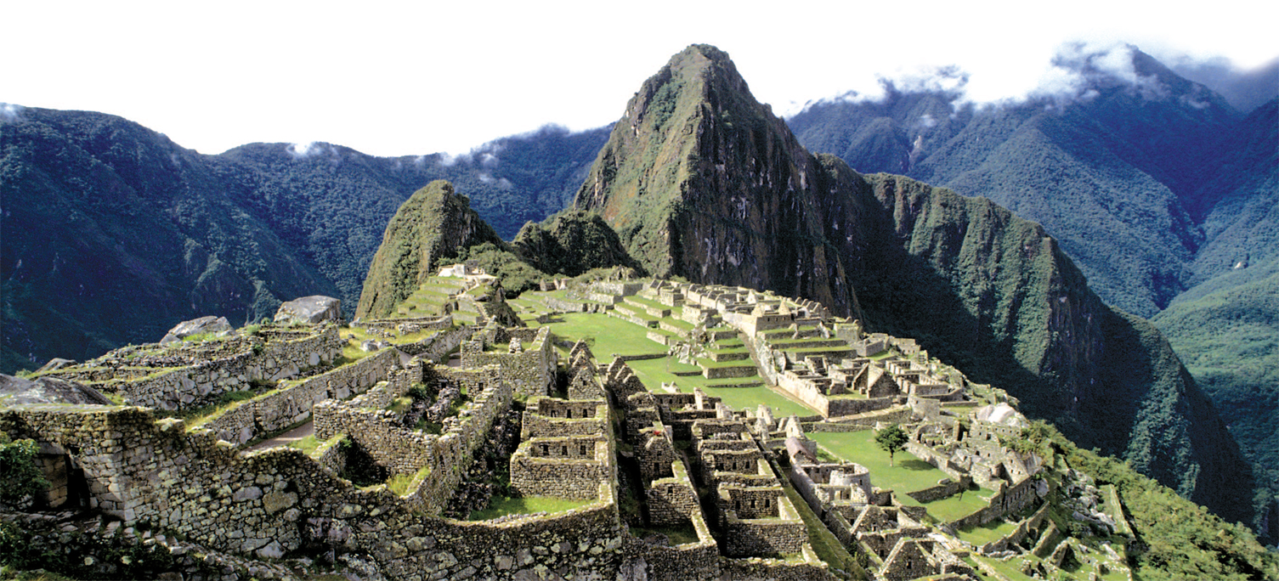
Machu Picchu remains today as a marvel of
Inca stonework.

Slide 27
The Inca strictly regulated the lives of the millions of people who lived in their empire.
In each village, an ayllu assigned jobs, organized work, and even arranged marriages.
Farmers worked for their community, with the government allotting shares of the harvest.
Farmers also worked on construction projects such as the terraces used for hillside farming.

Slide 28
The Inca were skilled in many fields.
In addition to
their skills as stonemasons, the Inca were experts in metalwork using copper, gold, tin, silver, and bronze.
The Inca were experts at weaving, using cotton and wool from llamas and alpacas.
Inca doctors cleansed wounds for surgery and used a drug
to make
the patient unconscious.

Slide 29
Religion and ritual were important to Inca life.
A powerful class of priests served the gods.
Chief among those gods was Inti, the sun god.
Special attendants called chosen women prepared ritual food and drink.
Special festivals celebrated each month with ceremonies, sports, and games.

