Slide 1
Unit 6 part 2
14-1 The Search for Spices
15-1 Conquest in the Americas

Slide 2
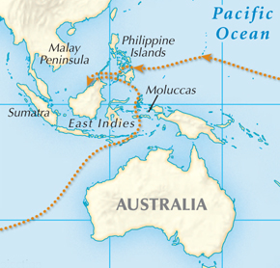
Europeans desired luxury goods from Asia, especially spices.
Muslim traders brought the goods to the Mediterranean.
Italian merchants carried them to European cities.
Most spices came from a chain of islands called the Moluccas.

Slide 3
Spices were used to flavor meats, preserve
food, and create perfumes and medicines.
Europeans had been introduced to these goods during the Crusades, but demand dropped during the Black Death.
Europeans outside of Italy realized it could be highly profitable to gain direct access to Asia.

Slide 4
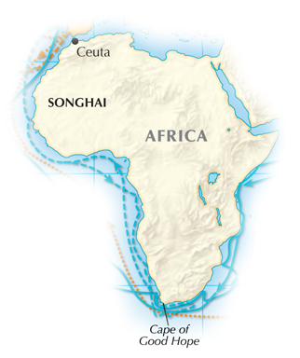
Led by Prince Henry “The Navigator,” Portugal expanded and explored along the coast of Africa.
Henry gathered cartographers and scientists.
They redesigned ships, trained sea captains, and prepared maps.
Henry inspired explorers and sponsored voyages.
Portugal hoped to Christianize the Africans and find a route to Asia.

Slide 5
New technology and old tools were adapted
and improved to aid navigation.
magnetic compass | First used by the Chinese; showed direction
portolan maps | Maps with lines radiating from compasses that showed routes to important ports
astrolobe | An ancient device, adapted for finding latitude and telling time
caravel | A new, lighter, fast ship that could travel long distances

Slide 6
Henry died in 1460, but Portuguese navigators continued his quest.
1488 – Bartholomeu Diaz rounded
the southern tip of Africa.
1490 – Vasco de Gama sailed around Africa and after 10 months reached India.
Vasco de Gama later helped Portugal claim
a vast trading network.

Slide 7
On August 3, 1492, Christopher Columbus sailed west from Spain with three ships.
Columbus knew the world was round.
Columbus was from Genoa, Italy, but had persuaded Ferdinand and Isabella of Spain to sponsor his journey.
He underestimated the size of the world and
sailed for many weeks.
He explored the islands of the Caribbean.

Slide 8
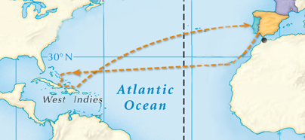
He returned to Spain a hero.
He led three more voyages to the New World but never realized it was not Asia.
Columbus believed he had reached the East Indies.
He called the people he found “Indians.”

Slide 9
In 1493 Ferdinand and Isabella appealed to
the pope to support their claim to all land in this new world.
Land to the west went
to Spain.
Land to the east went to Portugal.
The pope set a Line of Demarcation dividing all non-European land between Portugal and Spain.

Slide 10
In the Treaty of Tordesillas, in 1494, Spain and Portugal agreed to the line set by the pope.
The line was very imprecise due to the lack of knowledge of the geography at the time.
Other nations were eager to defy what they saw as arrogance on the part of Portugal and Spain.
An age of empire building began.

Slide 11
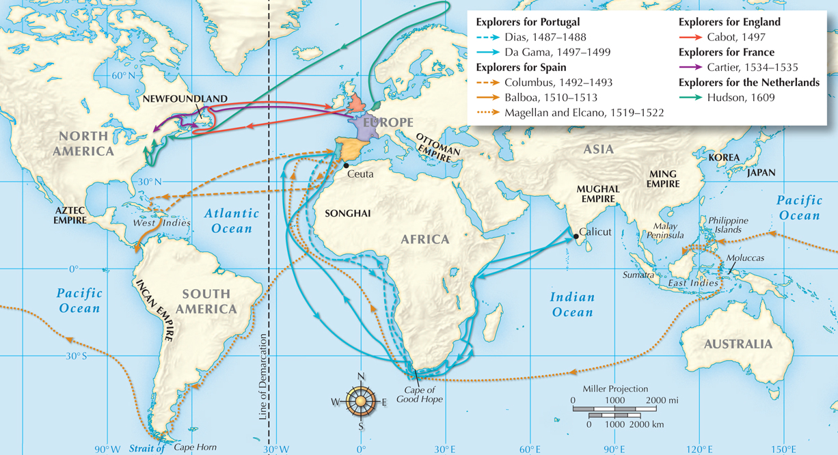
Early voyages of European explorers, 1487–1609

Slide 12
The Western Hemisphere was named “America” in 1507 by German cartographer Martin Waldseemüller.
The name came from Italian sea captain Amerigo Vespucci, who wrote about his visit.
The islands Columbus mistook for the East Indies became known as the West Indies.

Slide 13
The English, Dutch, and French explored
the coast of North America.
In 1513, Vasco Núñez de Balboa walked across the jungles
of Central America
and saw the Pacific Ocean, which he called the South Sea.
They unsuccessfully sought a “northwest passage” to Asia.

Slide 14
In 1519 Ferdinand Magellan set out to find a passage to the East by sailing south and west.
In 1521, after sailing around South America,
he and his crew crossed the Pacific and made it to the Spice Islands.
In 1522 one of his ships made it home to Spain, the first to circumnavigate the entire globe.

Slide 15
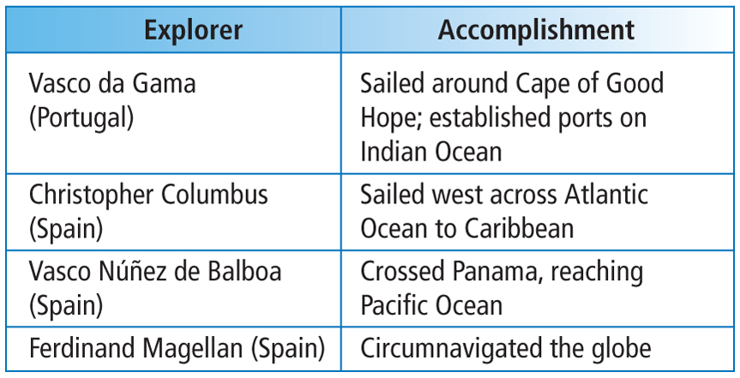
Important European Explorers

Slide 16
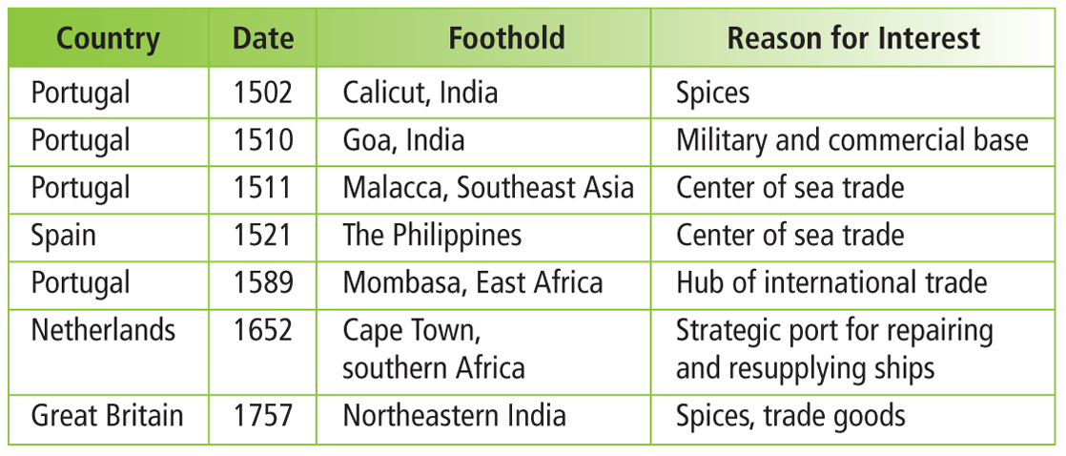
European Footholds in the Eastern Hemisphere

Slide 17
Christopher Columbus arrived in the West Indies and met the Taíno people in 1492.
They grew corn, sweet potatoes, and cotton and were very friendly to the Spanish.
Despite this, Columbus and his men were hostile. They killed Taínos who resisted them and claimed the land for Spain.
Notes:
17

Slide 18
Conquistadors who arrived in the new world in Columbus’s wake behaved the same way.
The deaths were a result of both force and disease. Native Americans lacked immunity to European illnesses.
A cycle began in which Spanish conquerors seized Native American gold and killed vast numbers of people.
Notes:
18

Slide 19
The Spanish had guns, cannons, metal armor,
and horses.
But the biggest factor
were the diseases they brought. Smallpox, flu,
and measles killed 90%
of the native population.
A tiny force of hundreds of Spaniards
conquered millions
of Native American.

Slide 20
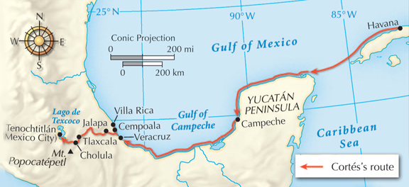
Hernán Cortés landed on the coast of Mexico in 1519 with 600 men.
  He planned to conquer the Aztecs and headed
  inland to Tenochtitlán.
Cortés was aided by a young Indian woman named Malinche, who served as trans-
lator and advisor.

Slide 21
Malinche helped Cortés form alliances with groups of people who’d been previously conquered by the Aztecs.
The Aztec emperor Moctezuma heard about the Spanish before they arrived. He sent gifts of religious importance and hoped they’d turn back.

Slide 22
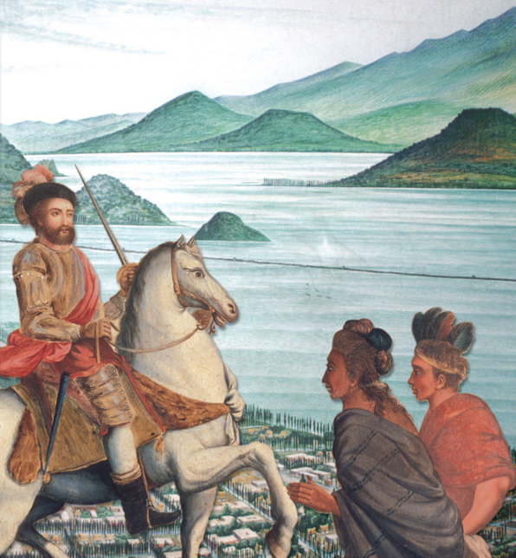
Cortés continued on to Tenochtitlán.
Montezuma welcomed
the Spanish, but hostilities quickly grew.
The Spanish tried to convert the Aztecs to Christianity and imprisoned Moctezuma
to gain control.

Slide 23
A new force of conquistadors arrived and challenged Cortés.
In the resulting struggle, the Aztecs drove the Spanish out of the city.
Cortés retreated to plan an assault and returned to Tenochtitlán in 1591.
This time, the city
was captured and
completely destroyed.

Slide 24
He began this quest in
1532, directly after an Inca civil war.
Atahualpa, the Inca ruler, refused to convert to Christianity. The Spanish captured and eventually
killed him.
Francisco Pizarro was inspired by Cortés to conquer the Inca empire in Peru.

Slide 25
Pizarro and his men overran the Inca empire and conquered much of the rest of the South America for Spain.
  As with Cortes, Pizarro benefited from superior weapons and diseases that killed millions of natives.
  Pizarro was killed by a rival Spanish group, but his actions forever changed the continent.

Slide 26
Effects of the Spanish Conquest
For the Spanish: | Spain became Europe’s greatest power. They seized huge quantities of valuable goods and established silver mines.
For the Native Americans: | Many lost faith in their gods, stopped resisting, and converted to Christianity. Some continued to fight the Spanish. Some resisted by preserving parts of their own culture.

