Slide 1
Unit 6 part 3
15-2 Spanish and Portuguese Colonies in the Americas
15-4 The Atlantic Slave Trade

Slide 2
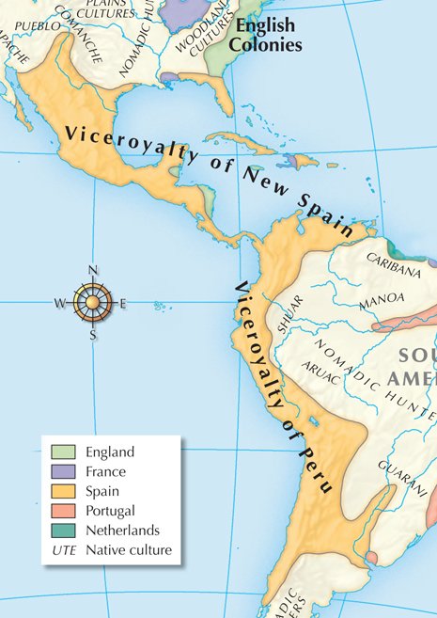
Spain controlled a huge empire by the mid-1500s.
  It divided the conquered lands into four provinces.
  The king appointed viceroys to rule in the provinces and established the Council of the Indies to monitor them.
Notes:
2
Map of Spanish empire, WH: p. 485.
Note this map appears in the book after Section 2, but I still think it is useful to show students how vast Spanish holdings were.

Slide 3
One of Spain’s main goals in the Americas was to spread Christianity.
As a result, Church leaders shared authority with royal officials.
Missionaries built churches and introduced European clothing and the Spanish language.
Notes:
3

Slide 4
Spain closely controlled trade throughout its empire.
Colonists could
export raw material
only to Spain.
They could only
buy Spanish
manufactured goods.
Trade with other
European nations
was forbidden
by law.

Slide 5
Sugar cane was introduced to the West Indies and became profitable.
It was grown on plantations that needed a large number of workers.
The Spanish used an encomienda system, in which labor could be demanded from Native Americans
in mines and on plantations. But the native population had fallen.
Notes:
Decline of Native American population graph, WH: p. 498.

Slide 6
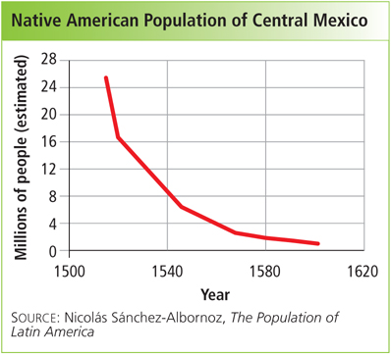
Notes:
Decline of Native American population graph, WH: p. 498.

Slide 7
Not everyone agreed that Spanish treatment of the Native Americans was fair.
A priest named Bartolomé de Las Casas condemned the encomienda system and pleaded with the king to end it.
Spain passed the New Laws of the Indies in 1542. Many natives were still forced to become peons, or workers forced to labor to pay off debts.

Slide 8
The Spanish started bringing millions of Africans to the Americas by the 1530s.
They were forced to work as slaves in the fields, mines, and households of landowners.
European, African, and Native American cultures began to blend together to form a distinct culture in the Spanish colonies.
Notes:
Clip art handshake

Slide 9
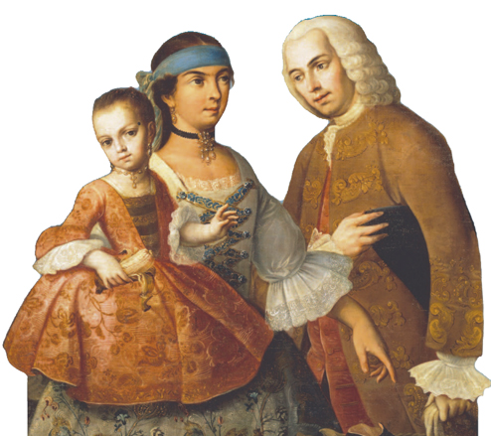
Cultural blending changed people’s lives in the Americas.
Food, religion, clothing, dance, songs, styles of building, and farming methods were all exchanged.
Notes:
A mixed race colonial family, WH: p. 480.
Population of Spanish America, WH: p. 480.

Slide 10
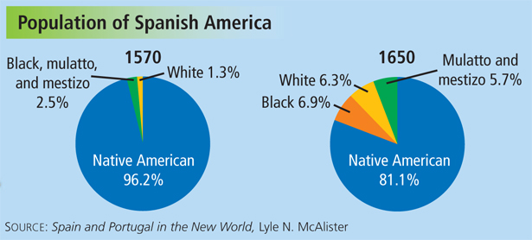
In addition, the composition of the population shifted.
Notes:
A mixed race colonial family, WH: p. 480.
Population of Spanish America, WH: p. 480.

Slide 11
Spanish colonial society was made up of layered social classes.
peninsulares | People born in Spain
creoles | American-born descendants of Spanish settlers
mestizos and mulattoes | Those of Native American and European descent and people of African and European descent, respectively
Native American and African | Those whose heritage did not include Europeans

Slide 12
The cities were lively centers of government, commerce, and cultural expression.
Mexico City became the largest Spanish-speaking city in the world by 1550.
The University of Mexico was established by 1551.
Spanish settlers lived in towns and cities and established universities.

Slide 13
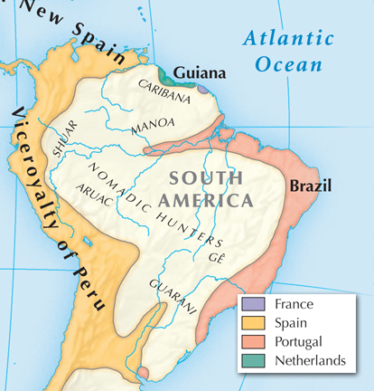
Portugal claimed an empire in the east part
of the continent in 1494.
  The country issued grants of land to nobles, and settlers came to build
  towns and plantations.
  They cut and exported brazilwood, raised cattle, and ran plantations.
Notes:
Portuguese colony in Brazil, WH: p. 485.

Slide 14
Other European nations grew jealous of Spain and Portugal’s wealth and control in the Americas.
Smugglers traded illegally with Spanish colonists.
Pirates called privateers operated with the approval of European governments.
Notes:
Pirate clip art.

Slide 15
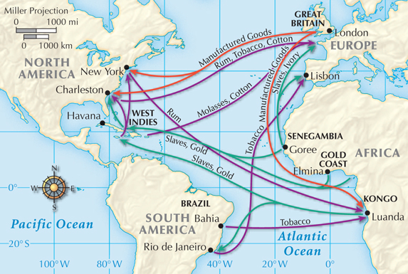
A series of trade routes linking Europe, Africa, and the Americas arose during the 1500s.
This was known as triangular trade.
The Atlantic slave trade, in which slaves were transported to America, was one part of the triangle.
Notes:
15

Slide 16
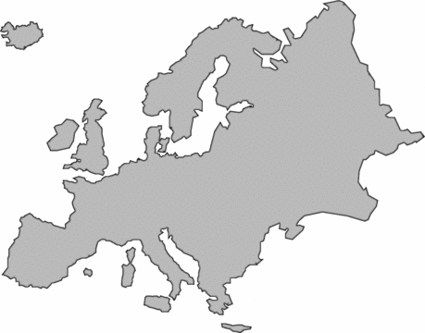
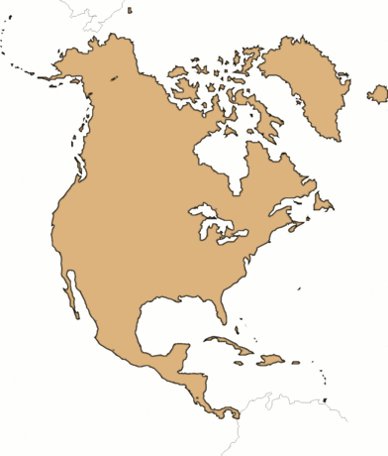
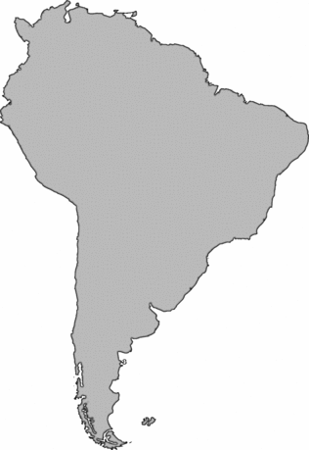
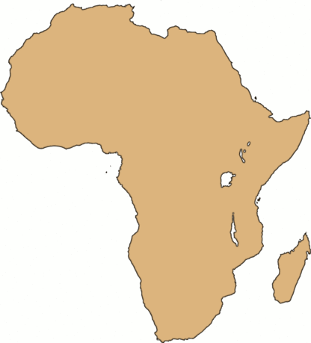
3. Finally, merchants carried goods from America to Europe—sugar, cotton, furs.
1. First, ships brought European goods
to Africa—guns,
cloth, cash.
2. Slaves were transported to
the Americas
on the second
leg, known as the Middle Passage.
Notes:
16

Slide 17
Merchants and certain
industries thrived. For
example, shipbuilding
and tobacco growing
were very lucrative.
Port cities such as Bristol
in England and Newport,
Rhode Island, grew quickly
as a result.
Triangular trade helped colonial economies grow.

Slide 18
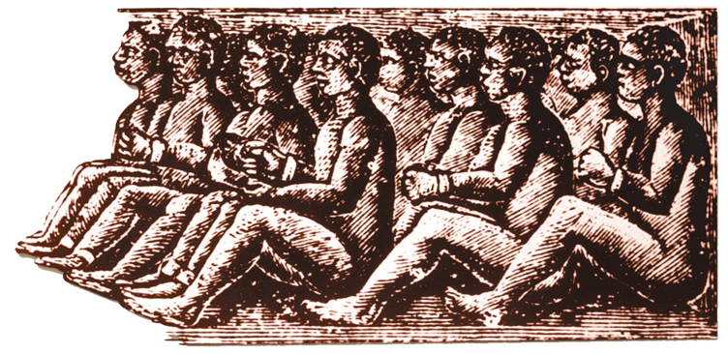
The Middle Passage was a terrible journey in which many people died.
Africans were taken from villages and forced to walk in chains to ports such as Elmina, Ghana.
Once on the ships, Africans were packed below the decks for a long voyage
of weeks
or months.

Slide 19
Slave ships faced many dangers and horrors on their journeys.
There were mutinies, storms at sea, and raids by pirates.
Slave ships were “floating coffins” in which up to half of
the Africans on
board died.
Most died of disease such as dysentery
or smallpox. Others committed suicide.

Slide 20
The impact of the Atlantic slave trade on Africans was devastating.
African states and societies were torn apart.
Individual Africans lost their lives, as many as 2 million during the brutal Middle Passage.
11 million enslaved Africans were taken to the Americas by the time the slave trade stopped in the mid-1800s.

