Slide 1
Unit 6 part 4
15-5 Effects of Global Contact

Slide 2
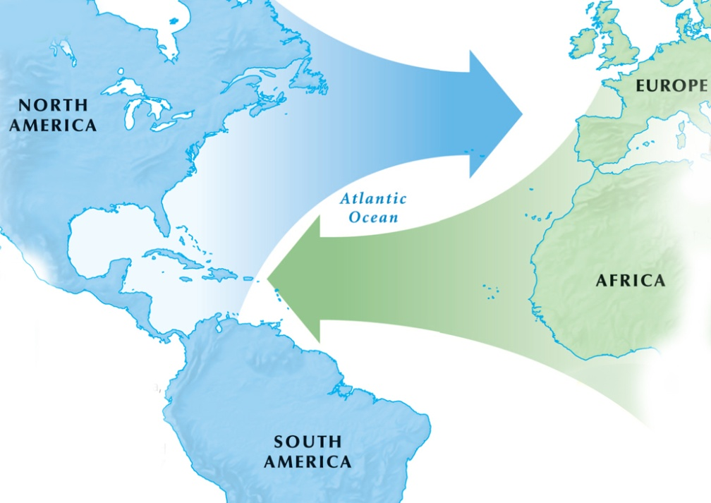
The Columbian Exchange of people, food, goods, and animals profoundly affected the world.
In the wake of explorers, traders took new foods such as tomatoes, peppers, and corn from America back to Europe.
They also brought plants and animals from Europe to the Americas, such
as horses and chickens.
Notes:
2

Slide 3
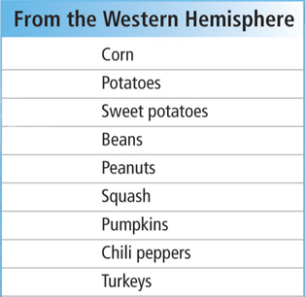
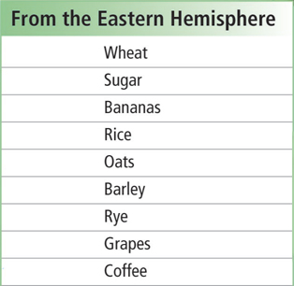
People’s diets changed around the world due to new types of foods crossing the globe.
Notes:
3

Slide 4
One of the key causes was the spread of new food crops from the Americas.
However, Native American populations declined severely due to
European diseases.
The global population started to explode
by 1700.
Millions of people migrated at this time. Europeans spread out in the Americas and Africans were forced to the Americas by the slave trade.

Slide 5
A commercial revolution occurred as a result of direct links between the continents.
Prices began to rise in Europe due to the huge amount of silver and gold coming in from the Americas. This led to inflation.
This time period was known as the price revolution and led to the growth of capitalism, in which most businesses are owned privately.

Slide 6
Trade increased and entrepreneurs who were willing to take risks looked overseas for opportunities to make profits.
Capitalists adopted bookkeeping methods from the Arabs, banks increased in importance, and joint stock companies grew.
People learned they could make money through investment, not just through labor.

Slide 7
Merchants began to bypass medieval guilds.
To do this, a merchant capitalist distributed
raw material such as wool to peasants, who processed it into cloth. Then, the merchant sold the finished product for a profit.
This was known by the term “cottage industry.”

Slide 8
The goal of this policy was to build the nation’s gold and silver reserves by exporting more goods
than it imported.
To do this, European nations had strict laws governing trade with their colonies and
imposed tariffs.
European monarchs adopted a
new economic policy called mercantilism.
As a result of these measures, national governments had a lot of control over their economies.

Slide 9
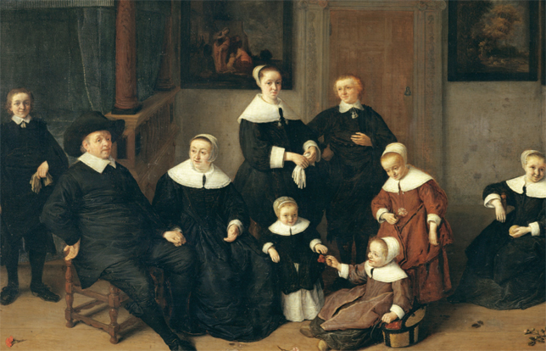
The majority of Europeans, peasants, were unaffected by these economic changes, but new middle-class families had a comfortable life.
The price revolution helped enrich merchants and skilled workers, but hurt nobles whose wealth was tied to the land.

