Slide 1
Unit 7
Absolutism and Enlightenment
Part 1
Spanish Power Grows
France Under Louis XIV

Slide 2
Charles I became king of Spain in 1516 and heir to the Hapsburg empire in 1519.
He took the name Charles V and began the difficult task of ruling two empires.
Charles, a devout Catholic, engaged in constant war to suppress Protestantism in Germany and push back the Muslim Ottomans advancing into Europe from Turkey.
Notes:
2

Slide 3
The task of ruling two scattered empires proved impossible for Charles V.
He gave up his crown, divided his sizable empire, and entered a monastery in 1556.
Charles gave Spain, the Netherlands, and Spain’s overseas empire to his son Philip, who became known as Philip II.
Notes:
3

Slide 4
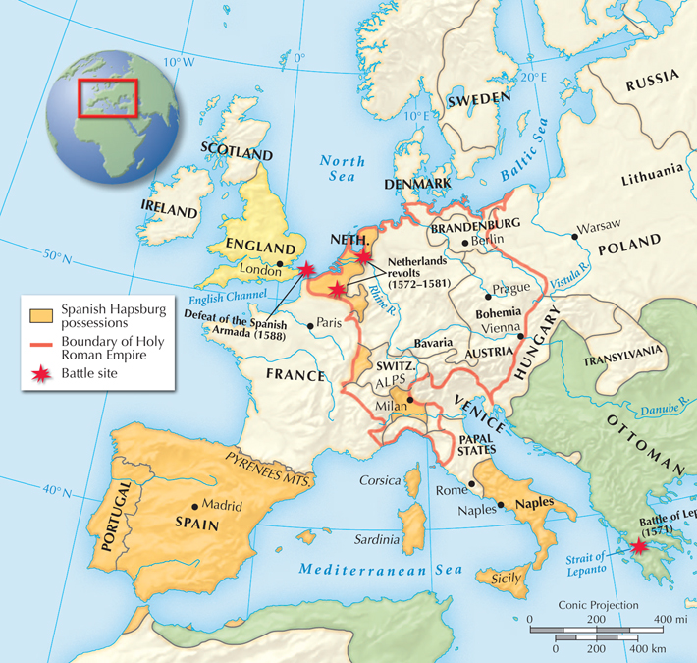
Philip II expanded Spanish influence and power during his 42-year reign.
One of his main
goals was to
advance Spanish Catholic power
in Europe.
He fought many
wars to this end.

Slide 5
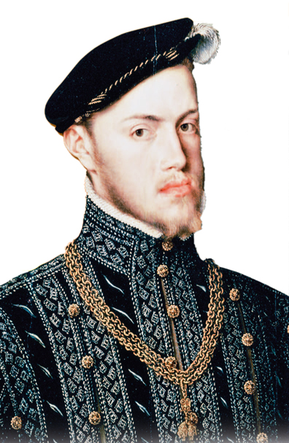
Philip made every part of the government answer to him.
He reigned as absolute monarch, which meant he had complete authority.
Philip asserted that he ruled by divine right. He believed his right to rule came from God.

Slide 6
Philip fought wars in the Mediterranean
and the Netherlands.
His goal was to keep the Ottomans at bay.
In 1571, Spain defeated an Ottoman fleet off
the coast of Greece.
Philip also
battled rebels in the Netherlands for many years.
Protestants there opposed Philip’s efforts to crush their faith.

Slide 7
Philip began to see Queen Elizabeth I in England as his main Protestant enemy.
He sent
a huge Spanish armada
to invade England.
The mission failed, however, because Spanish ships were outmaneuvered by faster English ships.
The Spanish retreated.

Slide 8
The armada’s defeat marked the beginning
of the end of Spain’s glory.
Philip’s successors did not rule as well as he did.
There were also economic problems, such as costly foreign wars and over-reliance on treasure from the Americas.
In the 1600s and 1700s, other European fleets arose and surpassed Spain’s power.

Slide 9
Prior to the sunset of Spain’s power, however, a golden age of culture occurred.
This golden age, fostered by Philip’s patronage of the arts, lasted from 1550 to 1650.
During this time, El Greco painted beautiful works of religious imagery.
Miguel de Cervantes completed Don Quixote, considered Europe’s first modern novel.

Slide 10
France was torn apart by wars over religion
in the late 1500s.
These wars were fought between:
The Catholic
majority
French Protestants, Huguenots
The worst violence during this time occurred on
a Catholic holiday in 1572, when 3000 Huguenots were killed. The incident symbolized a breakdown of order in France.
Notes:
10

Slide 11
Henry IV, a Huguenot, inherited the French throne in 1589.
He fought against the Catholics for four years and then converted
to Catholicism.
Nevertheless, Henry
issued the Edict of Nantes in 1598 to protect the Protestants by granting
the Huguenots religious toleration.

Slide 12
Next, Henry worked to repair France.
His goal was to put “a chicken in every pot.” Henry greatly increased the royal bureaucracy.
In so doing, he laid the groundwork for future kings to rule without any check on their power.
Henry IV reduced the power of nobles.

Slide 13
Henry IV was assassinated in 1610.
His son, Louis XIII, became king.
Louis appointed Cardinal Richelieu in 1624 as chief minister. Richelieu used all of his cunning to strengthen the central government.
He outlawed Huguenot armies and gave the nobles high posts at court to tie them to the king.

Slide 14
Louis XIV became king in 1643 and faced an uprising of nobles, merchants, and peasants.
This effort to take power away from the king was called the Fronde.
Rioters drove the young king from his palace.
Louis never forgot about this experience. He decided to take complete control of government and solidify his power as an absolute monarch.

Slide 15
Louis XIV took the sun as the symbol of his total power and declared “I am the state.”
He never called a meeting of the Estates General, the council made up of representatives of all the social classes, during his reign.
During this time, Louis appointed middle-class intendants to carry out his policies, and built the French army into the strongest force in Europe.

Slide 16
All of France’s economic policies were aimed at making the nation the wealthiest state in Europe.
Finance minister Jean-Baptiste Colbert imposed mercantilist policies.
He had new lands cleared for farming.
He put high tariffs on imported goods.
He fostered overseas colonies and carefully regulated trade with these colonies.

Slide 17
Even Colbert’s efforts could not produce enough income to support Louis’s spending.
An example was Louis’s decision to build the immense palace of Versailles.
There, the king insisted on ceremonies such
as the levée.
He also let many nobles live at Versailles tax-free to prevent them from threatening his power.

Slide 18
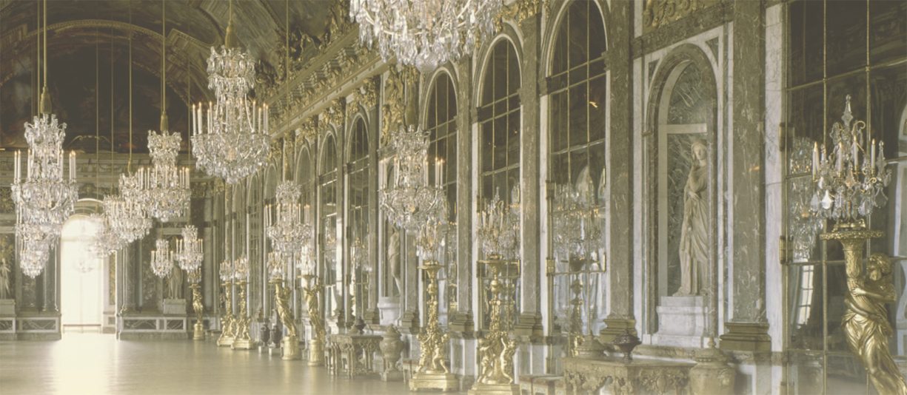
Versailles was designed to be a symbol of royal wealth and power.

Slide 19
Louis XIV ruled France for 72 years.
His court supported a “splendid century” of the arts in which drama, painting, and ballet flourished.
Louis sponsored the French Academies, which set standards for the arts and sciences.
At the end of his reign, France was the strongest state in Europe.

Slide 20
Despite these triumphs, Louis made some decisions that led to the decline of France.
He fought costly wars to expand French borders,
but was checked by rival rulers hoping to maintain
the balance of power.
He tried to unite France and Spain, but was unsuccessful.
  He revoked the Edict of Nantes, and 100,000 hard-working and prosperous Huguenots left France.

