Slide 1
Unit 7
Absolutism and Enlightenment
Part 2
Rise of Russia and Prussia
Absolute Monarchy in Russia

Slide 2
By the seventeenth century, the Holy Roman Empire was a loose patchwork of separate states.
They were ruled by the Holy Roman emperor, in theory.
But in reality, the emperor, who was chosen by electors, had little power.
The lack of a central authority led to the outbreak of the Thirty Years’ War.
Notes:
2

Slide 3
The Thirty Years’ War began in 1618 when
king Ferdinand tried to suppress Protestants
in Bohemia.
Protestant nobles threw two royal Catholic officials out of a window. This became known as the Defenestration of Prague, and sparked a revolt.
What began as a religious conflict changed to a political war for control of Europe.

Slide 4
The Thirty Years’ War
was very
brutal.
Mercenaries burned villages and killed without mercy.
Severe depopulation occurred.
Finally, a series
of treaties called the Peace of Westphalia ended the war.
France emerged the clear winner and German lands were divided into more than 360 separate states.

Slide 5
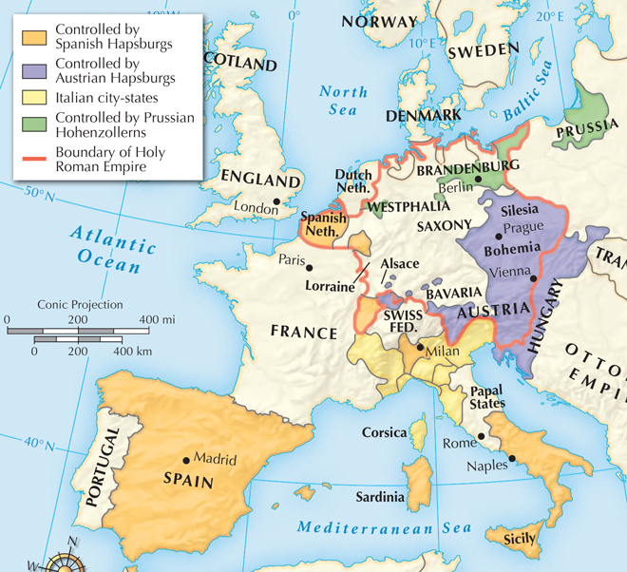
Europe after the Thirty Years’ War, 1648

Slide 6
After the war’s end, the Hapsburgs in Austria wanted to create a strong, unified state.
This was difficult, because the lands they wanted to unify were made up of many diverse people and languages.
Despite efforts to bring Austria, Bohemia, Hungary,
and parts of Poland together, the Hapsburgs never created a central government like the one in France.

Slide 7
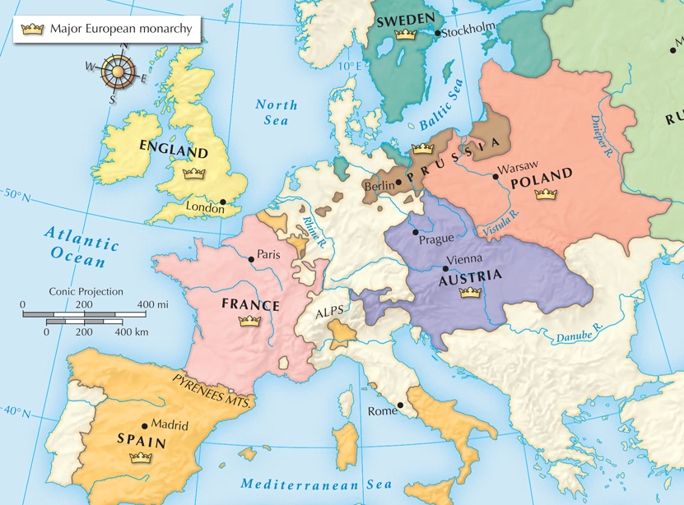
European nation-states
in 1700.

Slide 8
Hapsburg emperor Charles VI died in 1740 and
left the throne to his daughter, Maria Theresa, who immediately had to fight a new war.
The War of Austrian Succession began when
the king of Prussia seized an Austrian province.
With the help of her Hungarian subjects as well as Britain and Russia, Maria Theresa preserved her empire.

Slide 9
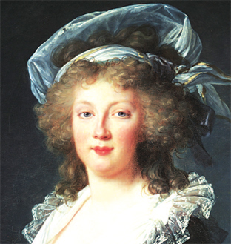
Maria Theresa was a good leader.
Though she did not succeed
in throwing Prussia out of the Austrian province it invaded, she did win the support of her people.
She also reformed tax collection and eased the burden on peasants.

Slide 10
While Austria grew as a Catholic state, Prussia emerged as a Protestant power.
Prussia was created in the 1600s when the Hohenzollern family united their lands.
Frederick William I came to power in 1713
and gained the loyalty of nobles by giving them positions in the army and government.

Slide 11
Frederick trained
his son Frederick II in the art of
war.
When the prince became king in 1740, he seized Silesia from Austria, sparking the War of Austrian Succession.
He forced Europe to see Prussia as a great power and became known as Frederick the Great.

Slide 12
Two basic rivalries existed in Europe by 1750.
Prussia
Austria
Britain
France
These rivalries sometimes resulted in worldwide conflict, as in the Seven Years’ War between 1756 and 1763. The Treaty of Paris ended this war and gave Britain a huge empire.

Slide 13
Peter the Great took control of Russian government and set out to modernize it.
There, he learned about new technologies and was impressed by Parliament in England.
He traveled to European cities in 1697.
Peter brought back people from Europe to help his policy of westernization. To force the change, he was very autocratic, ruling with unlimited authority.
Notes:
13

Slide 14
Peter worked to control the Church and the nobles in Russia.
He brought the Russian Orthodox Church under his control.
He made the boyars serve the state. He made them shave their beards and switch to a Western style of dress. In exchange, he strengthened serfdom.

Slide 15
If anyone revolted,
he had them killed.
He adopted mercantilist policies to pay for his reforms.
Peter was not afraid to use force to reach his goal.
He imported technology, improved schools, improved canals, and developed new industries.
Peter’s reforms were both social and economic.

Slide 16
Peter also sought to expand Russia’s borders so that
it could have a warm-water port.
Peter was not able to push through the Ottoman Empire to get his warm-water port, but Catherine the Great would eventually achieve this goal.
To this end, he built the largest army in Europe as well as a world-class navy.

Slide 17
Peter started a war against Sweden in 1700.
He defeated them in 1709 and gained territory along the Baltic Sea.
There, he built a new capital city, St. Petersburg, to rival any in Europe. It became a symbol of Peter’s goal of modernizing Russia.

Slide 18
During this time, Russia also expanded eastward.
Peter signed a treaty with China that recognized Russia’s claim to lands north of China.
He hired Vitus Bering to explore the strait between Siberia and Alaska.
These expansions made Russia the world’s largest country.

Slide 19
Peter the Great left a mixed legacy.
Positives | Negatives
Ended Russia’s isolation | Reforms died with him
Expanded Russia’s territory and gained ports on the Baltic Sea | Used terror to enforce his will
Built a big army | Policies led to the growth of serfdom

Slide 20
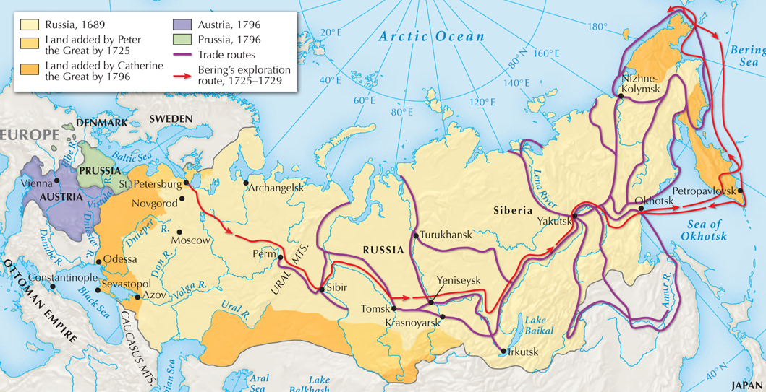
Russia expanded its territory between 1689 and 1796.

Slide 21
Peter died without an heir and
a power struggle ensued.
Russian nobles became more and more independent.
Then a new monarch took power.
She was to
be known as Catherine
the Great.

Slide 22
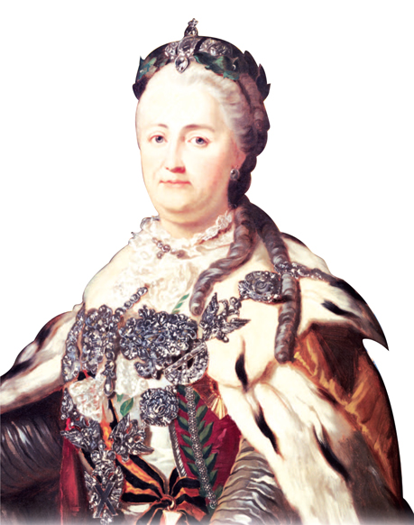
Catherine was born as a German princess.
She lived in the Russian court for twenty years with her husband, who was heir apparent and insane.
During this time, she learned Russian, studied, and built alliances. She used these alliances to assume power
in 1762.

Slide 23
Catherine was a very effective ruler and absolute monarch.
She embraced Western ideas.
She reorganized government in the provinces and codified laws.
She opened state-sponsored schools for children.

Slide 24
She could also be ruthless.
Peasants revolted
against the harsh
conditions
of serfdom.
Catherine repressed the rebellion and exempted the boyars from paying taxes.
Along with King Frederick II and Emperor Joseph II of Austria, Catherine partitioned Poland and took control of its eastern lands in 1772, removing the state from the map.

