Slide 1
Unit 7
Absolutism and the Enlightenment
Part 3
Philosophy in the Age of Reason
Enlightenment Ideas Spread

Slide 2

What effects did the Enlightenment philosophers have on government and society?
The spread of Enlightenment philosophers’ ideas sparked changes in governments and society throughout Europe.
Encouraged by ideas such as natural law
and social contracts, people challenged the structure of governments and society in existence since the Middle Ages.

Slide 3
By the early 1700s, European thinkers felt that nothing was beyond the reach of the human mind.
The discoveries
of the Scientific Revolution of the 1500s and 1600s convinced educated Europeans of
the power of human reason.
Natural law governed forces such as gravity and magnetism.
Notes:
3

Slide 4
Could human reason be used to better understand social, economic, and political problems?
This approach had been used to understand natural forces such as gravity and magnetism.
This approach led to a revolution in thinking,
the Enlightenment.
Notes:
4

Slide 5
Thomas Hobbes and John Locke tried to tackle society’s structure using reason. Their ideas
were extremely influential.
Thomas Hobbes’s Leviathan
People created social contracts because only a powerful government could ensure an organized society.
John Locke’s
Two Treatises
of Government
Only governments with limited power, which are accepted by all citizens, protected the natural rights of the people.

Slide 6
In France, the philosophes applied the methods of science to understand society.
Diderot
Edited and published the Encyclopedia to “change the general way of thinking”
Voltaire
Defended freedom of thought through his writings
Montesquieu
Published The Spirit of Laws
Advocated the idea of separation of powers in government
Rousseau
Wrote The Social Contract
Promoted the idea that people in their natural state were essentially good

Slide 7
Not everyone agreed with the philosophes.
Some women protested that “free and equal” did not apply to women. Mary Wollstonecraft, a writer, called for equal education for girls and boys.
The idea of women’s equality was ridiculed
and sharply condemned.
Other critics of the philosophes included the French government and the Catholic Church.

Slide 8
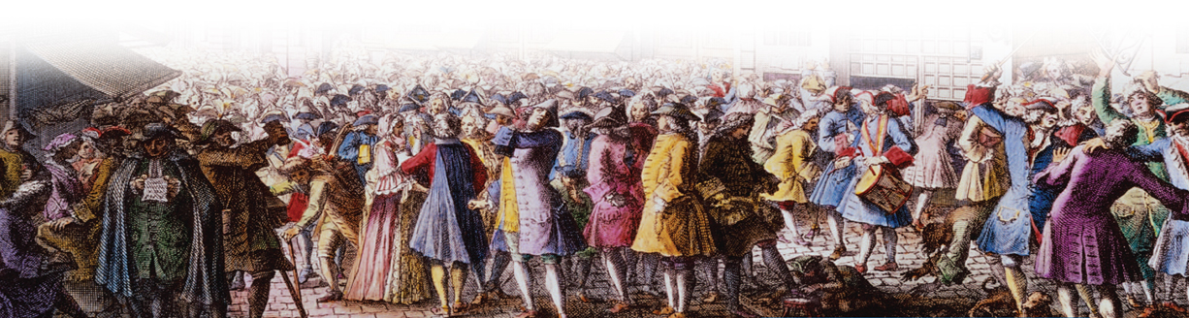
French thinkers known as physiocrats focused on economic reforms based on natural law. Physiocrats:
Rejected mercantilism, the idea that government regulation is needed to produce a favorable trade balance.
Advocated laissez faire policies, which suggested that business should operate with little or no government interference.
Investors in
Paris, France, 1720

Slide 9
The free market should regulate business activity.
All economic factors were related to the market forces of supply and demand.
The Scottish economist Adam Smith wrote
The Wealth
of Nations.
Although Smith supported laissez faire, he also believed that the government had a duty to protect society, administer justice, and provide public works.

Slide 10
What effects did the Enlightenment philosophers have on government and society?

Slide 11
As Enlightenment ideas spread across Europe, what cultural and political changes took place?
The Enlightenment brought cultural changes as writers, artists, and musicians spread new ideas.
Even absolute monarchs in Europe granted greater freedoms in their realms to become enlightened despots.

Slide 12

From France, the heart of the Enlightenment, ideas spread across Europe and beyond.
These new ideas created challenges to the rulers of the day. People saw that reform was necessary to achieve a just society.
Notes:
12

Slide 13
Most government and church authorities felt they had a sacred duty to defend the old order.
The most common defense was through censorship of writers and books. Writers fought back by disguising their ideas in fiction.
Voltaire’s Candide exposed corruption and hypocrisy. | Jonathan Swift’s Gulliver’s Travels satirized eighteenth- century England. | Montesquieu’s Persian Letters mocked French society.

Slide 14
Ideas spread through salons as well as books and pamphlets.
In the 1600s a group
of noblewomen in Paris began inviting a few friends to their homes for poetry readings.
By the 1700s, some middle-class women began holding salons
as well.
The most respected salons hosted
writers and musicians such as Diderot and Mozart.

Slide 15
The arts evolved along with the new ideas of the Enlightenment.
In the age of Louis XIV, courtly art and architecture were grand and opulent, reflecting the lives of saints or glorious battles.
This was the era of the baroque style.

Slide 16
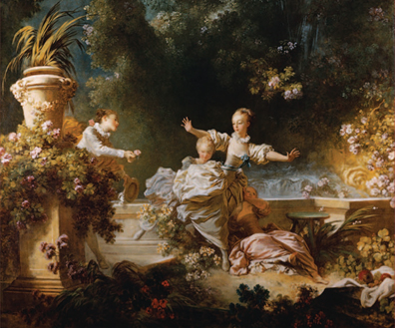
The court of Louis XV was much less formal, which was reflected in the rococo style.
Artists moved away from heavy splendor to light, elegant, and charming subjects.
This style was criticized
by the philosophes as superficial, but it was very popular among the upper and middle classes.

Slide 17
As in art, music evolved from baroque to rococo to the style known as “classical.”
Johann Sebastian Bach
Created religious works for organ and choirs
George Frideric Handel
Wrote pieces for King George I, as well as 30 operas
Franz Joseph Haydn
Developed the string quartet and the symphony
Wolfgang Amadeus Mozart
Created operas, symphonies, and religious music that defined the new style of composition

Slide 18
Literature developed new forms and readers by the 1700s.
Middle-class readers liked stories about their own times told in straightforward language.
Thus began an outpouring of novels, long works of prose fiction.
Robinson Crusoe, by Daniel Defoe, was an exciting tale about a sailor shipwrecked on a tropical island.

Slide 19

Absolute monarchs who adopted or accepted Enlightenment ideas were known as enlightened despots.
Monarchs who applied enlightened ideas to their governments included:
  Frederick the Great
  of Prussia
  Joseph II of Austria
  Catherine the Great
  of Russia

Slide 20
The ideas of the philosophes spread to the ruling classes and convinced some of them that reform was necessary.
Frederick the Great (Prussia)
Reduced use of torture
Allowed a free press
Tolerated religious differences
Joseph II (Austria)
Modernized Austria’s government
Supported religious equality for Protestants and Jews
Ended censorship
Abolished serfdom
Catherine the Great (Russia)
  Abolished torture
  Established religious tolerance
  Granted nobles a charter of rights
  Criticized the institution of serfdom

Slide 21
Although these rulers implemented reforms, they would not give up their own power.
Frederick the Great desired a stronger monarchy and more power for himself.
Catherine the Great refused to give up power
but greatly expanded the Russian empire.
Joseph II implemented many changes, but most were canceled after his death.

Slide 22
By the late 1700s ideas about equality and social justice reached peasant villages.
These ideas sowed
the seeds for the political upheaval
of the 1800s.
Most Europeans’
lives were untouched by the enlightened cultural movements.

Slide 23
As Enlightenment ideas spread across Europe, what cultural and political changes took place?

