Slide 1
Unit 9
The Industrial Revolution
Also known as the First Industrial Revolution. You will learn about the Second Industrial Revolution a little bit next week and a lot next year in U.S. History.

Slide 2
19-1
Dawn of the Industrial Revolution

Slide 3
The Industrial Revolution began in Britain and spread around the world.
The changes it brought affected peoples lives as much as any political revolution. But unlike a political revolution, it happened gradually.
The Industrial Revolution was the process by which production shifted from simple hand tools
to complex machinery.

Slide 4
The Industrial Revolution influenced people’s daily lives.
Life before 1750
People live in rural villages and work with their hands.
They grow their food or trade goods in the local market.
Travel is by foot, horse, or sail.
Life after 1850
People live and work in industrial towns or cities.
They buy food and clothing made elsewhere.
They can travel by train or steamboat.

Slide 5
These changes started in the farm fields of Europe.
The Dutch
The British
The Dutch built dikes and combined small fields to better use land.
They also experimented with fertilizer from livestock.
The British expanded on Dutch experiments.
They experimented with crop rotation and mixing different soils.
Jethro Tull invented a seed drill that planted seeds in rows rather than scattering them.

Slide 6
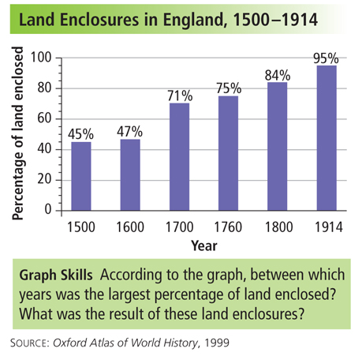
Enclosure improved output but displaced
peasant farmers.
With the help of legislation from Parliament, large landowners consolidated their holdings.
Larger farms were more efficient, producing more
food with less labor and cost.

Slide 7
But land enclosure threw many poor farm workers off the land.
Small landholders couldn’t compete,
and unemployed farm laborers migrated to
the growing cities for work.
These displaced farm workers provided a pool
of labor to tend machines in the growing manufacturing cities.

Slide 8
This agricultural revolution caused a population explosion in Europe.
1700
1800
Britain
5,000,000
9,000,000
Europe
120,000,000
190,000,000
Greater and more consistent food production reduced the impact of famines.
Improvements in hygiene, sanitation, and medical care improved health.

Slide 9
New technology helped trigger changes.
In 1709 Abraham Darby found a way to smelt iron using coal instead of charcoal.
The result was a less expensive and better-quality iron useful to make parts for steam engines.
His son and grandson continued to perfect the process, which led to iron bridges and railroad tracks.

Slide 10
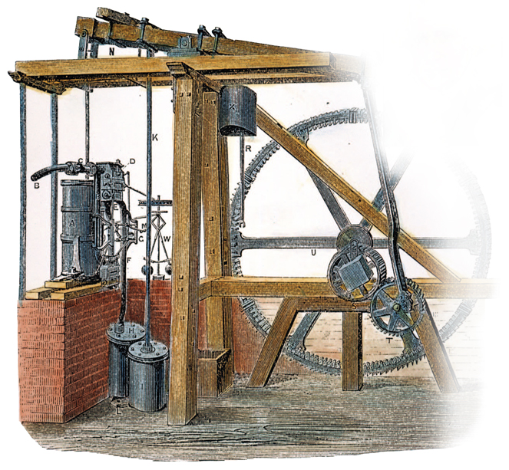
New materials and forms of energy played key roles in the Industrial Revolution.
In 1712 Thomas Newcomen invented a steam engine to pump water from mines.
In 1764 James Watt set out to make Newcomen’s engine more efficient.
Watt’s engine became the power source to run factories, trains, and steamships.
During the 1700s, coal was harnessed to produce
steam for power.

Slide 11
New technology quickly changed people’s lives.
Pain could be reduced during surgery and other procedures.
anesthetics
Messages could instantly be
sent long distances.
telegraph
sewing
machine
Machines could stitch far faster than a seamstress.
antiseptics
Reducing infections saved lives.

Slide 12

What events helped bring about the Industrial Revolution?

Slide 13
19-2
Britain Leads the Way

Slide 14
A number of characteristics made Britain ripe for industrialization in the eighteenth century.
Natural ports
Navigable rivers
Water for canals
Access to the sea
A plentiful supply of coal
Vast supplies of iron
Britain had plentiful natural resources, including:

Slide 15
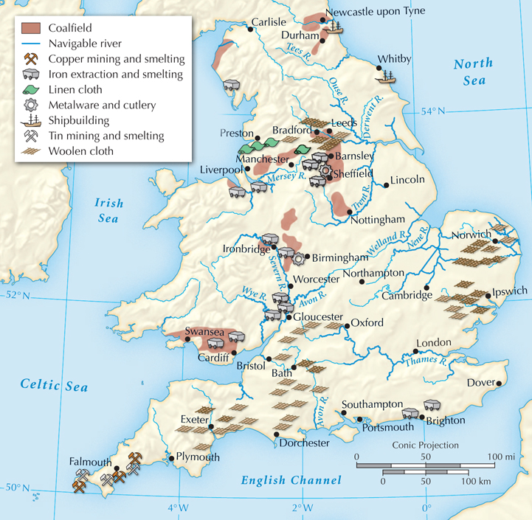
England’s Resources and Industries, 1750

Slide 16
In the 1700s, Britain had skilled inventors,
a ready workforce, and a growing population.
To meet the growing demand for jobs and products, one more thing was needed.
Money to start new businesses.

Slide 17
Entrepreneurs needed capital, or money to invest, in business enterprises such as shipping, mining, and manufacturing.
With a healthy economy, many were now willing to risk their money on new ventures.
From the mid-1600s, England had prospered from trade.
A business class had accumulated
the needed capital.

Slide 18
Britain had additional advantages.
Britain had a stable government that supported economic growth.
Other countries had river tolls, but Britain had no such barriers.
The powerful British navy protected shipping and overseas trade.

Slide 19
In the 1600s, cotton cloth from India became popular in Britain. Using the putting-out system, merchants began a cotton cloth industry in Britain.
Merchants gave cotton to peasant families, who spun thread and wove cloth at home as a cottage industry.
Skilled artisans in towns then finished and dyed the cloth.
This is also called “Cottage Industry”.
Notes:
This is also called “Cottage Industry”.

Slide 20
The demand for cotton cloth products, or textiles, made it Britain’s largest industry.
The putting-out system was too slow to meet the growing demand for cotton cloth.
New inventions would help to increase and speed up production.

Slide 21
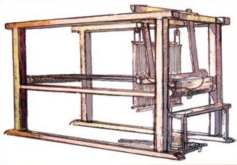
The flying shuttle sped up weaving.
The spinning jenny spun several threads at once.
The water frame used water to power the process.
John Kay’s flying shuttle, 1733

Slide 22
It took a long time to separate cotton fibers from the cotton seeds, limiting production.
In 1793 an American,
Eli Whitney, invented the cotton gin, which quickly did the job.
Cotton production soon increased exponentially.
But the new machines posed a problem. How could farmers provide enough cotton to meet English demand?

Slide 23
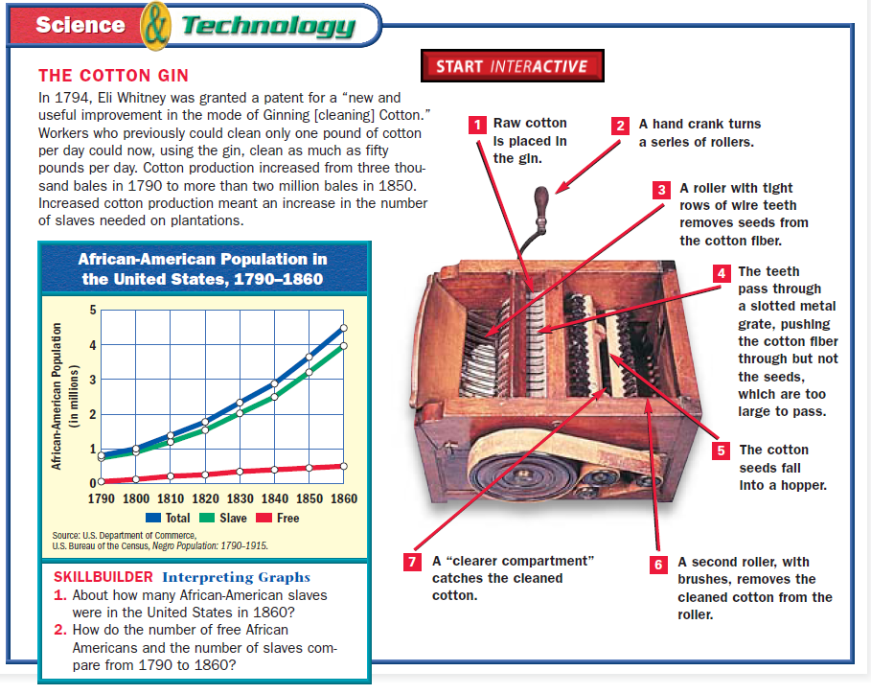

Slide 24
Machines were too large to put in peasant homes, so they were placed in large sheds along swift-moving rivers, which provided power. Workers came to labor in these factories.
The new machines doomed the putting-out system.
Factories brought together workers and machinery to produce large quantities of goods.

Slide 25
As production increased, cheaper ways were needed to move products.
Some entrepreneurs invested in turnpikes.
Products traveled faster on these roads.
England was soon linked by a series of roads.

Slide 26
Canals were dug to link rivers or to connect inland towns to coastal ports.
Engineers designed stronger bridges and upgraded harbors.
Factory owners needed still more efficient and inexpensive ways to move goods.

Slide 27
In 1763, the Bridgewater canal was opened.
The owners profited from the tolls, while the price of
coal in the city of Manchester was cut in half.
This success set off a canal-building frenzy.

Slide 28
Railroads did not have to follow rivers, allowing the shipment of goods efficiently and quickly over land.
The Liverpool to Manchester line opened in 1830. It began a railroad-building boom.
Railroad lines crisscrossed England, Europe, and the United States by 1870.

Slide 29
The new technology set off a cycle that dramatically affected how people lived.
Lower prices created more consumers and greater demand.
More affordable goods caused still lower prices.
Greater demand led to new inventions and still more affordable goods.

Slide 30
What key factors allowed Britain to lead the way in the Industrial Revolution?

