Slide 1
Unit 9
The Industrial Revolution
Part 2
19-3
Social Impact of the Industrial Revolution

Slide 2
The Industrial Revolution brought rapid urbanization.
Changes in farming, rising population, and the need for workers led people to migrate to cities.
Overnight, towns and cities near coal or iron mines mushroomed.
Manchester grew from 17,000 people in the 1750s to 70,000 in 1801.

Slide 3
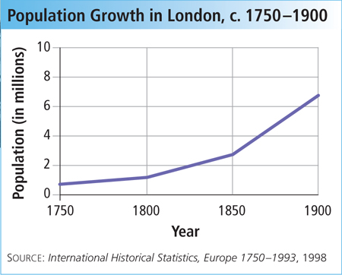
The rapid growth of population and industry changed the distribution of two key resources.
People and labor

Slide 4
The Industrial Revolution created a new middle class,
or bourgeoisie.
The middle class lived in clean neighborhoods with running water and paved streets. Women stayed home to raise their children.
They included merchants, inventors, investors, and “rags-to-riches” individuals who were admired for their hard work and “get-ahead” attitude.

Slide 5
The cities where the working class lived were crowded, dark, dirty, and smoky.
The poor lived in tiny, crowded rooms in multistory tenements packed into vile-smelling slums.
Lack of sanitation left waste and rotting garbage in the streets, creating a terrible stench.
Raw sewage was dumped in rivers, contaminating drinking water and spreading disease.

Slide 6
Organizations such as labor unions were illegal.
Frustration at times turned to violence:
Frustrated workers tried to organize secretly, but they lacked a political voice and were powerless to affect change.
Between 1811 and 1813, textile workers rioted.
Groups called Luddites smashed labor-saving machines that were replacing workers.

Slide 7
Many workers were comforted by religions such as Methodism, founded by John Wesley in the 1700s.
Wesley encouraged self-improve-ment through adopting sober and moral ways.
Meetings featured hymns and sermons stressing forgiveness and salvation.
Methodism rekindled workers’ hopes and channeled anger into reform.

Slide 8
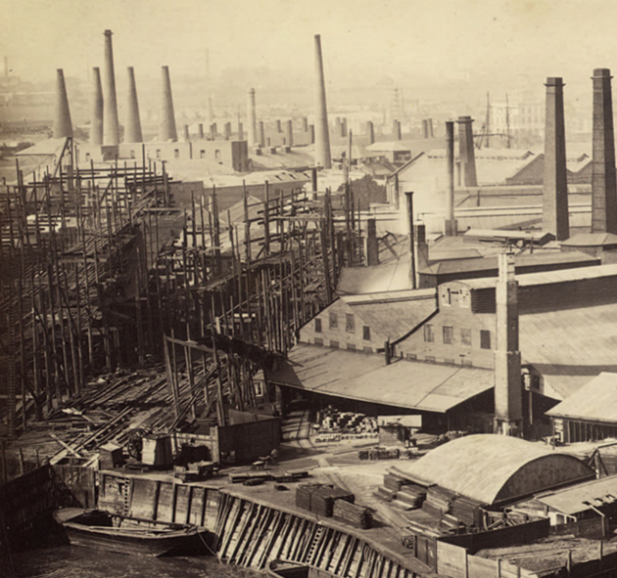
The heart of the industrial city was the factory.
The technology of
the machine age and the rapid pace of industrialization imposed a harsh new way of life on factory workers.

Slide 9
Factory workers lived and worked in
unpleasant conditions.
In factories the work pace was rigidly set. Shifts lasted 12 to 16 hours.
Tired workers were easily hurt by machines with no safety devices. Textile factory air was polluted with lint.
In rural villages people worked hard, but work varied by the season. They controlled their own work pace.

Slide 10
Most early factory workers were women.
Women could
be paid half what men earned.
They were considered easier
to manage.
It was believed
they could adapt better than men.
This created a double burden on women.
After 12 hours of work, they returned home to care for their families in damp, crowded tenements.

Slide 11
Working conditions in the mines were even worse than in factories.
Crippling coal dust filled workers’ lungs.
There were dangers of cave-ins, floods, and explosions.
They worked long hours in darkness.
Miners earned more than factory workers, but conditions were more dangerous.

Slide 12
Child labor was an accepted practice.
Most children began work at age seven or eight.
Nimble-fingered, small, and quick, they crept into machines to change spools or repair thread.
They worked in dust- and lint-filled rooms.
Children in mines worked in the dark and dampness for long hours, often doing hard labor.

Slide 13
Child labor reform laws called “factory laws” were passed in the early 1800s.
Children’s workdays were reduced to
12 hours.
Children under eight were removed from the cotton mills.
New laws in the 1830s and 1840s further reduced hours for women and children, sent inspectors into factories, and required that children be educated.

Slide 14
Since the 1800s people have debated whether industrialization was a blessing or a curse.
The industrial age brought great hardship.
Pay was low, conditions were terrible, and housing was dismal.
Workers later gained the vote and political power. Wages
rose in time.
The cost of new products and of travel dropped.

Slide 15

What were the social effects of the Industrial Revolution?

Slide 16
19-4
New Ways of Thinking

Slide 17
Thomas Malthus was an English economist who carefully studied the impact of the population explosion in eighteenth-century Britain.
He concluded that poverty was unavoidable because the population was growing faster than the nation’s ability to grow food.

Slide 18
Malthus said that unless
the working class had
fewer children, they were doomed to remain in poverty.
He felt that “natural events” such as famine or war were
the only mechanisms to maintain a sustainable population.
Many agreed with Malthus, but he proved to be wrong. Food production rose quickly over the
next century.

Slide 19
Eighteenth-century thinkers such as Malthus believed that natural laws govern the world
of business and economics.
They believed these laws should be allowed to operate without any government interference.
This attitude of keeping “hands off” was called
“laissez-faire.”

Slide 20
Most famous among these thinkers was Adam Smith. Most middle-class capitalists agreed with his laissez-faire approach to capitalism.
Supporters of free-market capitalism saw the success of the industrial age, in which government played no part, as evidence for laissez-faire.

Slide 21
Another British laissez-faire economist
was David Ricardo.
Like Malthus,
Ricardo saw no hope for the working class to escape poverty.
Ricardo opposed help for the poor, contending that this would only
lead them to have
more children.
Malthus and Ricardo saw the best cure for poverty
as the “laws of the free market” and advised the poor
to be thrifty, work hard, and have fewer children.

Slide 22
Other thinkers, such as Jeremy Bentham, believed there should be some government intervention in the economy.
Bentham believed that the goal of society should be “the greatest happiness for the greatest number of citizens.” This idea was called utilitarianism.
Laws should be judged
by their utility to benefit people.

Slide 23
A follower of Bentham was John Stuart Mill.
Like Bentham and Smith, Mill believed in
individual freedom.
But he also believed, “The only purpose for which power can be rightfully exercised over any member of a civilized community, against his will, is to prevent harm to others.”
Mill saw capitalists harming workers. He called for limiting their power to do so by giving workers the right to vote.

Slide 24
The champions of laissez-faire economics
praised individual rights, whereas socialists
focused on the good of society in general.
Capitalism:
Individuals should own and operate the means of production for profit.
Socialism:
The people as
a whole should own and operate the means of production for the general good.

Slide 25
Socialists set up communities where work was shared and property was commonly owned.
These early socialists were called Utopians. The name implied impractical dreamers.
Robert Owen set up a Utopian community
at his cotton mill in New Lanark, Scotland.

Slide 26
At New Lanark, Owen:
Raised wages
Provided schools
Refused to use child labor
Built homes for workers
Ran a profitable business
Owen’s model community was intended to
show that mill owners could make a profit
and still offer decent wages
and conditions.

Slide 27
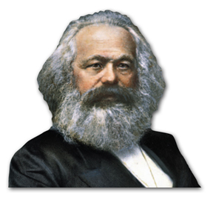
German philosopher Karl Marx condemned the ideas of the Utopians as unrealistic idealism.
He formulated a new theory of “scientific socialism.”

Slide 28
Along with Englishman Frederick Engels, Marx published The Communist Manifesto
in 1848.
He predicted a struggle between the social classes that would lead to a classless society.
The workers would take over all of the means of production, such as the farms, factories, and railways, and run them for the public good.

Slide 29
In industrialized Western Europe, the “haves” were the business owners or bourgeoisie.
The “have-nots” were the workers, or proletariat.
In the end, the proletariat would unite along class lines, take control of the means of production, and end the struggle.
Marx theorized that all of history was a struggle between the “haves” and
the “have-nots.”

Slide 30
In Germany, socialists adapted Marx’s beliefs to form social democracy,
a political ideology
calling for a gradual transition from capitalism to socialism.
Russian socialists embraced Marx’s ideas
and set up a communist-inspired government in 1917.
Marx called for workers everywhere
to unite and overthrow the capitalists.

Slide 31
Revolutionaries around the world adapted Marx to their local goals
and needs.
But workers
worldwide never united as
a class.
The later failures of communist nations illustrated
flaws in Marx’s theories.

Slide 32
What new ideas about economics and society were fostered as a result of the Industrial Revolution?

