Slide 1
Unit 9
The Industrial Revolution
Part 3
(The Second Industrial Revolution)

Slide 2
21-1
The Industrial Revolution Spreads

Slide 3
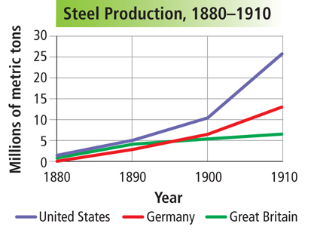
Henry Bessemer patented his process in 1856, and steel production soared.
William Kelly and Henry Bessemer invented a new process for
making steel.
Because steel was so cheap and strong, it became the main material used to make tools, bridges, and railroads.

Slide 4
Innovations in chemistry and electricity changed how industry operated in the late 1800s.
Inventor | Major invention | Year
Alfred Nobel | Dynamite | 1866
Michael Faraday | First simple electric motor and the dynamo | Late 1800s
Thomas Edison | Electric light bulb | 1870s

Slide 5
New methods of production improved efficiency in factories.
Manufacturers designed products with interchangeable parts.
Workers on an assembly line added these parts to the product as it moved along a belt through the factory.
As goods were produced more quickly and cheaply, their prices decreased.

Slide 6
Transportation was transformed during the Industrial Revolution.
Transcontinental railroads linked cities together. Automakers such as Nikolaus Otto, Karl Benz, Gottlieb Daimler, and Henry Ford changed the way people traveled by using gasoline, the international combustion engine, and the assembly line.
The internal combustion engine also made sustained flight possible. Orville and Wilbur Wright flew the first airplane at Kitty Hawk in 1903.

Slide 7
The revolution in communication made the world seem smaller.
Inventor | Major invention | Year
Samuel Morse | Telegraph | 1844
Alexander Graham Bell | Telephone | 1876
Guglielmo Marconi | Radio | Late 1890s

Slide 8
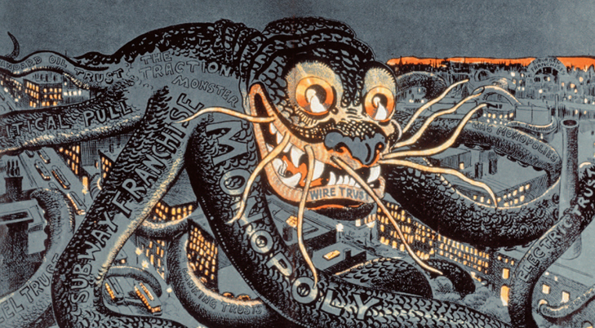
Business leaders created monopolies and cartels in their pursuit of profit.
This created a debate
between those who
saw big business
as positive and
those who viewed
it negatively.
Reformers called for laws to break up monopolies and regulate corporations.

Slide 9

How did science, technology, and big business promote industrial growth?

Slide 10
21-2
The Rise of Cities

Slide 11
Cities experienced big changes as
industrialization progressed.
City planners led urban renewal projects.
Settlement patterns changed as the rich moved to the outskirts of cities and the poor lived in slums at the center.
Electric street lights lit up the night and cities organized police forces.
Cities became safer.

Slide 12
Sewers made cities healthier and steel skyscrapers
made them taller.
Despite these improvements,
poor people lived
in bad conditions
in slums.
On the whole, however, cities were very attractive. People were drawn by the excitement, the promise of work, and entertainment.

Slide 13
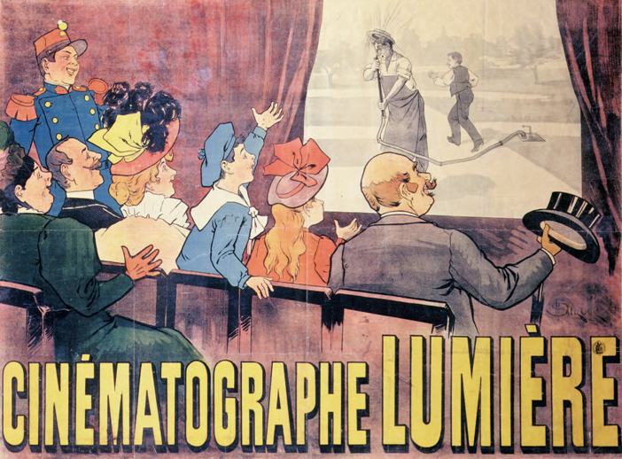
The standard
of living rose
among workers.
People had more time for leisure activities such as going to
the movies.
People ate better and dressed in mass-produced clothing. Health improved, and some workers moved to the suburbs.

Slide 14
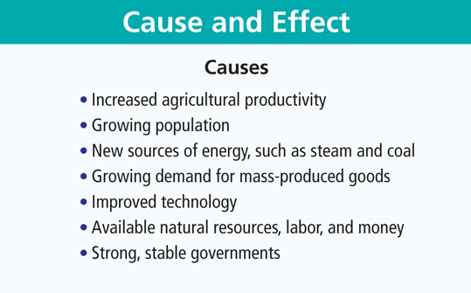
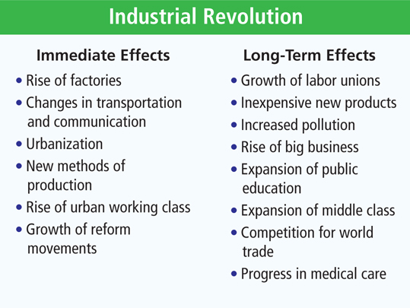
The Causes and Effects of the Industrial Revolution

Slide 15
How did the Industrial Revolution change life in the cities?

Slide 16
21-3
Changing Attitudes and Values

Slide 17
Some women worked to change the restrictions placed upon them.
They sought fairness in marriage, divorce, and property laws.
Many women’s groups also supported the temperance movement.
The struggle for political rights, including women’s suffrage, posed the biggest challenge.
Elizabeth Cady Stanton and Sojourner Truth were two of the leaders
of the movement.

Slide 18
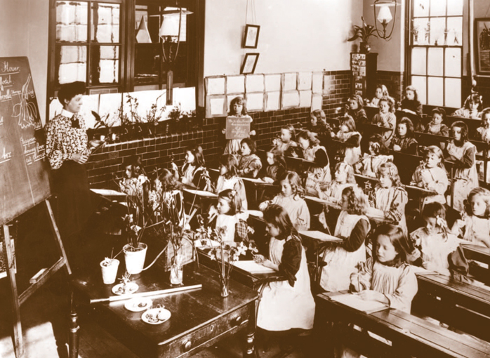
Many governments set up public schools by the late 1800s.
  Industrialized societies needed literate workers.
  Education was different for boys and girls, with few girls receiving training in science or math.
Universities expanded at this time, and reformers sought greater educational opportunities for women.

Slide 19
Some people used Darwin’s theory of natural selection to support their own beliefs about society.
Social Darwinists, for example, contended that industrial tycoons were more “fit” than those they put out of business.
Some argued that victory in war or business was proof of superiority, a view that encouraged racism.

Slide 20
How did the Industrial Revolution change the old social order and long-held traditions in the Western world?

Slide 21
21-4
Arts in the Industrial Age

Slide 22
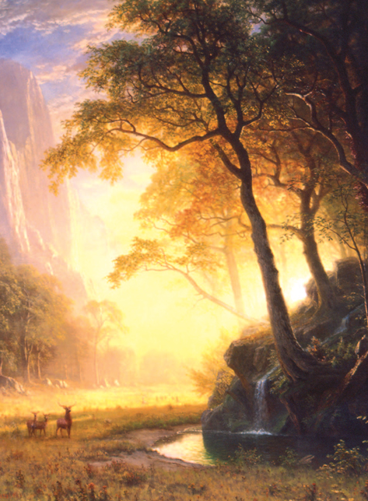
Romanticism glorified nature and communicated intense feelings.
This artistic style emerged
in the mid 1700s and was
a reaction to neoclassicism, which focused on reason
and restraint.

Slide 23
Romantic writers created a new kind of hero.
Lord Byron was known for creating isolated, larger-than-life characters in his poetry.
His hero was often mysterious and different from others in society.
Two other examples of this sort of character were Goethe’s Faust and Charlotte Brontë’s Rochester in her novel Jane Eyre.
Notes:
23

Slide 24
Romantic composers and artists stirred deep emotions.
Ludwig van Beethoven took advantage of all the instruments in the orchestra to produce a stirring range of sound.
Landscape painters such as J. M. W. Turner tried to show the power of nature in their work with bold color.

Slide 25
A new artistic movement
called realism emerged in the
mid-1800s.
Realists sought
to depict life as
it really was, and often focused on the harsh side of existence.
Charles Dickens portrayed the lives of slum dwellers and orphans in his popular novels, and Émile Zola wrote of class warfare in his work.

Slide 26
As photography emerged, painters took new directions in their work.
  Louis Daguerre improved on earlier technology to produce photographs by the 1840s.
  Since the camera could be used to realistically depict life, painters faced the challenge of what
  to do next. Impressionism evolved as a result.

Slide 27
Unlike earlier artists, Claude Monet and other impressionists did not attempt to hide their brush strokes.
These artists attempted to create a fresh view of the world.
Postimpressionists, such as Vincent van Gogh, experimented further with line and color to add a dreamlike quality to images in their work.
Impressionist painters sought to capture an “impression”
of an object
or a scene.

Slide 28
What artistic movements emerged in reaction to the Industrial Revolution?

